Slide 1
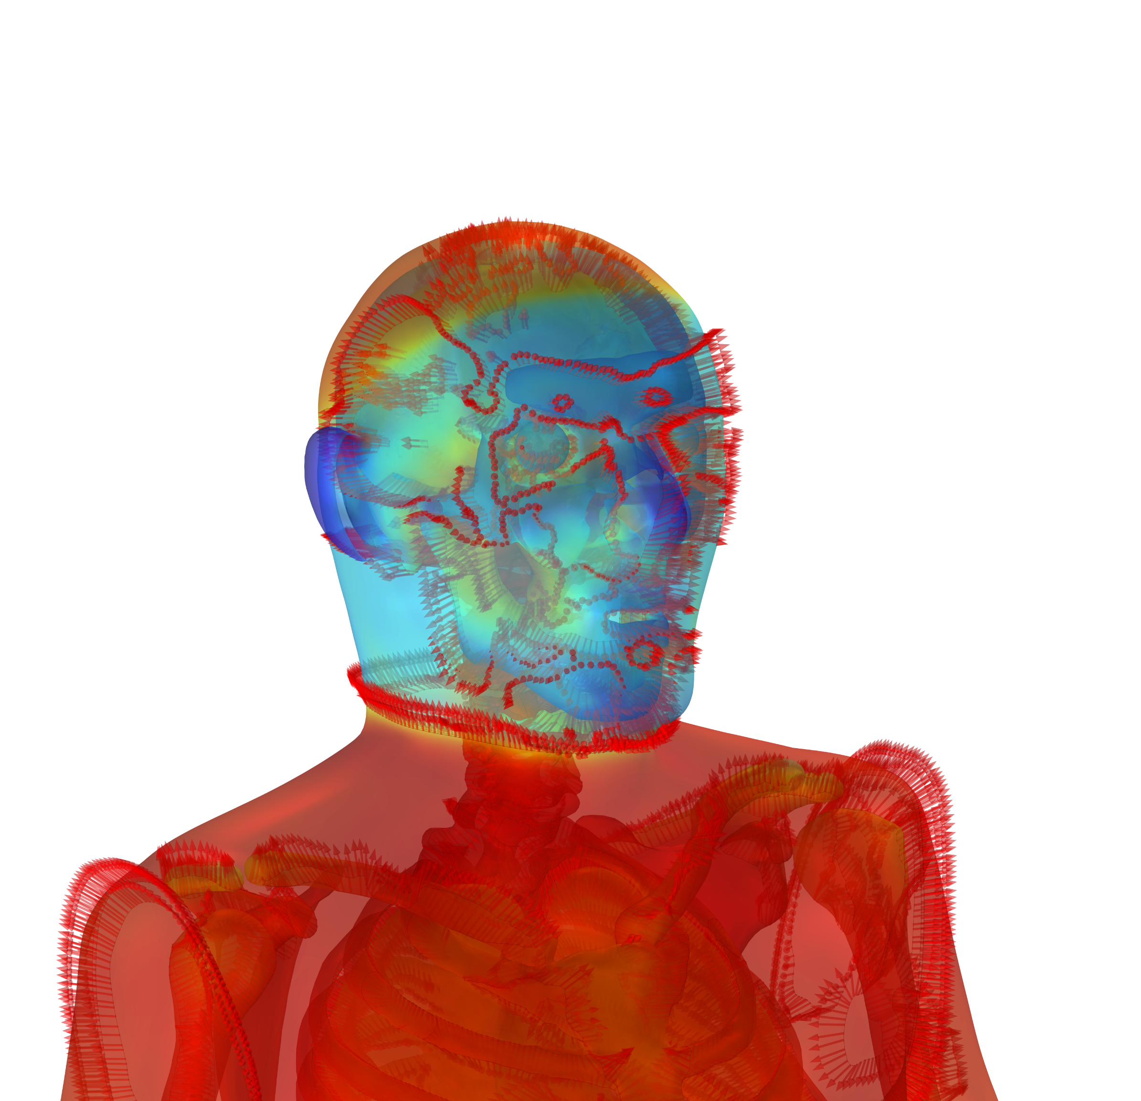
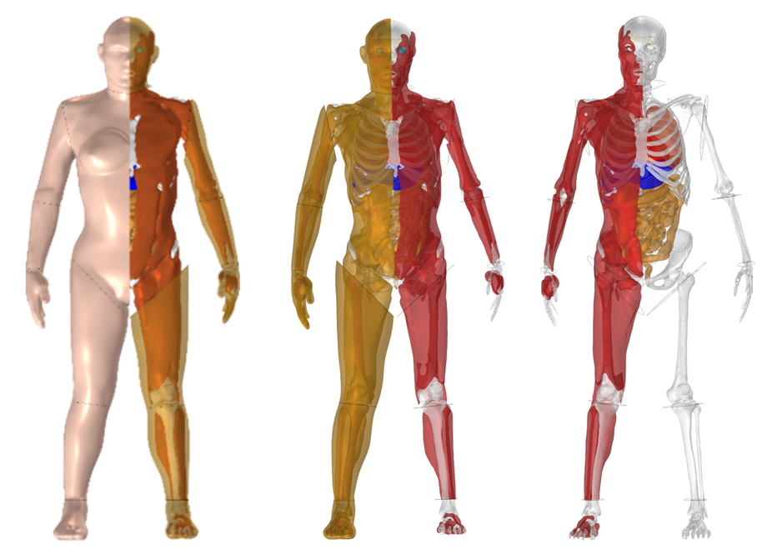
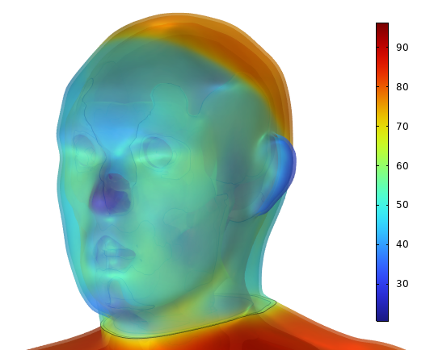
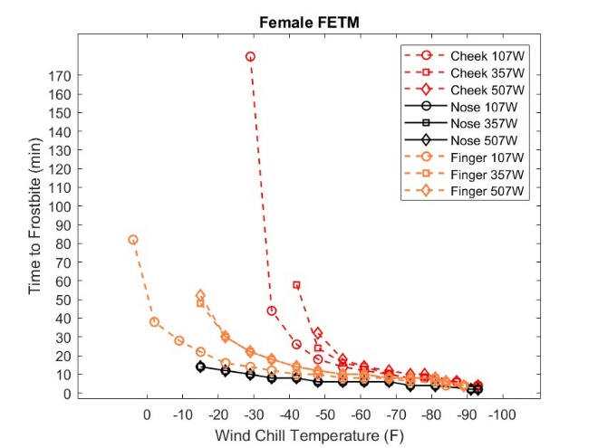
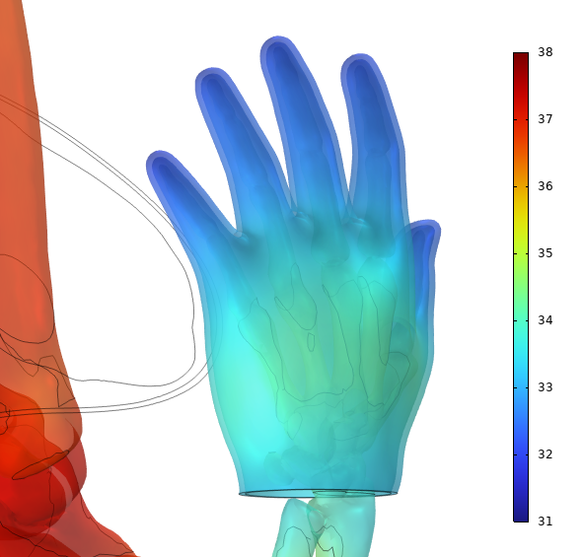

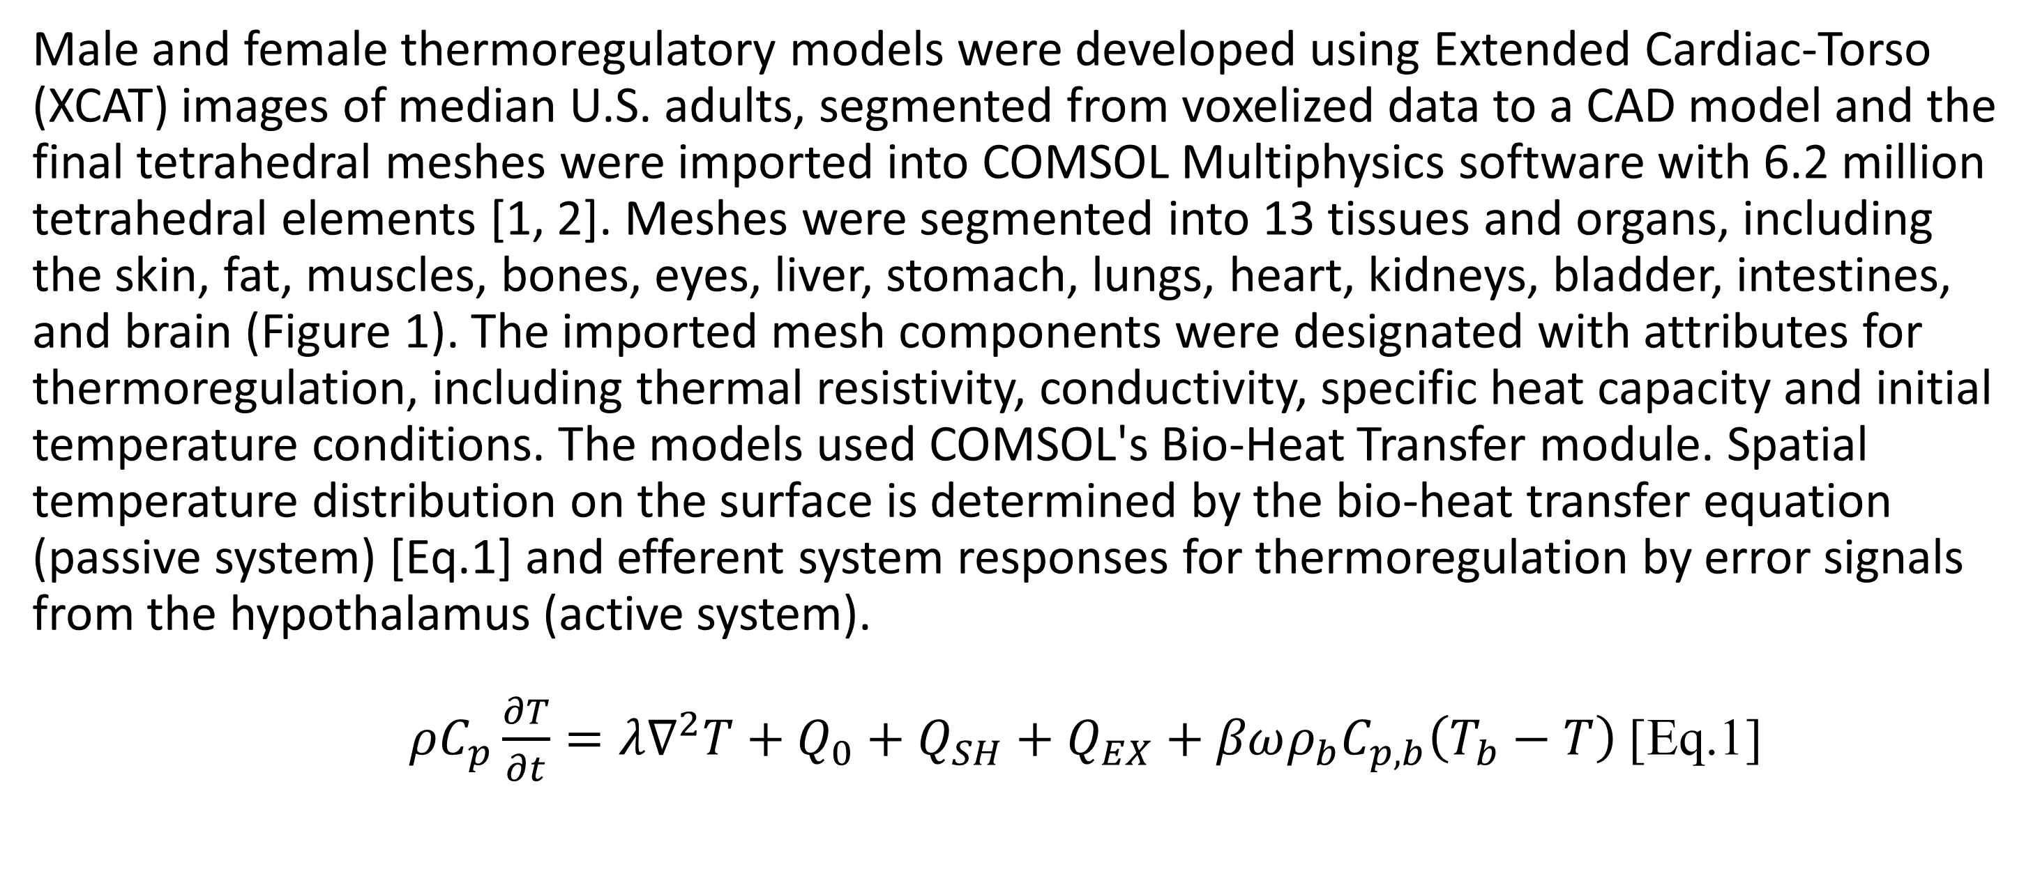
Human Thermoregulation and Spatial Temperature for Frostbite Prediction with COMSOL’s Bio-Heat Transfer Module
Male and female finite element thermoregulatory models (FETM) were used to predict exposure time to frostbite across the body. COMSOL’s Bio-Heat Transfer Module and thermoregulatory equations allows for an accurate spatial temperature profile in extreme ambient conditions.
Juliette Jacques^{1,2}, Timothy Rioux¹, Xiaojiang Xu¹, John Castellani¹
¹ United States Army Research Institute of Environmental Medicine
² Oak Ridge Institute for Science and Education (ORISE)
*Author views not official U.S. Army or DoD policy*
Abstract
The following work outlines the male and female finite element human thermoregulatory models (FETM) for frostbite prediction with COMSOL Multiphysics Software using the Bio-Heat Transfer module[1, 2]. The models use medical phantoms of the median U.S. male and female to provide an anatomically accurate geometric mesh, including layers of skin, fat, muscle, bones, and 9 essential organs. Using a variable order Backward Differentiation Formula (BDF) during Time-Dependent simulations, the models predict spatial temperature distribution across all layers at high resolution.
Models were previously validated with thermoneutral, hot and cold conditions. In these simulations, we evaluate the models in extreme cold and windy conditions for the prediction of exposure time to frostbite. Simulations are compared to the current National Weather Service (NWS) Wind Chill Temperature Index (WCTI) and published data in similar conditions [3]. In the male and female FETM, the results show shorter exposure times to frostbite in the finger and nose compared to the cheek. Male and female FETM results are compared, with an observed difference in the finger times to frostbite.
Methodology
Male and female thermoregulatory models were developed using Extended Cardiac-Torso (XCAT) images of median U.S. adults, segmented from voxelized data to a CAD model and the final tetrahedral meshes were imported into COMSOL Multiphysics software with 6.2 million tetrahedral elements [1, 2]. Meshes were segmented into 13 tissues and organs, including the skin, fat, muscles, bones, eyes, liver, stomach, lungs, heart, kidneys, bladder, intestines, and brain (Figure 1). The imported mesh components were designated with attributes for thermoregulation, including thermal resistivity, conductivity, specific heat capacity and initial temperature conditions. The models used COMSOL's Bio-Heat Transfer module. Spatial temperature distribution on the surface is determined by the bio-heat transfer equation (passive system) [Eq.1] and efferent system responses for thermoregulation by error signals from the hypothalamus (active system).
$ρC_{p}\frac{∂T}{∂t}=λ∇^{2}T+Q_{0}+Q_{SH}+Q_{EX}+βωρ_{b}C_{p,b}\left(T_{b}−T\right)$ [Eq.1]
Figure 1: Skin layer and fat layer [Left], fat layer and muscle layer [Middle], muscle layer and bones and organs [Right]
Results
Simulation results confirm the cheek has the longest exposure time until frostbite compared to the nose and finger in both male and females (Figure 2). This effect in the nose and finger is likely due to their smaller diameters, larger exposure areas relative to mass and increased vasoconstriction in the peripheral regions. Facial cooling with and without exercise heat production is consistent with previous findings in which cheek skin temperatures were influenced and minimal effect was observed in the nose and finger [4]. Nose times to frostbite remained the same with added exercise, while the cheek was impacted largely with exercise at higher temperatures. Between the male and female model, the female nose reached frostbite marginally faster than the male model. Predicted cheek times to frostbite were similar between the two models with and without exercise. However, in the finger, the female model consistently reached frostbite at a slower rate (~2 min less) than the male finger. This effect is possibly due to the higher initial temperature in the finger of the female model compared to the male (0.6℃) higher. Initial temperatures were estimated in each model based on population averages in previous studies.
Figure 2: Female FETM face and hand [Left] during 0W exercise WCTI simulation and graph of cheek, nose, and finger during all exercise simulations [Right]
1. Castellani, M.P.; Rioux T.P.;Castellani, J.W.; Potter, A.W.; Notley, S.R.; Xu, X; Finite element model of female thermoregulation with geometry based on medical images. Journal of Thermal Biology, 2023. 113.
2. Castellani, M.P., Rioux, T.P.; Castellani, J.W.; Potter, A.W.; Notley, S.R.; Xu, X; A geometrically accurate 3-dimensional model of human thermoregulation for transient cold and hot environments. Comput Biol Med, 2021. 138: p. 104892.
3. National Weather Service, Windchill Temperature Index, W. Office of Climate, and Weather Services, Editor. 2001, National Oceanic and Atmospheric Administration: Washington, D.C.
4. Gavhed, D.; Makinen, T.; Holmer, I; Rintamaki, H.; Face cooling by wind in walking subjects. J Biometeorol, 2003. 47: p. 7.
5. Gavhed, D.; Makinien, T.; Holmer, I; Rintamaki, H.; Face temperature and cardiorespiratory responses to wind in thermoneutral and cool subjects exposed to -10C. J Appl Physiol 2000. 83: p. 7.

