Slide 1
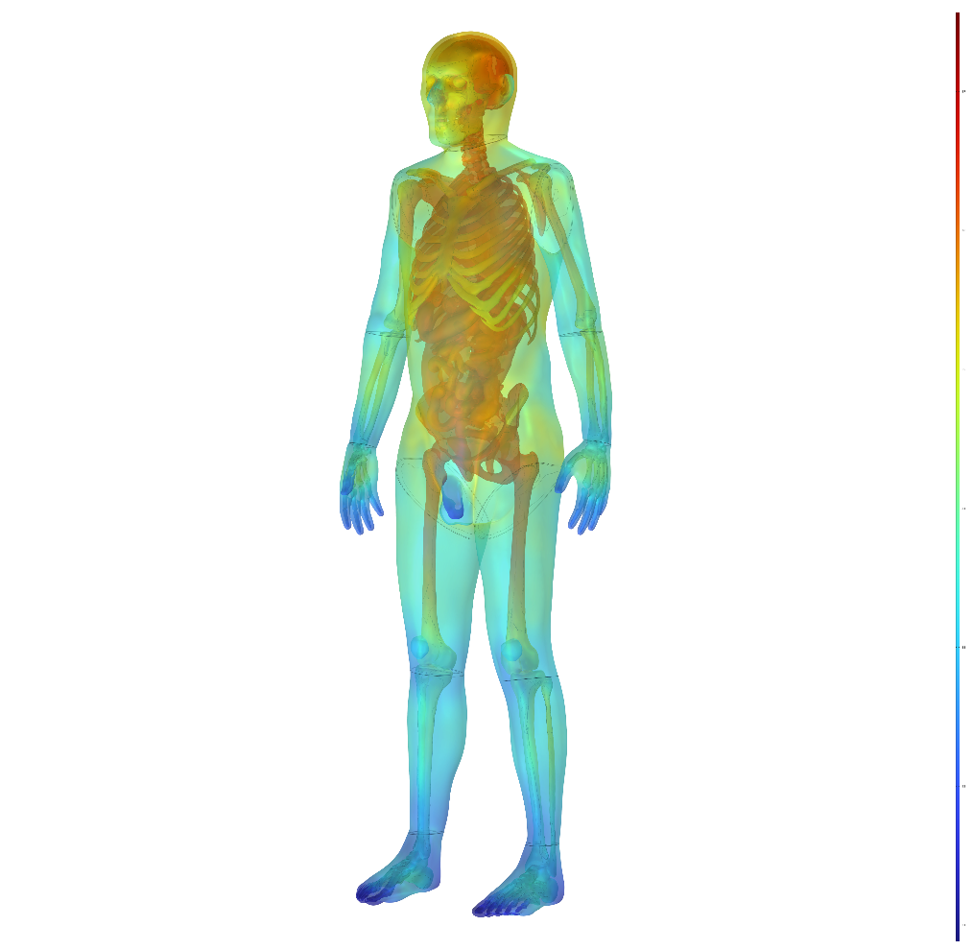
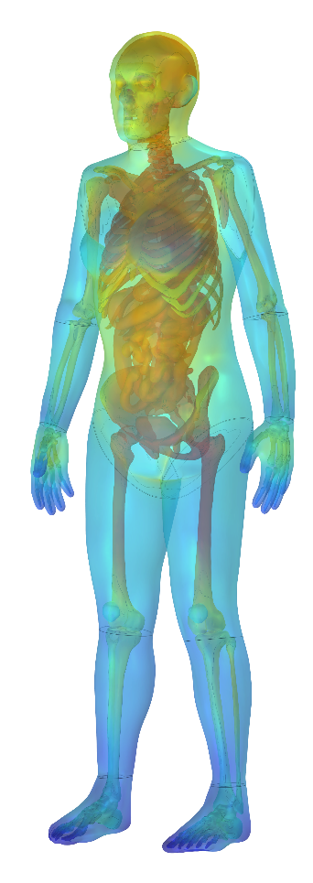
U.S. Army Research Institute of Environmental Medicine
Thermal and Mountain Medicine Division
Human Thermoregulation and Spatial Temperature for Frostbite Prediction with COMSOL’s Bio-Heat Transfer Module
Juliette Jacques, BEng
Timothy Rioux, MSc
Xiaojiang Xu, PhD
John Castellani, PhD

Slide 2
Disclaimer
Approved for public release; distribution is unlimited. The opinions or assertions contained herein are the private views of the author(s) and are not to be construed as official or reflecting the views of the Army or the Department of Defense. Citations of commercial organizations and trade names in this report do not constitute an official Department of the Army endorsement or approval of the products or services of these organizations.

Slide 3
U.S. Army Research Institute of Environmental Medicine
Thermal and Mountain Medicine Division conducts research to optimize physical and cognitive performance and prevent illness associated with military operations at environmental extremes, such as heat, cold, high terrestrial altitude, and subterranean.
Frostbite and cold injury risk in below freezing ambient temperatures is accelerated by wind.
Find areas of body most susceptible to frostbite.
Methods to reduce frostbite risk.
Predict frostbite risk and exposure time with specific conditions.

Slide 4
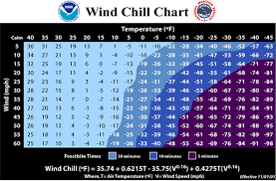
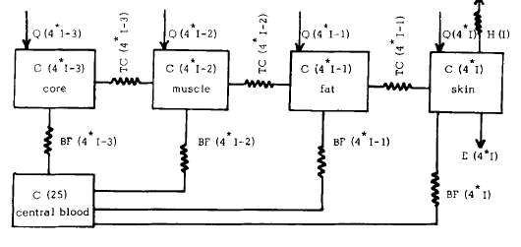
Background
Frostbite and cold injury risk in below freezing ambient temperatures is accelerated by wind.
National Weather Service (NWS) Wind Chill Temperature Index (WCTI) calculates skin temperatures for frostbite risk on the cheek with minimal activity levels based.
Wind chill models have also utilized numerical methods and cylindrical models in predicting frostbite risk in humans.
Male and Female Finite Element Thermoregulatory Models (FETM) are used to predict a more accurate WCTI with a geometrically and anatomically correct model.
Core
Muscle
Skin
Multi-layer Cylindrical Model
National Weather Service, 2001
Schematic of heat-exchange for multi-layer compartments (Stolwijk and Hardy)

Slide 5
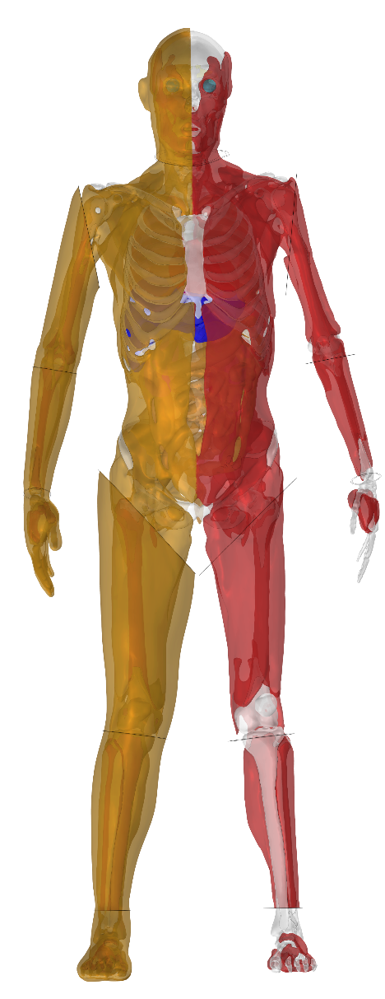
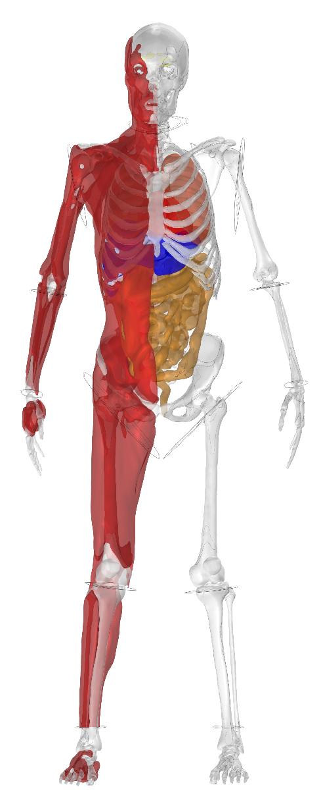
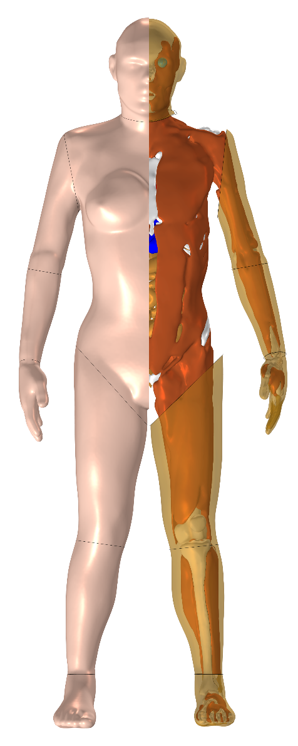
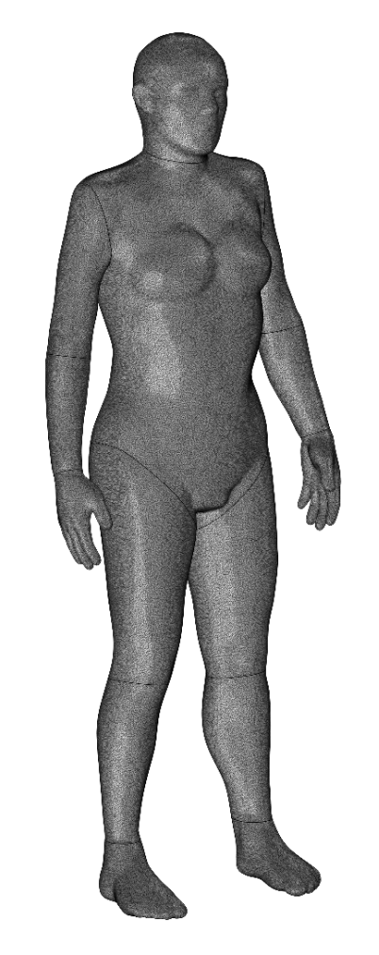

Meshing
Female Mesh
36 years old
1.62 m tall
66 kg
30% Body Fat
Male Mesh
37 years old
1.76 m tall
81 kg
22% Body Fat
Median U.S. Female
Median U.S. Male
Female Model Slices – Skin/Fat , Fat/Muscle, Muscle/Bones and Organs

Slide 6
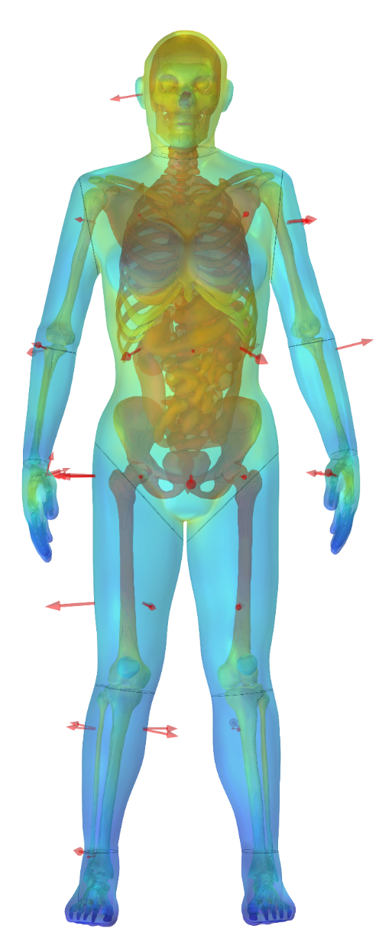
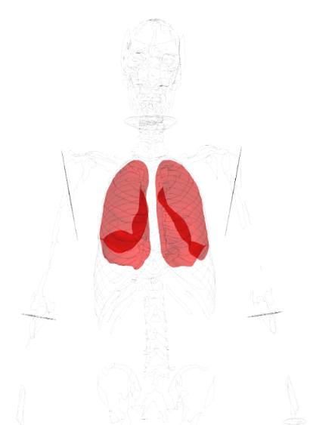
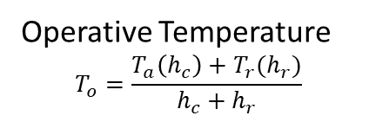
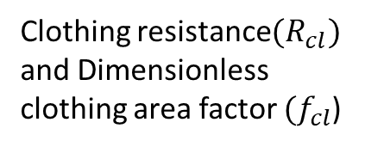
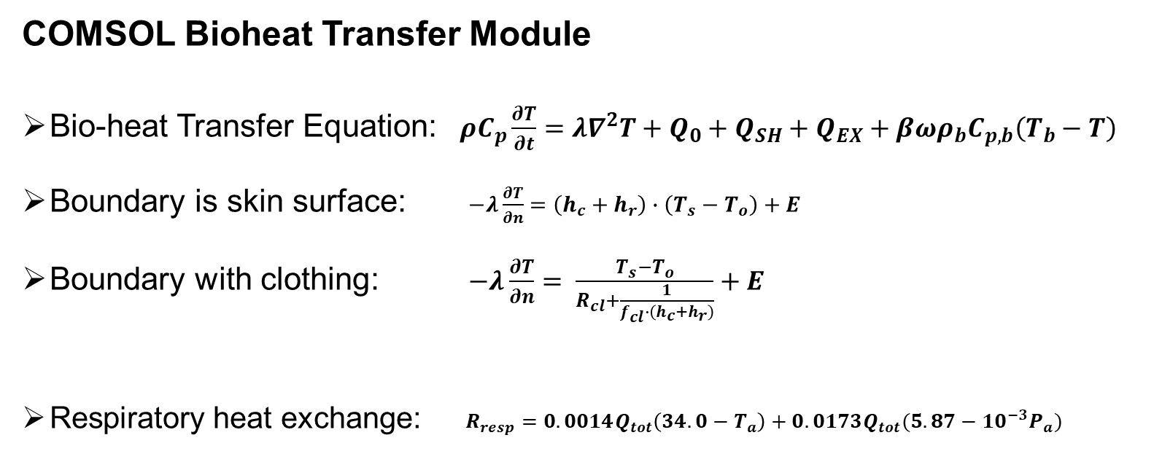
Passive System
COMSOL Bioheat Transfer Module
Bio-heat Transfer Equation: $ρC_{p}\frac{∂T}{∂t}=λ∇^{2}T+Q_{0}+Q_{SH}+Q_{EX}+βωρ_{b}C_{p,b}\left(T_{b}−T\right)$
Boundary is skin surface: $−λ\frac{∂T}{∂n}=\left(h_{c}+h_{r}\right)∙\left(T_{s}−T_{o}\right)+E$
Boundary with clothing: $−λ\frac{∂T}{∂n}= \frac{T_{s}−T_{o}}{R_{cl}+\frac{1}{f_{cl}∙\left(h_{c}+h_{r}\right)}}+E$
Respiratory heat exchange: $R_{resp}=0.0014Q_{tot}\left(34.0−T_{a}\right)+0.0173Q_{tot}(5.87−{10}^{−3}P_{a})$
Blood flow rate
Operative Temperature
$$T_{o}=\frac{T_{a}\left(h_{c}\right)+T_{r}(h_{r})}{h_{c}+h_{r}}$$
Clothing resistance${(R}_{cl})$ and Dimensionless clothing area factor ${(f}_{cl}$)
Assumption: 100% of respiratory heat exchange occurs in the lungs
Notes:
With these imported into COMSOL, we set up the global and component parameters with the component materials and the bio-heat transfer equations
In this model there is a passive and active system, the passive system being the bioheat transfer equation and the relation to geometry and anatomical characteristics (shown at the top) with initial values being the blood temperature of 37 C and the skin surface being the boundary of the model.
In most instances we will need some sort of clothing on the model which causes additional thermal insulation and resistance. Therefore, the bondary condition must be modified with these values where fcl is the dimensionless clothing factor and Rcl is the intrisinc resistance.

Slide 7
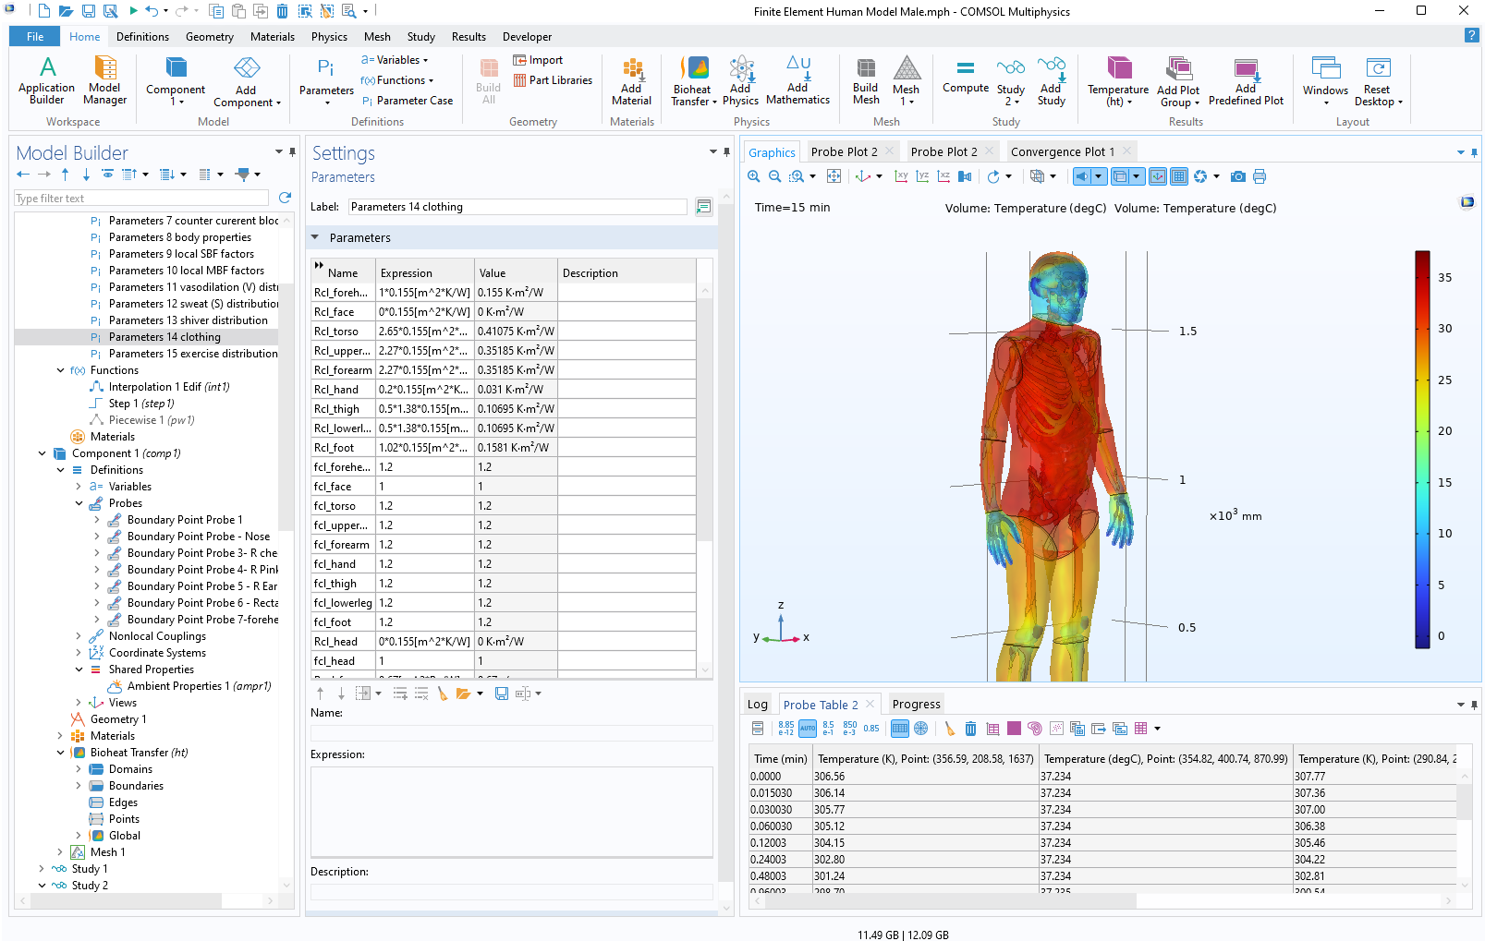
Clothing
Notes:
Here is the screen of the male model in COMSOL, highlighting the clothing parameters in the global definition section.

Slide 8
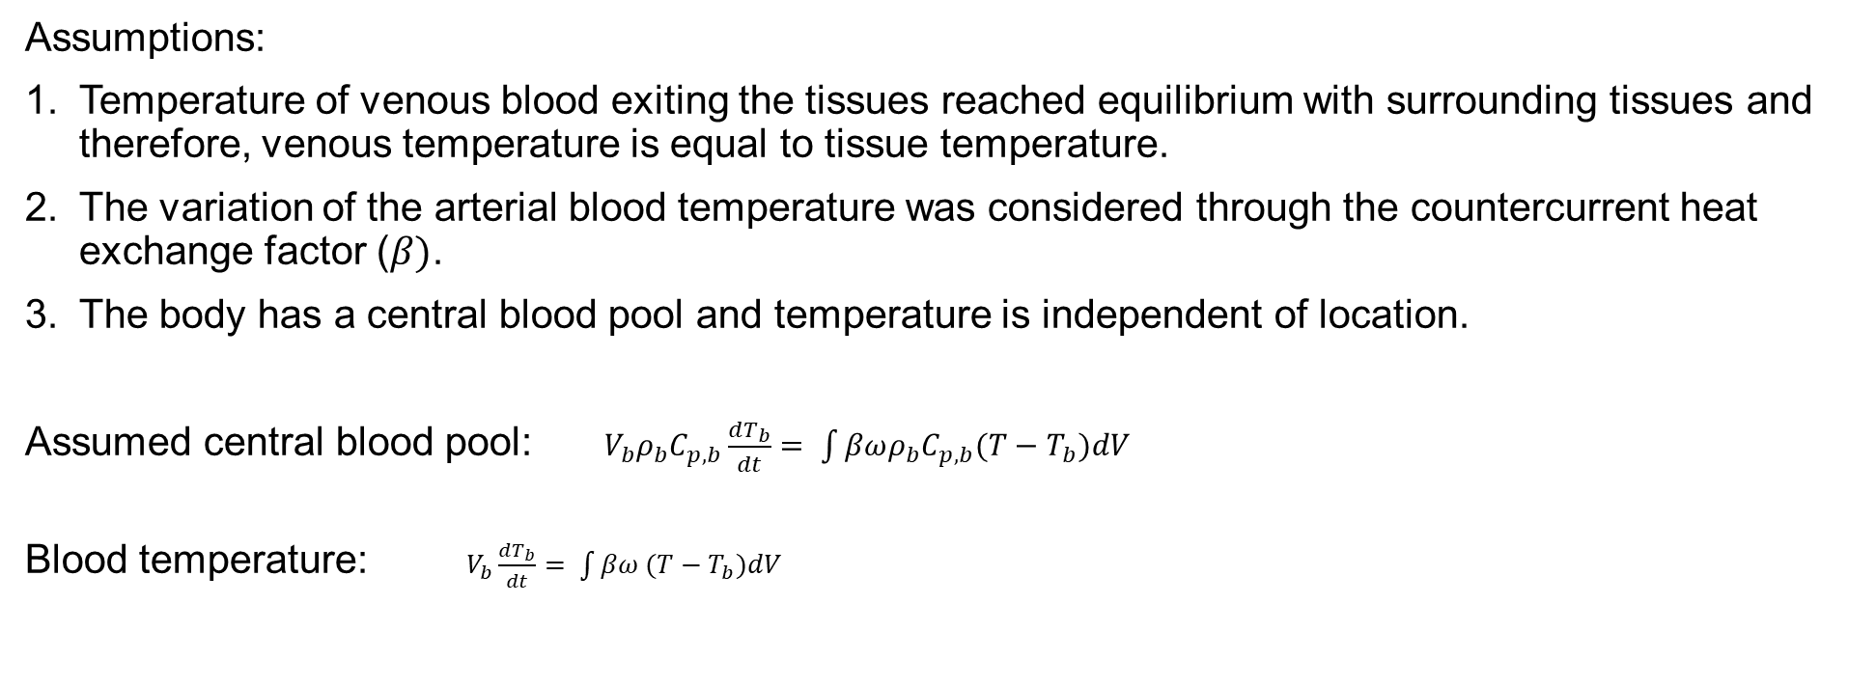
Global Equation- Blood Temperature
Assumptions:
Temperature of venous blood exiting the tissues reached equilibrium with surrounding tissues and therefore, venous temperature is equal to tissue temperature.
The variation of the arterial blood temperature was considered through the countercurrent heat exchange factor ($β)$.
The body has a central blood pool and temperature is independent of location.
Assumed central blood pool: $V_{b}ρ_{b}C_{p,b}\frac{dT_{b}}{dt}= \int{βωρ_{b}C_{p,b}(T−T_{b})dV}$
Blood temperature: $V_{b}\frac{dT_{b}}{dt}= \int{βω (T−T_{b})dV}$
Notes:
With these imported into COMSOL, we set up the global and component parameters with the component materials and the bio-heat transfer equations
In this model there is a passive and active system, the passive system being the bioheat transfer equation and the relation to geometry and anatomical characteristics (shown at the top) with initial values being the blood temperature of 37 C and the skin surface being the boundary of the model.
In most instances we will need some sort of clothing on the model which causes additional thermal insulation and resistance. Therefore, the bondary condition must be modified with these values where fcl is the dimensionless clothing factor and Rcl is the intrisinc resistance.

Slide 9
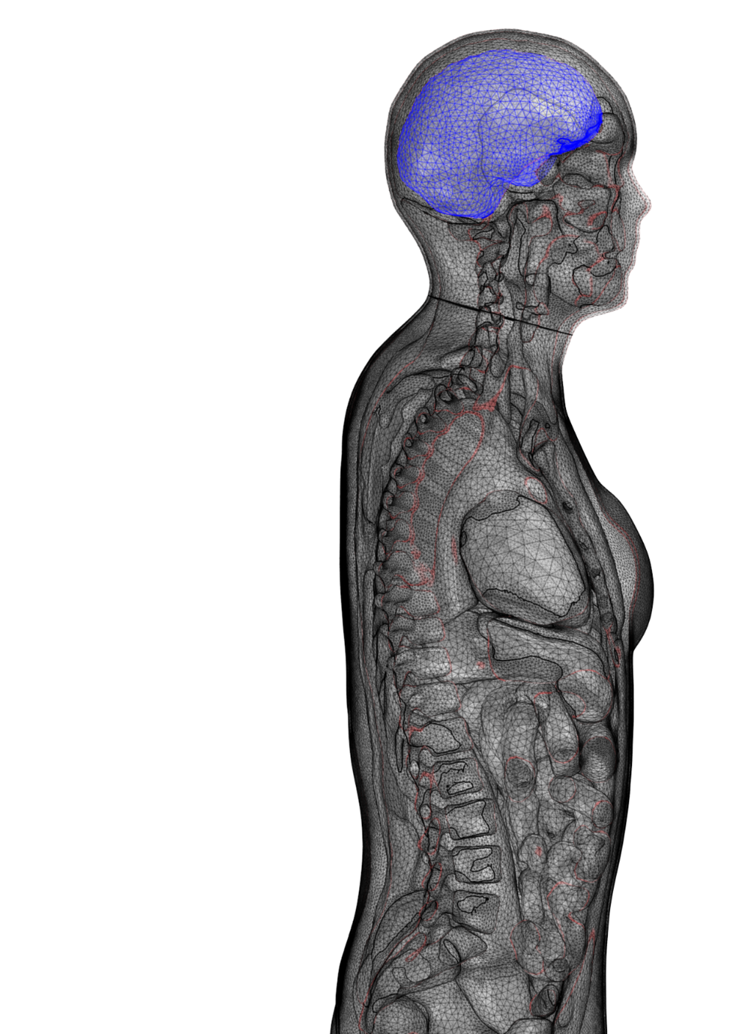
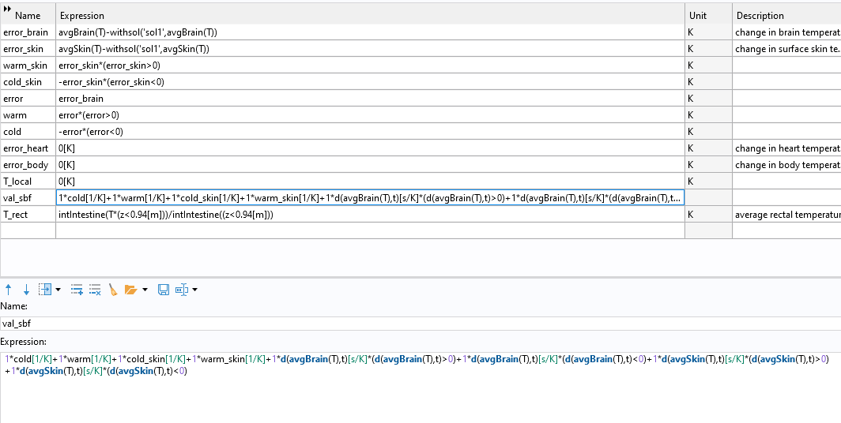
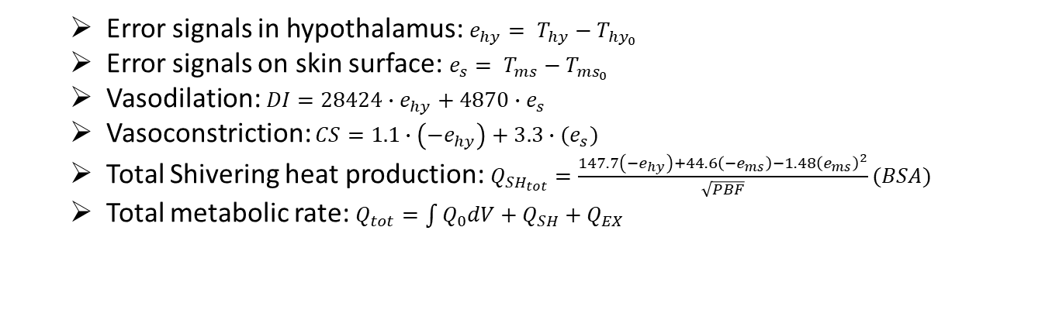
Active System
  Error signals in hypothalamus: $e_{hy}= T_{hy}−T_{{hy}_{0}}$
  Error signals on skin surface: $e_{s}= T_{ms}−T_{{ms}_{0}}$
  Vasodilation: $DI=28424∙e_{hy}+4870∙e_{s}$
  Vasoconstriction: $CS=1.1∙\left(−e_{hy}\right)+3.3∙{(e}_{s})$
  Total Shivering heat production: $Q_{{SH}_{tot}}=\frac{147.7\left(−e_{hy}\right)+44.6\left(−e_{ms}\right)−1.48{\left(e_{ms}\right)}^{2}}{\sqrt{PBF}}(BSA)$
  Total metabolic rate: $Q_{tot}=\int{Q_{0}dV}+Q_{SH}+Q_{EX}$
Notes:
The active system is a feedback loop of responses for human thermoregulation. Thermoregulatory responses are user-defined and controlled within the parameter sections in COMSOL. Tms set and Thy set are found from running solution 1 which is a steady-state thermoneutral simulation with ambient properties at 29 C, 0.18m/s, RH of 40% and 107W metabolic heat production.
These reference values are used to then compute the error in the time-dependent study in Solution 2 for the hypothalamus and mean skin differences. The calculated error signals are then used to find the warm and cold thermoreceptor outputs. These values are used to then find the total efferent vasodilation and vasoconstriction commands (SI and CS), which are further used to find skin blood flow rate, which then is used in the blood perfusion rate in the Bio-heat transfer biological tissue section. The error signals are also used in determining sweat rate and shivering heat production. SO the total heat production is determined by the added exercise heat production the shivering and the basal metabolic rate.

Slide 10
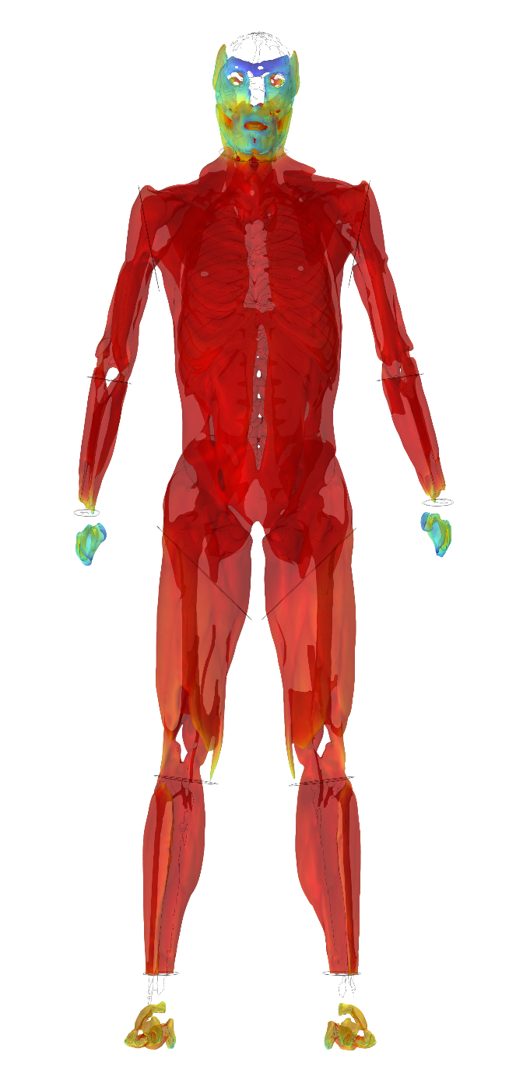
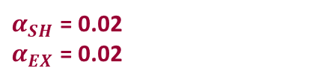

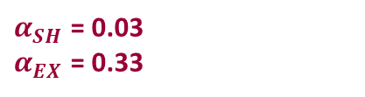
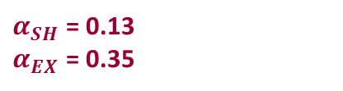
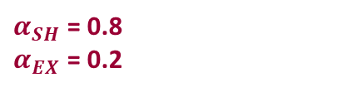
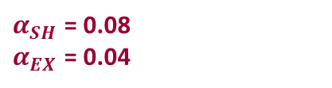

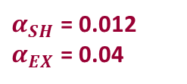
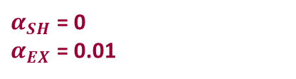

Metabolic Heat Production
$α_{SH}$ = 0.02
$α_{EX}$ = 0.02
$$ω_{m}= ω_{m0}+ c_{m}∙\left(Q_{SH}+Q_{EX}\right)$$
$α_{SH}$ = 0.012
$α_{EX}$ = 0.04
$α_{SH}$ = 0.8
$α_{EX}$ = 0.2
$$Q_{SH}= \frac{α_{SH}∙Q_{SH,tot}}{V_{i}}$$
$α_{SH}$ = 0.08
$α_{EX}$ = 0.04
$$Q_{EX}= \frac{α_{EX}∙Q_{EX,tot}}{V_{i}}$$
$α_{SH}$ = 0
$α_{EX}$ = 0.01
$α_{SH}$ = 0.13
$α_{EX}$ = 0.35
$α_{SH}$ = 0.03
$α_{EX}$ = 0.33
$α_{SH}$ = 0
$α_{EX}$ = 0.01

Slide 11
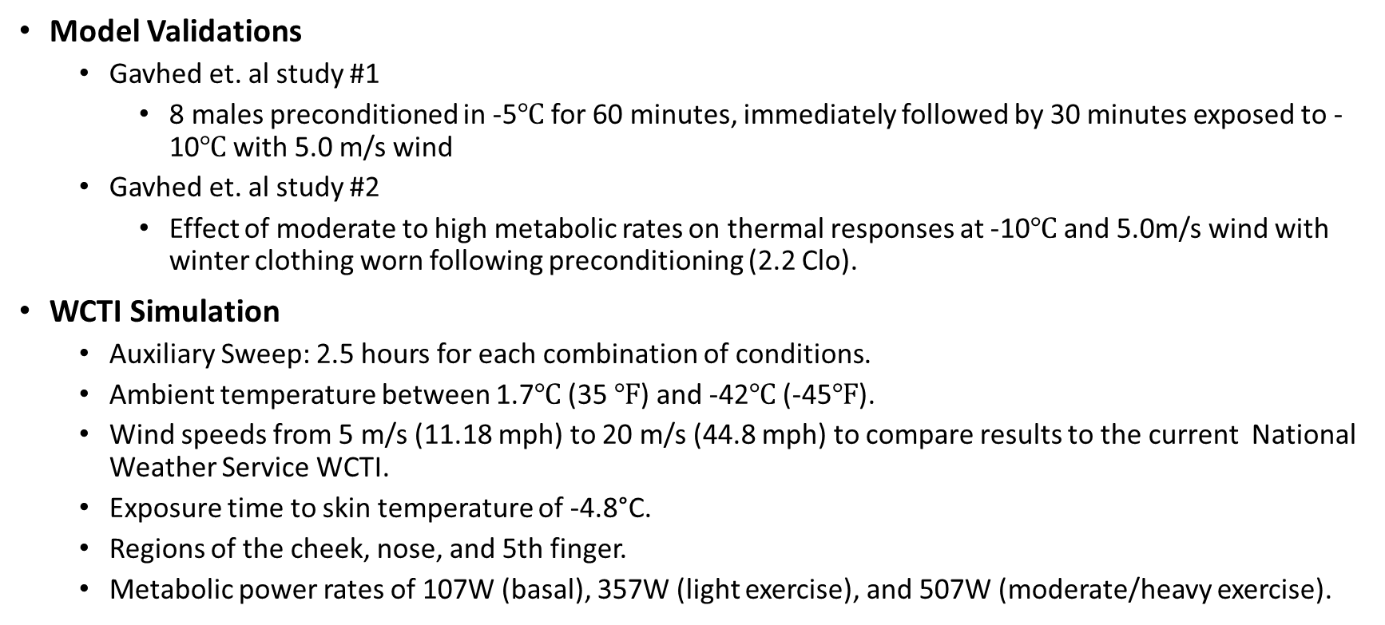
Time-dependent Simulations
Model Validations
  Gavhed et. al study #1
    8 males preconditioned in -5℃ for 60 minutes, immediately followed by 30 minutes exposed to -10℃ with 5.0 m/s wind
  Gavhed et. al study #2
    Effect of moderate to high metabolic rates on thermal responses at -10℃ and 5.0m/s wind with winter clothing worn following preconditioning (2.2 Clo).
WCTI Simulation
  Auxiliary Sweep: 2.5 hours for each combination of conditions.
  Ambient temperature between 1.7$℃$ (35 $℉$) and -42$℃$ (-45$℉$).
  Wind speeds from 5 m/s (11.18 mph) to 20 m/s (44.8 mph) to compare results to the current National Weather Service WCTI.
  Exposure time to skin temperature of -4.8°C.
  Regions of the cheek, nose, and 5th finger.
  Metabolic power rates of 107W (basal), 357W (light exercise), and 507W (moderate/heavy exercise).
Notes:
-So, we went over the summary of model equations and the relationships to find the spatial temperature distribution. Now for the actual implementation.
The model has been previously validated in thermoneutral and transient hot and cold, but not before in these extreme conditions.
Brief validation simulations run were to compare to current datasets which only used male subjects, so we used the male model to do a brief model validation, as we still need to conduct the human study to confirm any of the WCTI results. The two studies ‘validated’ were from a group (Gavhed et al) where they had a steady state study preconditioned in -5C for 60 mins and then exposed to -10C with wind of 5m/s for 30 mins.
The next study by the same researchers viewed two different metabolic rates following a preconditioning period.
Because these two studies involved certain parameters changing within the same simulation, such as the clothing resistance as clothing is being taken off or on and the ambient conditions, in COMSOL piecewise functions were used to control these components.
For this work, following a stationary study (Study 1) with thermoneutral conditions, a time-dependent study was run for 2.5 hours with sample rate of 2 mins of the probes at the nose, finger and cheek. The temperature and wind range were similar to that of the current wind chill chart, 35F to -45F and 5m/s to 20m/s. We determined -4.8C as the temperature to frostbite based on previous work, which this is the minimum value – also used in the WCTI. The exercise heat productions used were 0W – 107W basal metabolic rate, 250W, and 400W. The total metabolic rates would fluctuate in the simulation based on shivering and blood flow as we saw in the earlier equations.

Slide 12
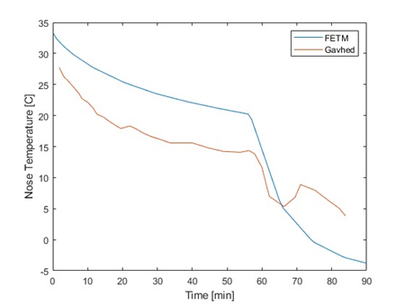
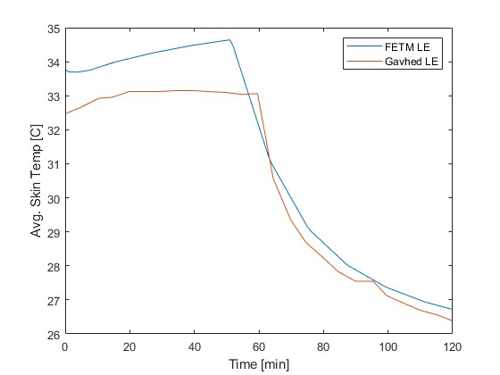
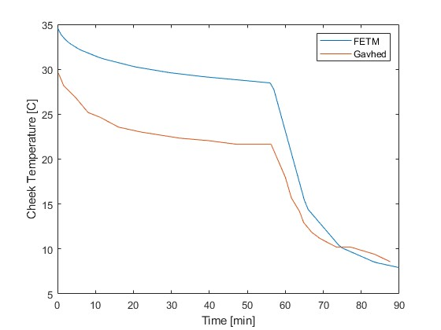
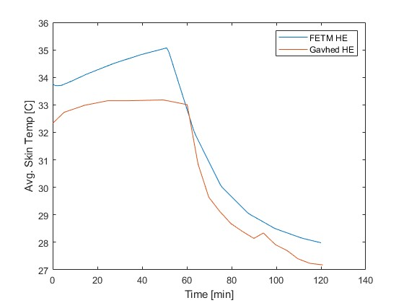
Model Validation
Gavhed et al study #1
Gavhed et al study #2
Gavhed et al study #1 vs FETM [left] for nose[top] and cheek [bottom]; Gavhed et. al study #2 [right] for average skin temperature at low intensity exercise (LE) [top] and high intensity exercise (HE) [bottom].
Notes:
Damping effects of BDF?
FETM shows good agreement after the preconditioning phase (0-60 min)
Subject average initial temperatures were much greater than the male FETM.
In study #2, average skin temperatures in experimental phase (60-120min) were marginally different with final values of 26.4$℃$ for LE in the FETM and 26.1$℃$ for the observed data.
FETM HE simulation overpredicts temperature in experimental portion of HE

Slide 13
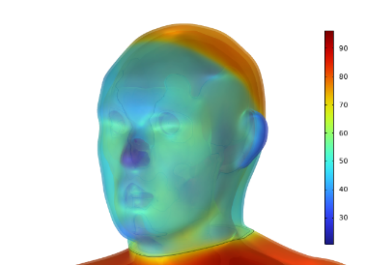
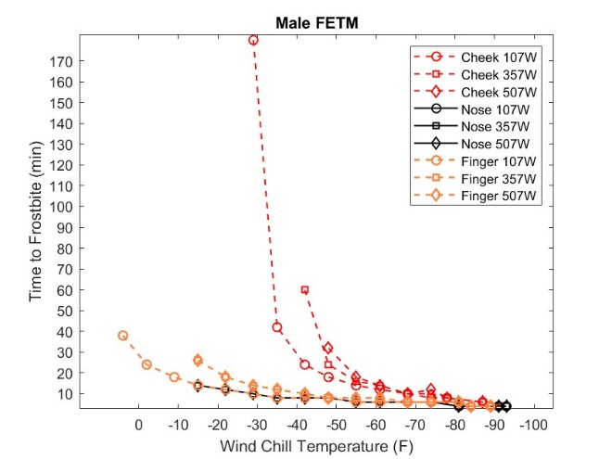
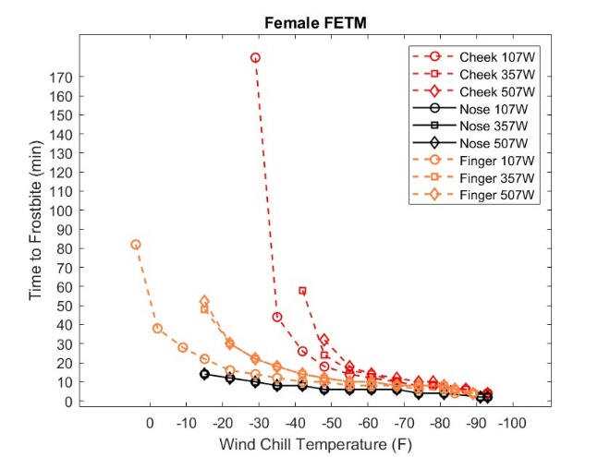
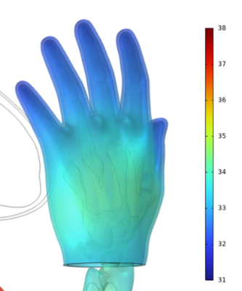
WCTI Simulation Results
Female FETM face [top] and hand [bottom] during 0W exercise WCTI simulation.
Notes:
The WCTI simulations results overall show that the nose and the finger are the more susceptible sites for cold injury and frostbite compared to the cheek. This is likely because of the larger mass to surface area proportion and more blood flow in the cheek.
Between the male and female models the results are very similar with only subtle differences, which was expected because the only distinction is the geometries and BF between the two. The body surface area and BF% impact would alter the shiver heat production results as it is inversely related to the root of BF% and proportional to the surface area.
With increasing metabolic heat production the time to frostbite increases, reducing the risk in warmer wind chill temperatures, although as wind chill temperature reduces, the impact of exercise becomes insignificant.

Slide 14
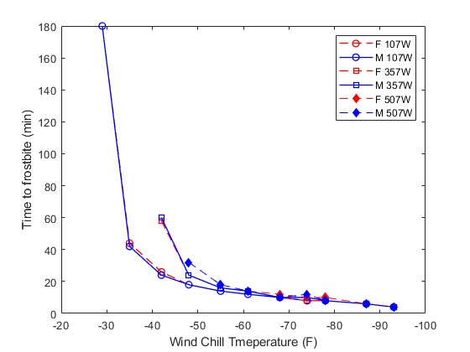
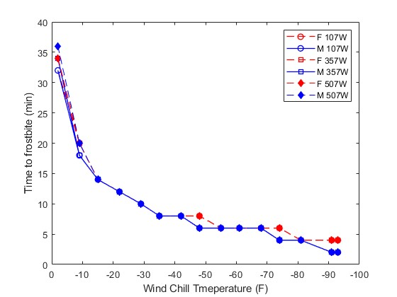
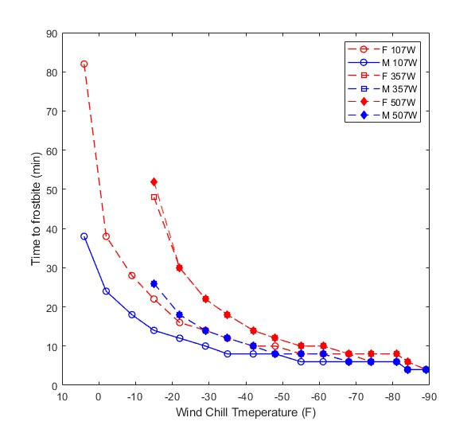
Male vs. Female FETM
Cheek
Nose
Finger
Notes:
- Male vs. Female results
- cheek: similar towards higher WCTIs (lower temp and high wind), female takes longer in lower wctis
- Finger frostbite differences may be due to slightly elevated initial conditions (temperature) in female model (0.6 F)

Slide 15
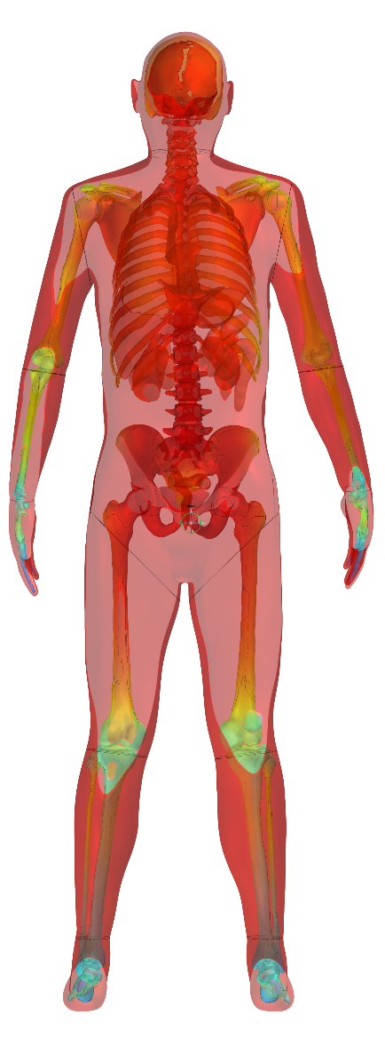
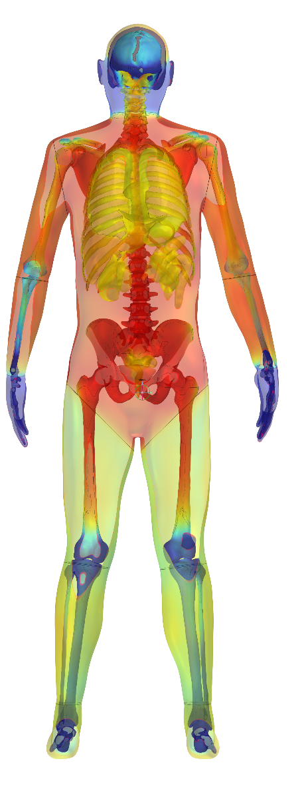
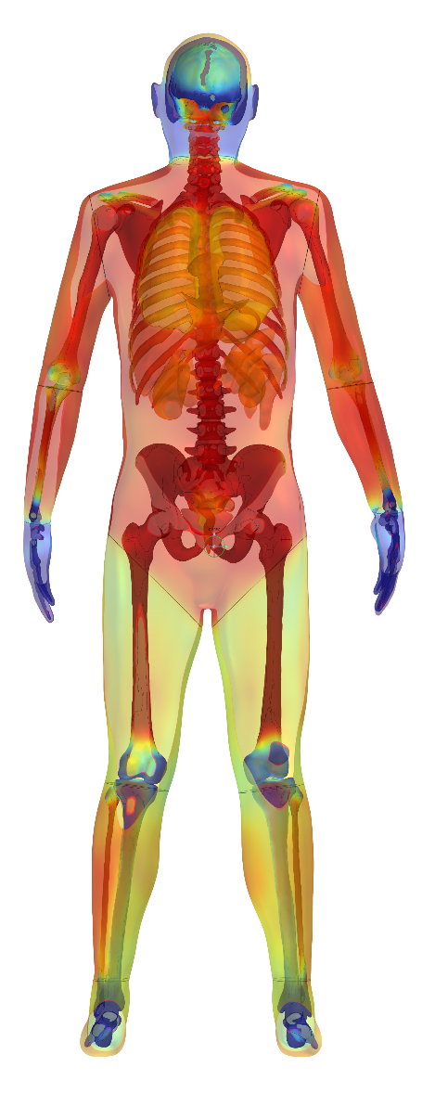
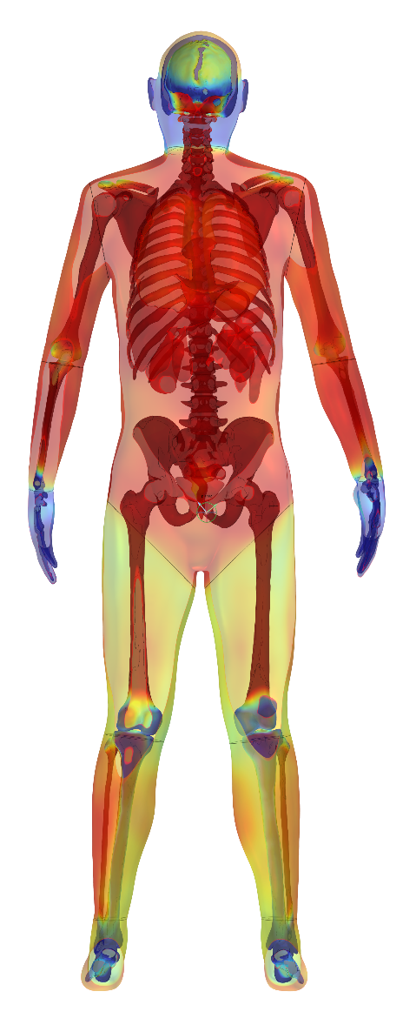
Effects of Exercise on Temperature Distribution
Thermoneutral
No Exercise
Light Exercise
Moderate Exercise
Notes:
-Here is a 3D cut plane of the male model at thermoneutral conditions and no exercise, then 0C and 15 m/s with no exercise, light exercise and moderate exercise. These were all created with the same scale where red is warm(38C) and blue is cold (31C).

Slide 16






Conclusion
The FETM in COMSOL Multiphysics can be used to estimate human heat transfer and thermoregulation in extreme cold and windy conditions.
The FETM simulation suggests the nose and finger are more susceptible to frostbite than the cheek in varied conditions and exercise can increase time to frostbite in higher wind chill temperatures (WCT).
More human studies must be conducted to validate the FETM in these conditions.
Male and female model regional skin temperatures are similar with distinct differences only recognized in the finger.
Exercise has greater impact on the cheek in higher WCT, though has a negligible effect with decreasing WCT.
Predict future individual outcomes with FETM simulation.

Slide 17
References
Castellani, M.P.; Rioux T.P.;Castellani, J.W.; Potter, A.W.; Notley, S.R.; Xu, X; Finite element model of female thermoregulation with geometry based on medical images. Journal of Thermal Biology, 2023. 113.
Castellani, M.P., Rioux, T.P.; Castellani, J.W.; Potter, A.W.; Notley, S.R.; Xu, X; A geometrically accurate 3-dimensional model of human thermoregulation for transient cold and hot environments. Comput Biol Med, 2021. 138: p. 104892.
Gavhed, D.; Makinen, T.; Holmer, I; Rintamaki, H.; Face cooling by wind in walking subjects. J Biometeorol, 2003. 47: p. 7.
Gavhed, D.; Makinien, T.; Holmer, I; Rintamaki, H.; Face temperature and cardiorespiratory responses to wind in thermoneutral and cool subjects exposed to -10C. J Appl Physiol 2000. 83: p. 7.
National Weather Service, Windchill Temperature Index, W. Office of Climate, and Weather Services, Editor. 2001, National Oceanic and Atmospheric Administration: Washington, D.C.
Stolwijk, J.A.J., A mathematical model of physiological temperature regulation in man (Washington, D.C.), 1971

