Slide 1

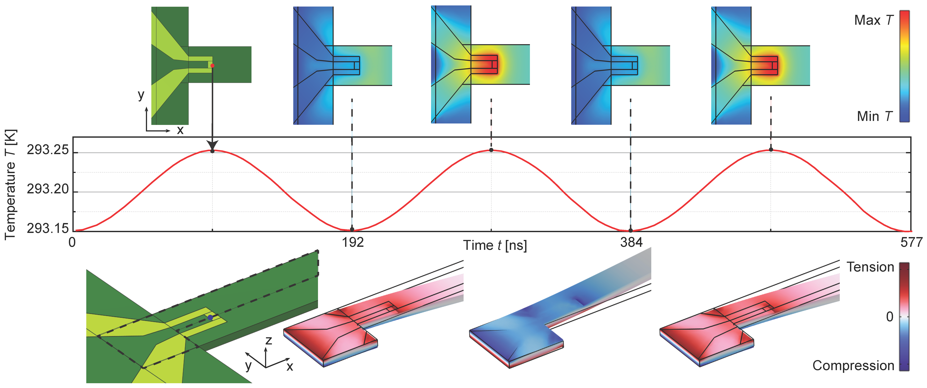
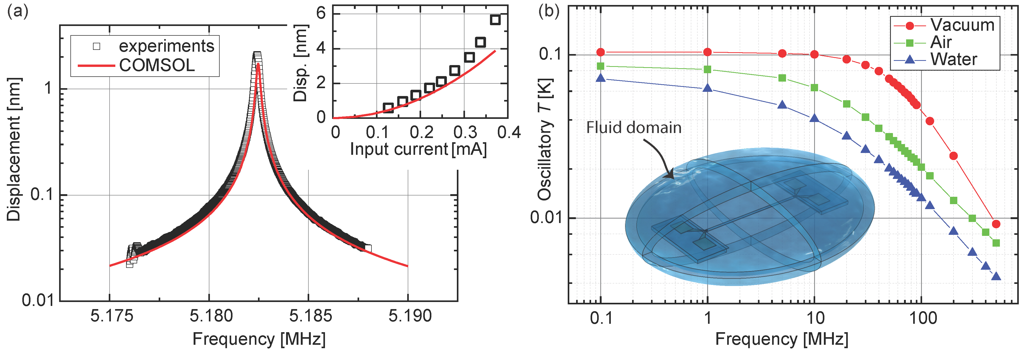

Electrothermal Actuation of Nanomechanical Resonators
Electrothermal actuators convert an electrical signal into a mechanical one via the Joule heating effect. They are crucial components responsible for driving and controlling many devices, from nanometer scale resonators to mesoscale soft robots. Our work focuses on nanomechanical resonators.
Monan Ma and K. L. Ekinci
Department of Mechanical Engineering, Division of Materials Science and Engineering, and the Photonics Center, Boston University, Boston, USA.
Introduction and Goals
Our nanomechanical resonator is a doubly clamped beam with dimensions of 50 µm x 900 nm x 100 nm and made of silicon nitride¹ (SiN). Electrothermal actuators are near each clamp region and are made of gold (Au). Typically, the actuators would excite mechanical oscillations in the resonator beam, and one would look for changes in the resonant frequency due to subtle changes in the surrounding environment. Due to its miniscule size, nanomechanical resonators are capable of ultrasensitive detection. As a result, they are widely used in single-molecule mass spectrometry, virus detection and gas sensing.
The input to the electrothermal actuator is an AC current. The electrical field results in a time-varying temperature field and thermal expansion. Due to the mismatch between the thermal expansion coefficients of Au and SiN, a bending moment ensues, resulting in harmonic mechanical oscillations of the beam.
Modern applications require operation in various fluids and at high (MHz-GHz) frequencies. To this end, we compute the key performance parameters when the nanoactuator is operated in water, air and vacuum settings, and compare these parameters with experiments.
Methodology
Our model combines the time-dependent and frequency domain solvers, resulting in fast convergence times and improved accuracy.
Using the prestressed eigenfrequency study step, we compute intrinsic stress, damping, and eigenfrequencies of the resonator.
Compute the time-dependent temperature field as a result of a supplied AC current using the Ohm’s law and heat equation.
Impose the temperature field as a harmonic perturbation using frequency domain solver. Sweep the frequency near an eigenfrequency, and compute the ensuing mechanical response.
Figure 1. Nanoactuator temperature change in time due to an input current of 1 mA at 5.2 MHz. The temperature field and stress/strain field at indicated time points are shown on the top and bottom of the figure, respectively.
Results
First, we validate our model by comparing the frequency-response amplitude for a given input current near the fundamental resonance with experiments² [Fig. 2(a)]. In the inset, we show the peak resonant response as a function of input power and obtain good agreement.
Second, we compute how the oscillatory temperature (which is proportional to the mechanical response and efficiency) changes with respect to the operation frequency in vacuum, air and water. As the frequency increases, the oscillatory temperature decreases due to thermal roll-off, which reduces the actuation efficiency. This is because the temperature change lags behind the Joule heating³, which simply raises the average temperature.
Figure 2. (a) Frequency-response curve of the resonator’s fundamental mode compared with experimental measurements². The inset shows the peak displacement vs. input current. (b) Oscillatory temperature vs. drive frequency in vacuum, air and water. Inset shows the infinite-element domain used for modeling fluids.
Ma, Monan, and Kamil L. Ekinci. J. Appl. Phys. 134.7 (2023).
Ti, Chaoyang, et al. Nano Lett. 21.15 (2021): 6533-6539.
Bargatin, I., I. Kozinsky, and M. L. Roukes. Appl. Phys. Lett. 90.9 (2007).

