Slide 1
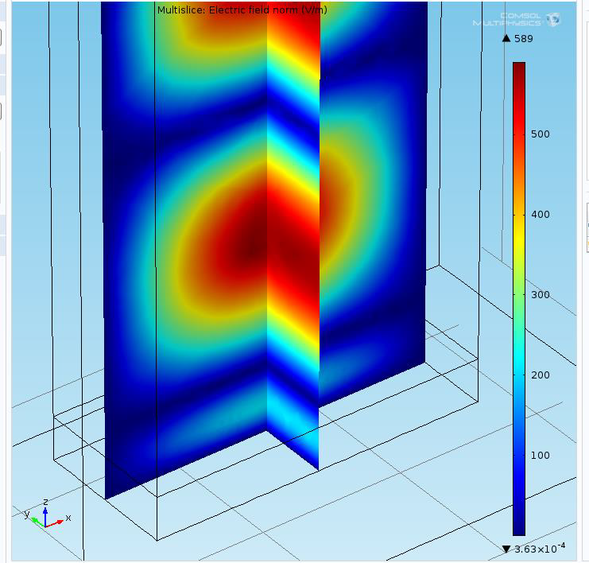
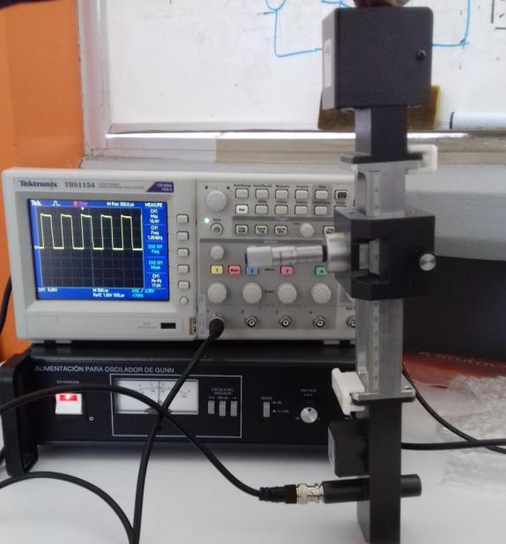
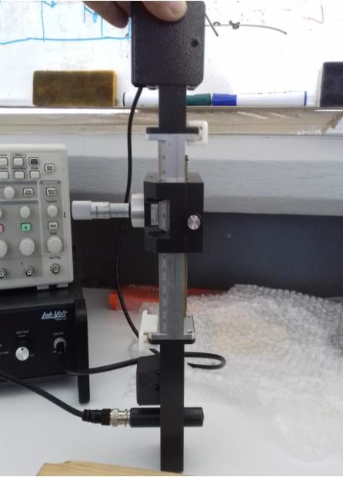
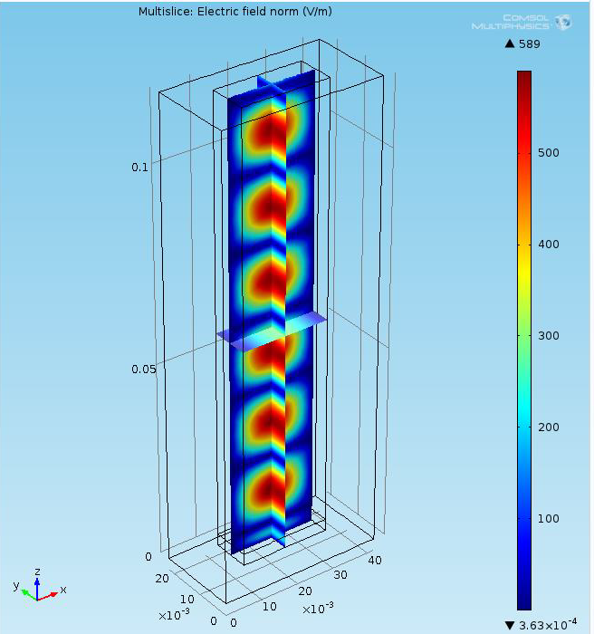
Electromagnetic Characterization And Simulation Of Mexican Heavy Oil Altamira.
Electromagnetic characterization plays an important role in both simulation and microwave heating applications.
A. Vazquez Vazquez¹, Z. Chen²
1. Universidad Politecnica de Altamira, Altamira, Tamaulipas, Mexico.
2. University of Calgary, Calgary, Alberta, Canada.
Abstract
Electromagnetic characterization plays an important role in both simulation and microwave heating applications. Particularly in the recovery of Mexican heavy oil [1], it is essential to perform electromagnetic characterization in order to understand more about the behavior of Mexican heavy oil Altamira being heated by electromagnetic fields.
Through the electromagnetic characterization of the Mexican heavy oil Altamira, an accurate measurement of the dielectric constant can be performed. Because of this, it will be possible to have a better understanding of the behavior of the Mexican heavy oil Altamira with electromagnetic fields when it is heated and recovered with this innovative technique.
Methodology
In the measurement of dielectric constants using the Von-Hippel short-circuited waveguide method. The dielectric sample is positioned within a waveguide section with a thickness of 3 millimeters, terminated by a reflector cap, and measurements of the standing wave ratio and the position of the minimum voltage are made. The equations for the dielectric properties can then be expressed in equation form [2].
Figure 1.- Equipment necessary to carry out characterization by the Von Hippel method.
Results
Through the simulation and electromagnetic characterization of the Altamira heavy crude oil from the Tamaulipas-Constituciones field, it is possible to obtain extensive knowledge of the heavy crude oil and how an improved recovery of heavy crude oil could be obtained when irradiated by an electromagnetic field.
Figure 4. Electric fields in the waveguide.
1. A Sánchez, "Metodología para estimar la capacidad de almacenamiento geológico de CO2 en campos maduros de hidrocarburos", in Boletín de la Sociedad Geológica Mexicana, Mexico, 2024.
2. W. H. Surber, Jr., " Dielectric Measurement Methods for Solids at Microwave Frequencies ", in Princeton University , 1948.

