Slide 1
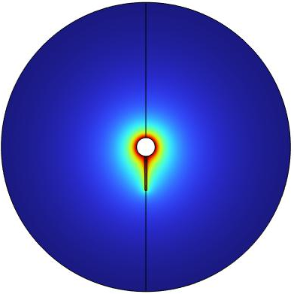
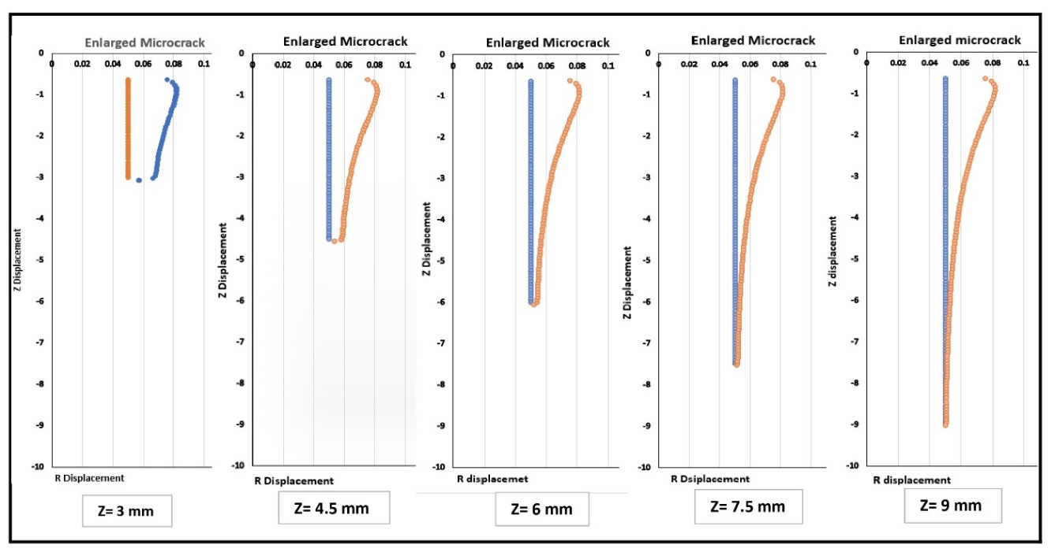
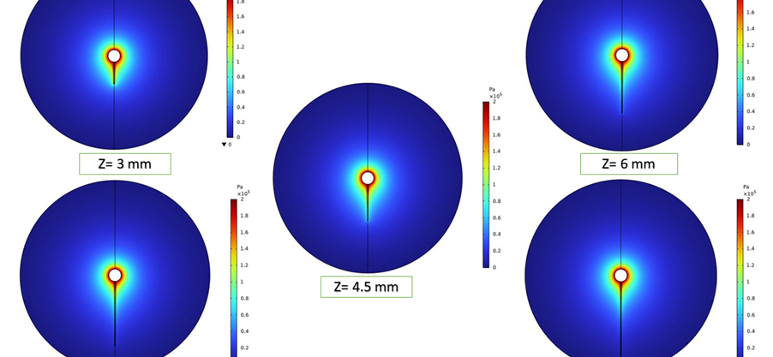

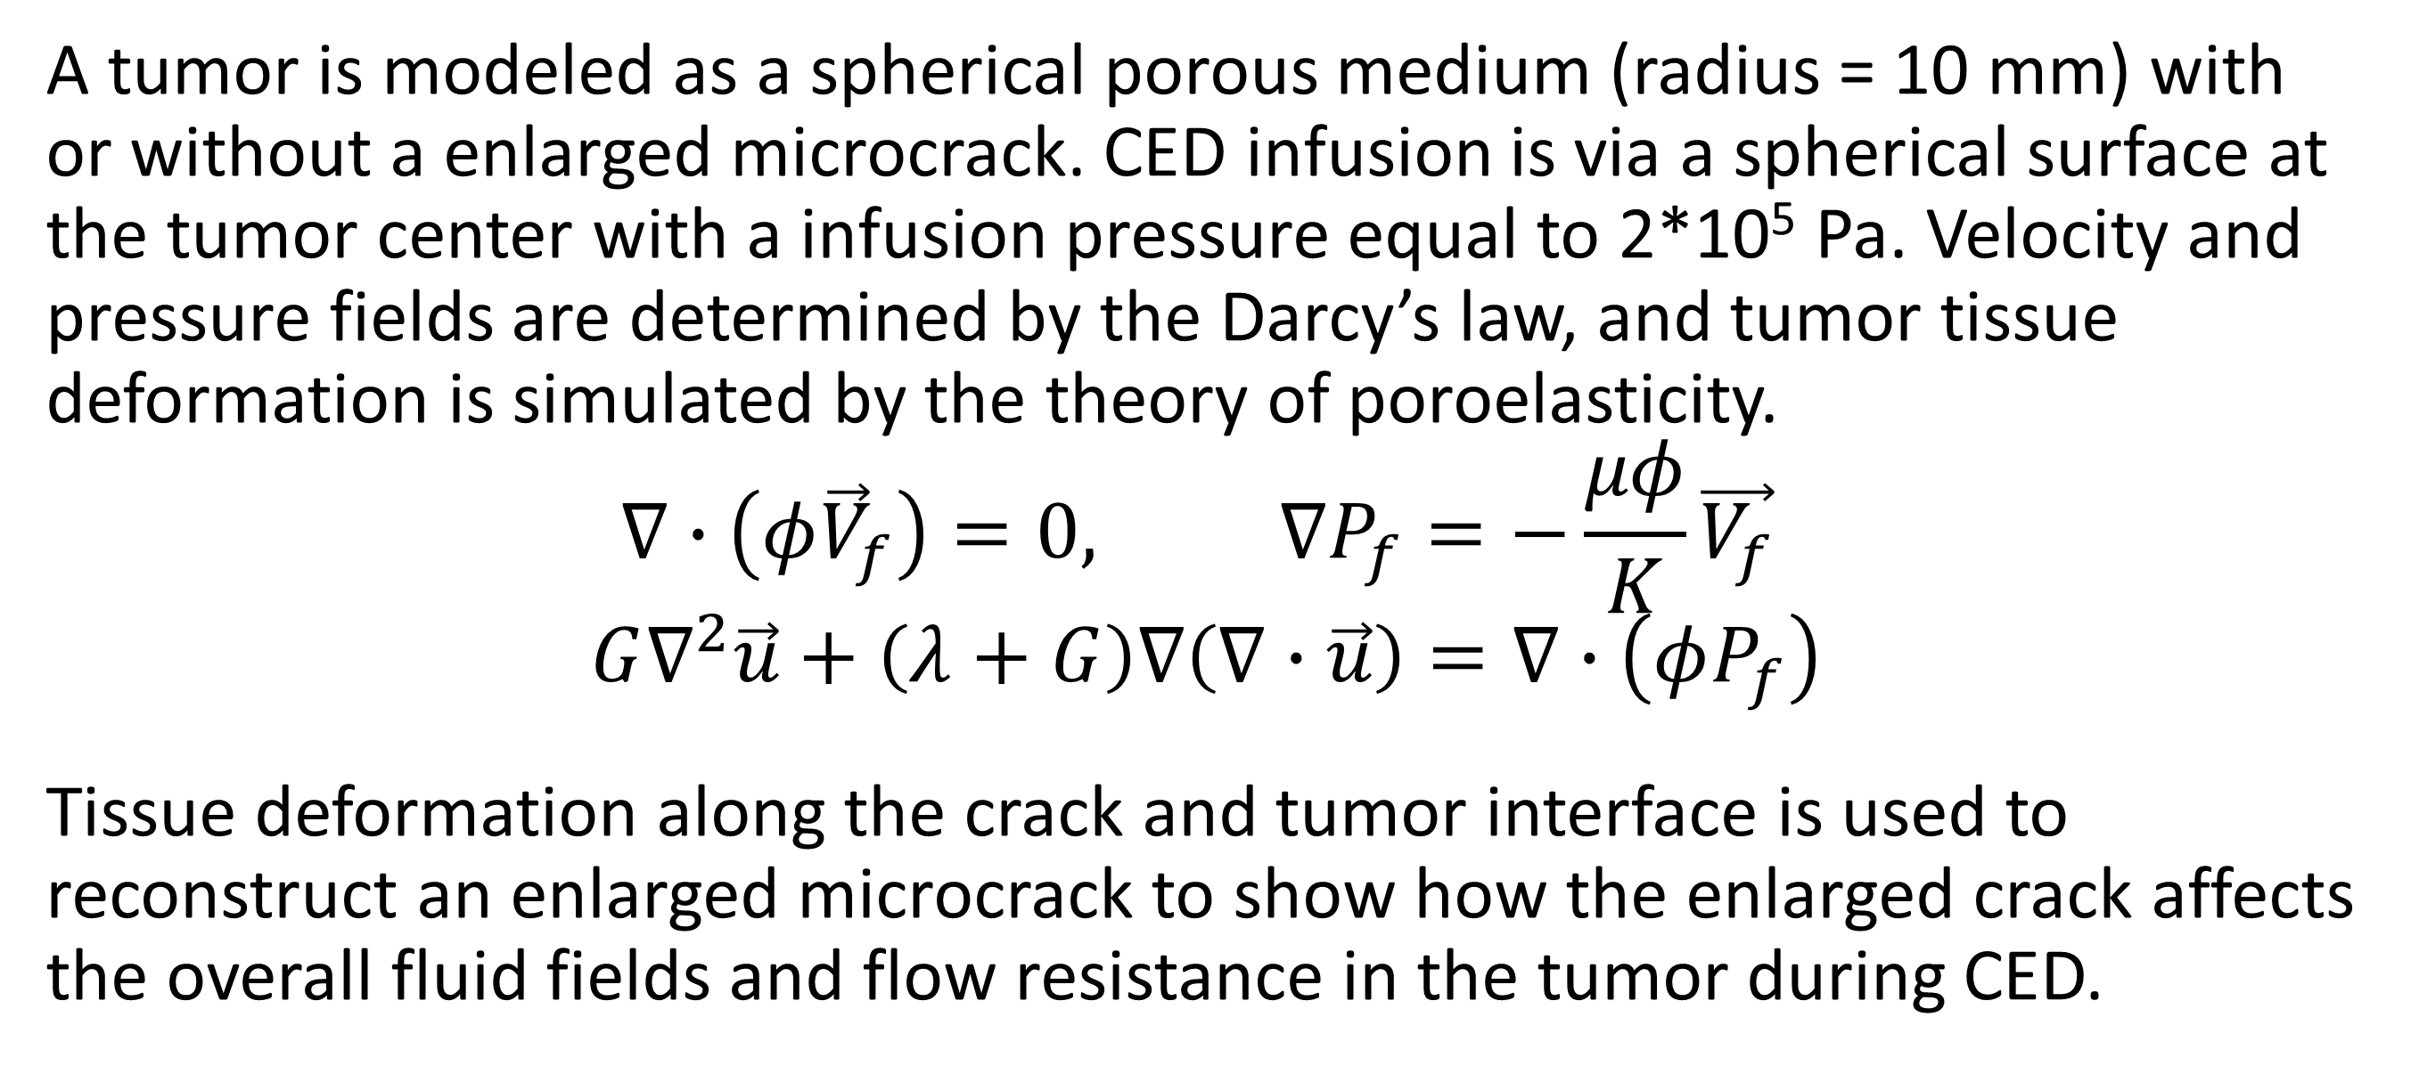
Effect Of Crack Length On Crack Enlargement During Convection-enhanced Nanofluid Delivery In Tumors
We perform theoretical simulations to evaluate how the introduction and enlargement of a microcrack in tissue reduces the overall flow resistance in the porous tumor during convection-enhanced delivery (CED).
Md Jawed Naseem, Ronghui Ma, and Liang Zhu
Department of Mechanical Engineering, University of Maryland Baltimore County
Introduction and Goals
In chemical ablation of tumors, convection-enhanced delivery (CED) is used to infuse chemicals via a single cannula inserted into tumors. Unfortunately, very high interstitial fluid pressure and small porosity in tumors often cause backflow through the needle track. This leads to leakage of the chemicals to surrounding healthy tissue, resulting in severe pain to patients. In this study, we perform theoretical simulation to evaluate how introduction of a microcrack (0.05 mm radius) in tissue reduces the overall flow resistance in a porous tumor, as well as further decrease in the flow resistance as this microcrack enlarges in a direct infusion process using CED. Both Darcy’s law and the poroelasticity theory are used in the simulation to understand the fluid transport in porous tumors with or without microcrack introduction and/or enlargement. We expected that the study would provide quantitative measures to evaluate whether this approach is effective to enhance the fluid transport in dense porous tumors.
Methods
A tumor is modeled as a spherical porous medium (radius = 10 mm) with or without a enlarged microcrack. CED infusion is via a spherical surface at the tumor center with a infusion pressure equal to 2*10⁵ Pa. Velocity and pressure fields are determined by the Darcy’s law, and tumor tissue deformation is simulated by the theory of poroelasticity.
$$∇∙\left(φ{\vec{V}}_{f}\right)=0, ∇P_{f}=−\frac{μφ}{Κ}\vec{V_{f}}$$
$$G∇^{2}\vec{u}+\left(λ+G\right)∇\left(∇∙\vec{u}\right)=∇∙\left(φP_{f}\right)$$
Tissue deformation along the crack and tumor interface is used to reconstruct an enlarged microcrack to show how the enlarged crack affects the overall fluid fields and flow resistance in the tumor during CED.
Figure 1. The original and post-deformation interfaces between the microcrack and the tumor using the deformation vector.
Results
We vary the length of the microcrack from 3 mm to 9 mm to examine how the length of the microcrack affects the pressure and velocity fields, as well as the enlargement of the microcrack. The enlargement of the microcrack due to tissue deformation is illustrated in Figure 1 and the obtained pressure field in Figure 2. One can see the lateral displacement due to large pressure in the microcrack, however, the deformation is significantly subdues after 6 mm in the axial direction. The flow resistance in the tumor is defined as the pressure difference divided by the flow rate at the tumor outer surface. Compared to the control without any microcrack, the flow decreases significantly with an enlarged microcrack, varying from 14% when the crack is 3 mm long to 17% when the crack is 9 mm long.
Figure 2. Pressure distributions in the tumor with different crack lengths (3 to 9 mm) after microcrack enlargement.
M. Kuang, M.-D. Lu, et al. Ethanol ablation of hepatocellular carcinoma Up to 5.0 cm by using a multipronged injection needle with high-dose strategy. Radiology, 253(2):552-561 (2009).
D. Su, R. Ma, and L. Zhu. Numerical study of nanofluid infusion in deformable tissues in hyperthermia cancer treatment. Medical and Biological Engineering & Computing.

