Slide 1
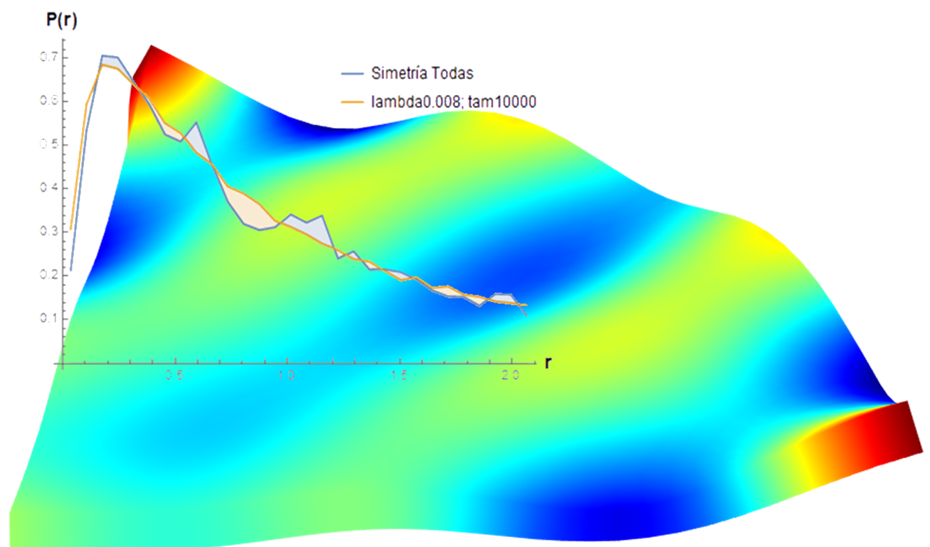
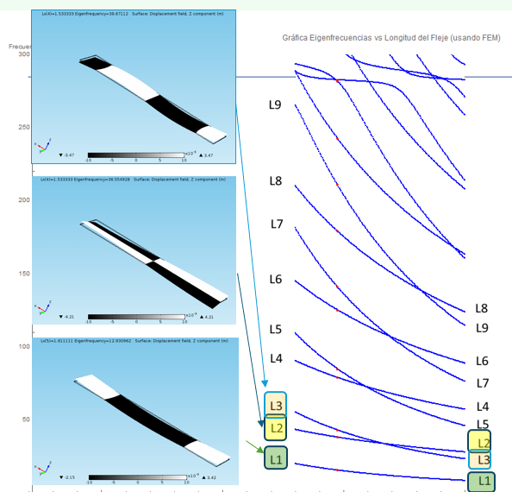
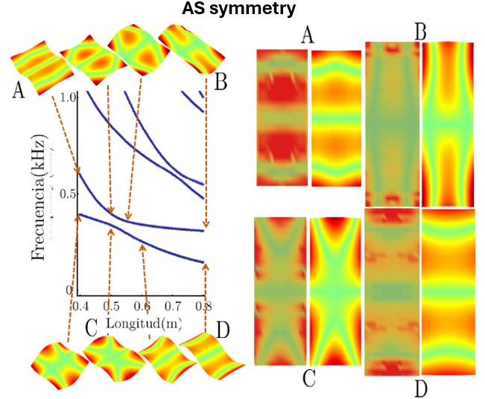

Discovery Of Avoided Crossings In Plate Vibrations Using COMSOL
Unveiling basic, interesting and unexpected spectral features related to wave chaos on free vibrations.
J. Luis Lopez-Gonzalez,
Department of Mathematics and Physics,
Universidad Autónoma de Aguascalientes, México.
Luisideas@gmail.com
Abstract
The understanding of FREE PLATE VIBRATIONS has been an open problem for more than two hundred years and now, with the development of the aerospace industry, characterization of these vibrations becomes more important. We have recently published the discovery of avoided crossings present in the spectrum of freely vibrating rectangular thin plates [1]. The Structural Mechanics module of COMSOL Multiphysics was a fundamental tool to accomplish this feat since we easily generated thousands of normal modes by changing the length of one side of the plate and we could classify them into symmetrical and anti-symmetrical modes. It was revealed that for each symmetry sector of the spectrum, avoiding crossings appear. We corroborated experimentally that modes shapes around an avoiding crossing are interchanged. Since this phenomenon is not present for simple supported vibrating plates, our hypothesis is that these avoided crossings are caused by the presence of evanescent waves traveling at the system´s boundary. We found also avoiding crossings of this kind in a freely vibrating disk sector when we vary its angle.
Methodology
Using the Structural Mechanics module, the free vibration of a thin aluminum plate was simulated.
14000 normal modes were generated by varying a length of the plate, 70 frequencies for each of 200 lengths.
To analyze the modes, the complete spectrum of the plate was constructed by plotting the frequency of the modes against their length (see right side of Figure 1).
The distributions of the energy spacing ratios were constructed from the spectrum.
FIGURE 1.- Left: three out of plane modes in black and white that shows the symmetry along and across the free vibrating thin plate. Right: complete spectrum for all the simulated modes, frequency vs length. The three modes belong to different spectral lines.
Results
Following the shape of the modes, in black and white, for each spectral line, the nodal structure was found to be invariable (see Figure 1).
By classifying the modes according to their symmetry, avoided crossovers were found in the spectra for each symmetry sector (see left side of Figure 2).
The permutation in the shape of the modes before and after several avoided crossings was experimentally verified (see right side of Figure 2).
A similar behavior is observed in the simulation of free vibrations for a disk sector, that is, presence of avoided crossings in their symmetry spectra when varying the angle (see header Figure).
It was found that the distributions of the ratio of energy spacings for each symmetry sector approximate more to the Rosenzweig-Porter transition model of random matrices theory (see inset of header Figure).
FIGURE 2.- Left: Avoiding crossings between the spectral lines of the Antisymmetric-Symmetric sector for the out of plane modes of the free rectangular plate. : Measured and simulated modes before (points A, C at two spectral lines) and after an avoiding crossing (points B and D).
1.- J.L. López-González, et.al. "Deviations from Poisson statistics in the spectra of free rectangular thin plates", Phys. Rev. E, 103, 043004, 2021. http://dx.doi.org/10.1103/PhysRevE.103.043004

