Slide 1
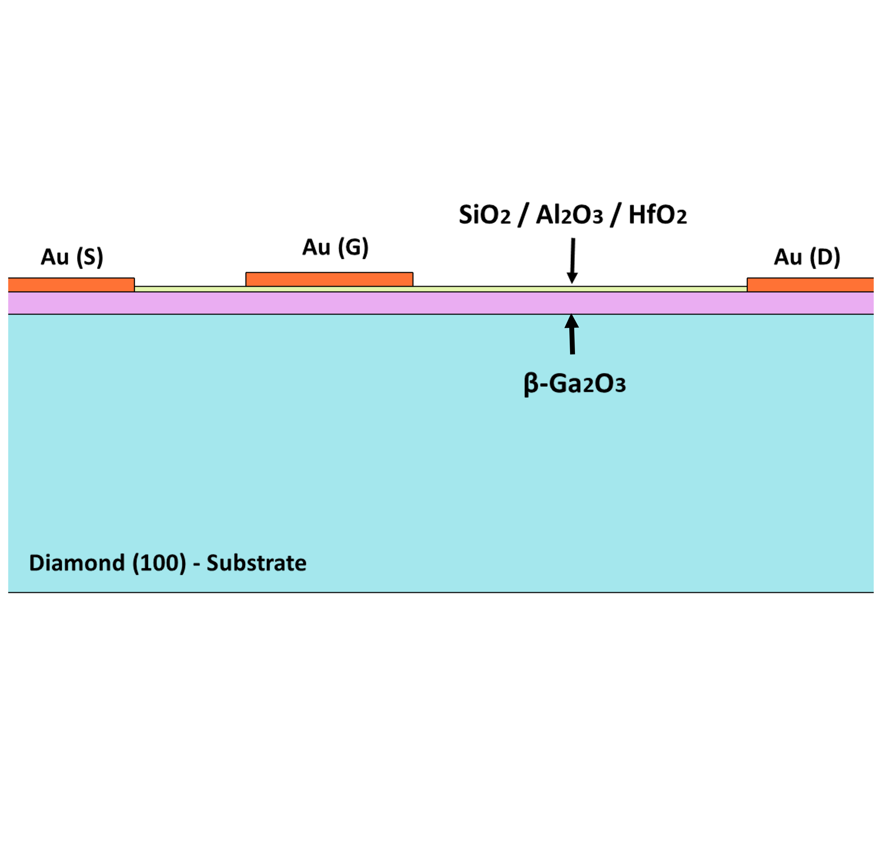
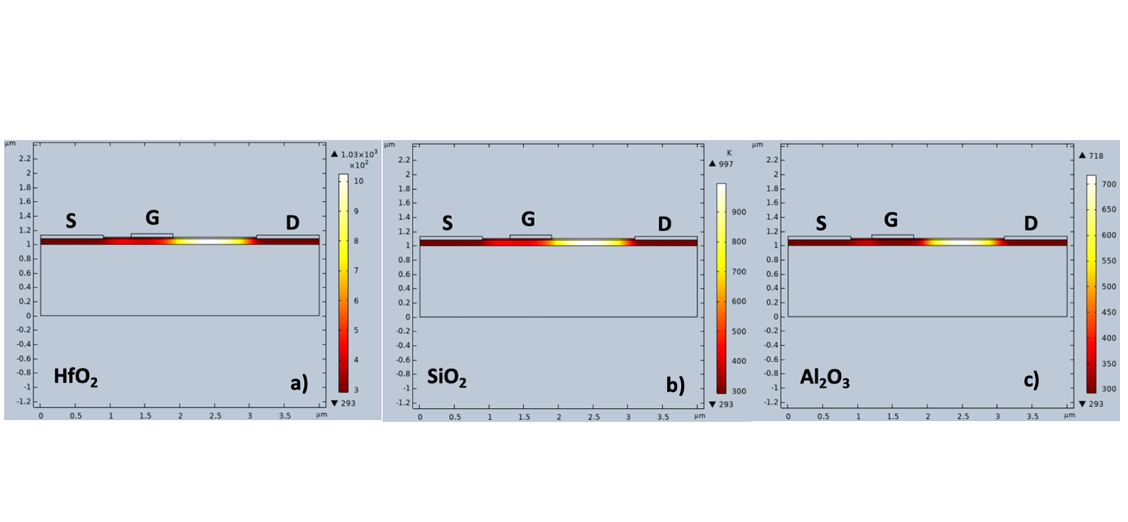
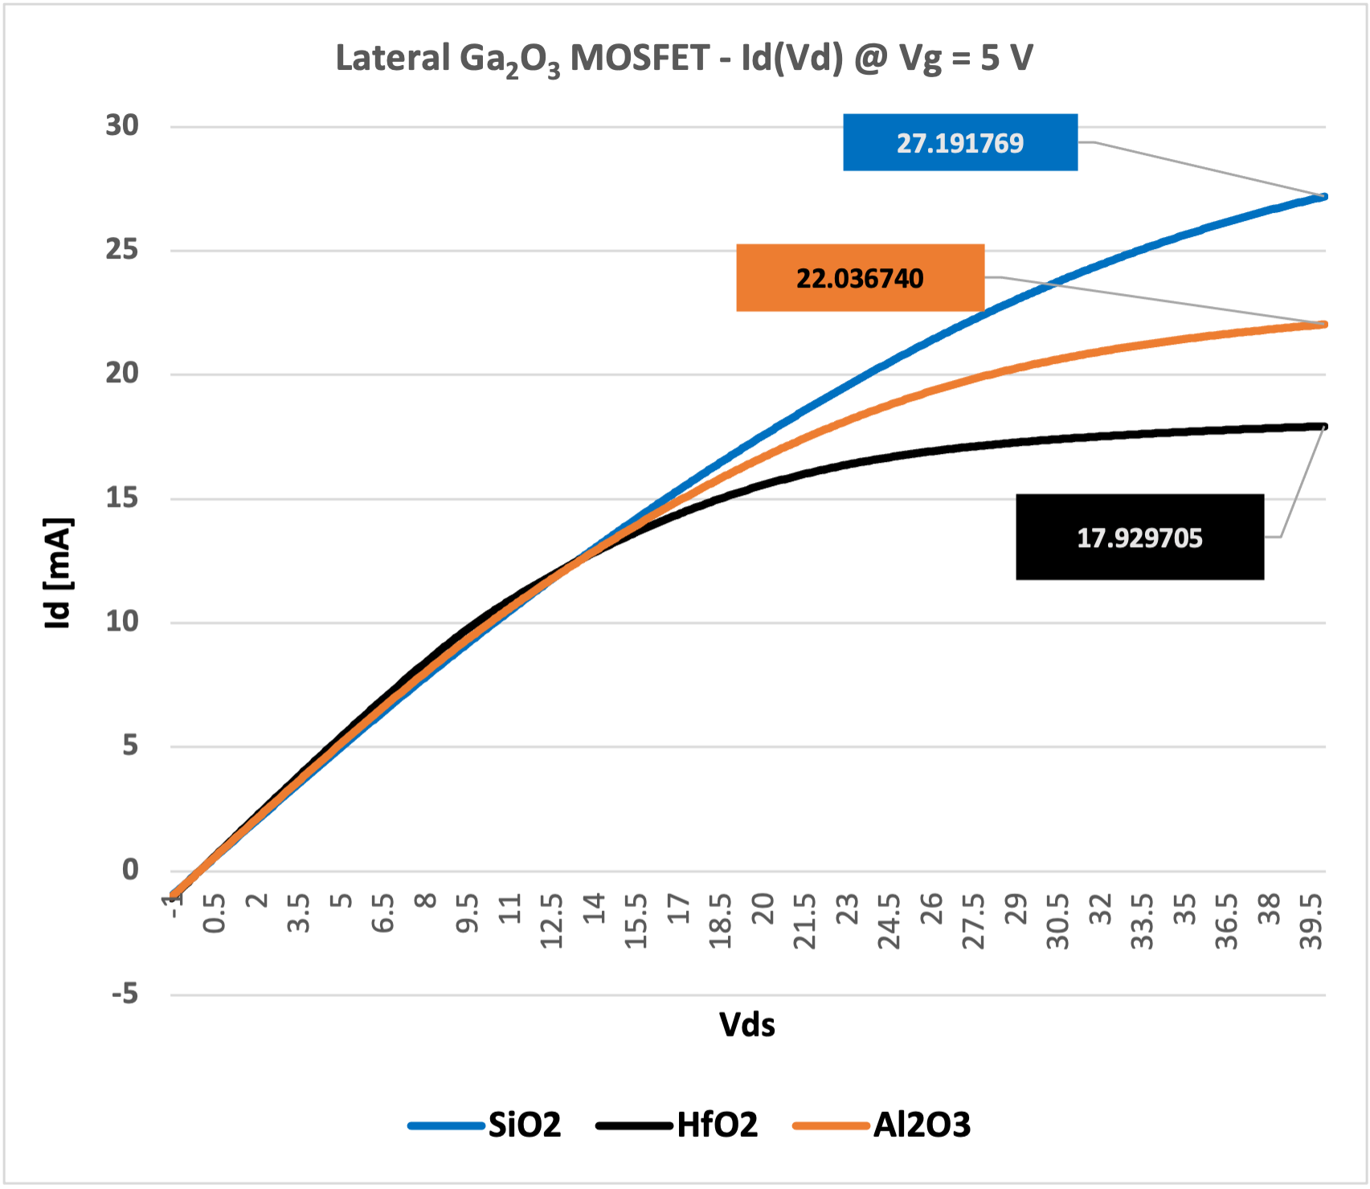

Dielectric Influence on a 2D Lateral Gallium Oxide (Ga₂O₃) MOSFET using COMSOL Multiphysics
Study the electrical and thermal response of a 2D lateral Gallium Oxide MOSFET using different gate dielectric oxide materials to investigate the effect of dielectrics on dissipating heat in the Ga₂O₃ layer.
J. M. Bisignano ¹, A. Bhalla ², R. Guo ³
University of Texas at San Antonio - Multifunctional Electronic Materials & Devices Research Lab - San Antonio TX - USA
Abstract
Gallium Oxide (Ga₂O₃) is an emerging wide bandgap transparent oxide semiconductor that has garnered attention for power electronic applications because of its large 4.8 eV bandgap and large critical electrical field strength of 8 MV/cm ^{[1]}. However, due to Ga₂O₃’s poor thermal conductivity k = 27 W/mK the self-heating effects can severely limit device performance and reliability. This work studies the electrical and thermal response of a 2D lateral Ga₂O₃ MOSFET using different gate dielectric oxide materials to investigate the effect of dielectrics on dissipating heat in the Ga₂O₃ layer. The three gate dielectrics considered are Silicon Oxide (SiO₂), Aluminum Oxide (Al₂O₃), and Hafnium Oxide (HfO₂). The results show that Al₂O₃ dissipates approximately 27% to 29% more heat compared to SiO₂ and HfO₂, respectively.
Methodology
A 2D Lateral MOSFET model was constructed using an 80 nm thick Ga₂O₃ layer for the semiconductor layer. In addition, a 20 nm oxide layer is used that alternates between SiO₂, HfO₂, and Al₂O₃. Finally, the source, drain and gate of the device are 50 nm ideal ohmic Au layers.
Charged carriers and phonon generation are modeled in COMSOL Multiphysics using the Semiconductor and Heat Transfer in Solids modules. Terminals are defined at the metal contacts to apply a bias to the device while the heat source is defined as the semiconductor layer. Convective heat flux boundaries are applied to the metal contacts to imitate heat generation from device operation.
FIGURE 1: Phonon generation plots of the 2D Lateral Ga₂O₃ MOSFET for three dielectrics considered: a) HfO₂, b) SiO₂, and c) Al₂O₃
Results
The gate of this device was held at a constant 5 V bias while the drain was swept from -1 V to 12 V with a 0.1 V step. The source was grounded to operate this device in enhancement mode. The results show that Al₂O₃ helps dissipate heat more effectively compared to SiO₂ and HfO₂ as a gate dielectric.
A peak temperature of 718.2 K was observed for Al₂O₃ as a gate dielectric, while SiO₂ had a peak temperature of 996.6 K and 1025.4 K for HfO₂. Al₂O₃ shows a 27.94% and 29.96% reduction in temperature compared to SiO₂ and HfO₂ respectively under the same operating conditions.
FIGURE 2: Comparison of output drain current Id(Vd) of 2D Lateral Ga₂O₃ MOSFET for the three dielectrics HfO₂, SiO₂, and Al₂O₃ evaluated
J. Y. Tsao et al. S. Chowdhury, M. A. Hollis, D. Jena, N. M. Johnson. A. Jones, R. J. Kaplar, S. Rajan, C. G. Van de Walle, “Ultrawide‐Bandgap Semiconductors: Research Opportunities and Challenges,” Adv. Electron. Mater., vol. 4, no. 1, p. 1600501, Jan. 2018, doi: 10.1002/aelm.201600501.
M. Higashiwaki, “β-Ga2O3 material properties, growth technologies, and devices: a review,” AAPPS Bull., vol. 32, no. 1, p. 3, Jan. 2022, doi: 10.1007/s43673-021-00033-0.
B. R. Tak et al. S. Kumar, A. K. Kapoor, D. Wang, X. Li, H. Sun, R. Sing, “Recent advances in the growth of gallium oxide thin films employing various growth techniques—a review,” J. Phys. Appl. Phys., vol. 54, no. 45, p. 453002, Nov. 2021, doi: 10.1088/1361-6463/ac1af2.
N. P. Sepelak, “Demonstration of High-Temperature Operation of Beta-Gallium Demonstration of High-Temperature Operation of Beta-Gallium Oxide (β-Ga2O3) Metal-Oxide-Semiconductor Field Effect Oxide ( -Ga2O3) Metal-Oxide-Semiconductor Field Effect Transistors (MOSFET) with Electrostatic Model in COMSOL”.
P. Kachhawa et al., N. Chaturvedi, “High-k Dielectric Influence on Recessed-Gate Gallium Oxide MOSFETs,” in Micro and Nanoelectronics Devices, Circuits and Systems. Singapore: Springer Nature Singapore, 2023, pp. 21–29.

Slide 2
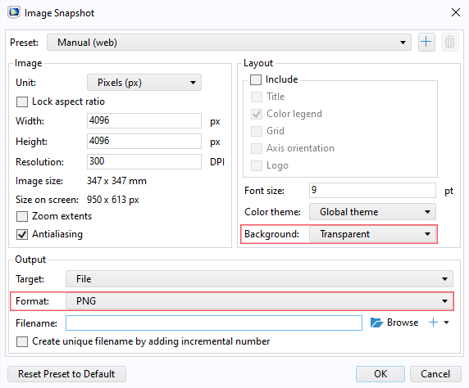
Guidelines
General Notes for Using the Template
Do not adjust the template; work within it. See the examples provided.
Left align text within textboxes, and do not justify your text.
Titles are the largest font on the slide (90–120 pt.), then subtitles (70–80 pt.). Captions, references, and affiliation are the smallest text (18–40 pt.).
Titles and subtitles are bold; any other use of bold should be for emphasis.
Text is either black or grey and should only be adjusted for diagrams.
Images can be adjusted and fitted into the boxes using the Crop feature. (In PowerPoint: Format tab → Size section on the right → Crop.)
Please keep in mind:
The solid red lines are the 3 mm that will be cut off during printing.
The dotted lines represent a small margin that may or may not be cut off during printing.
Exporting an Image for the Header
The settings shown on the right export the highest quality image with a transparent background.
The most important settings to use are the two outlined in pink. This will export an image that can be placed in the blue space of the header.

Slide 3
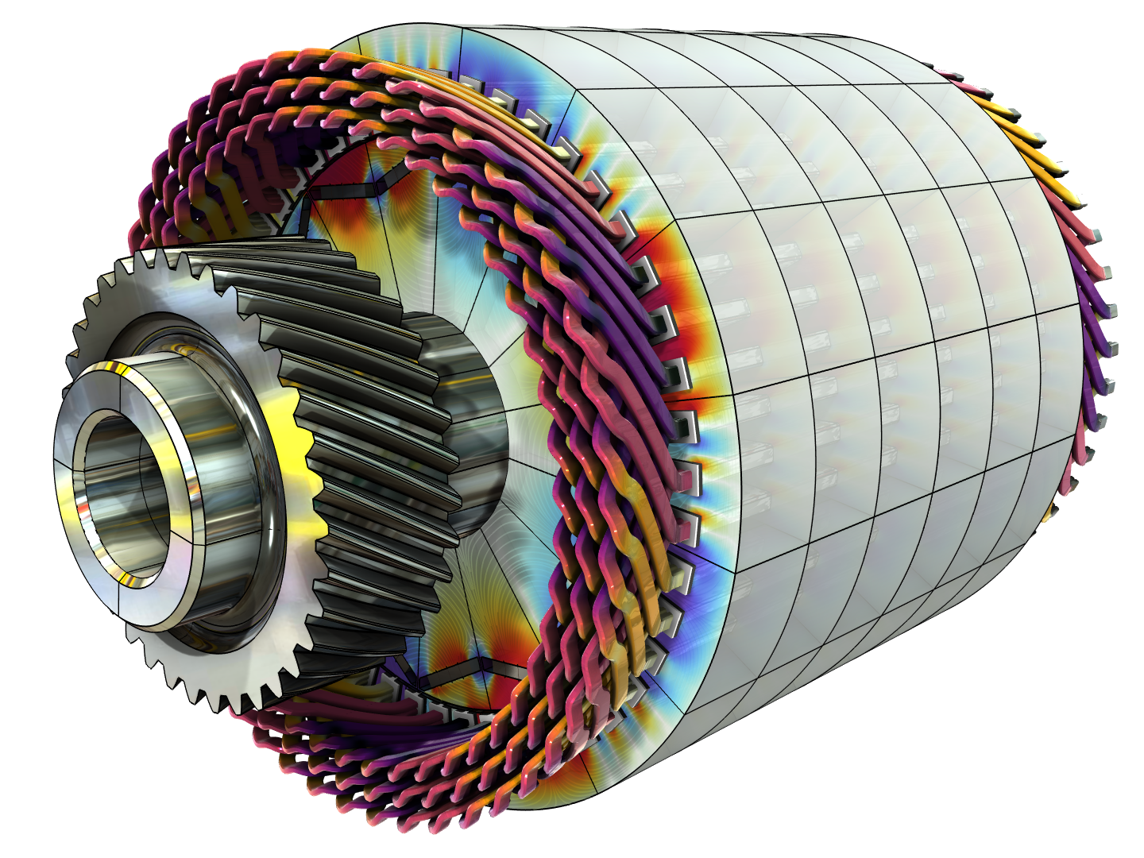
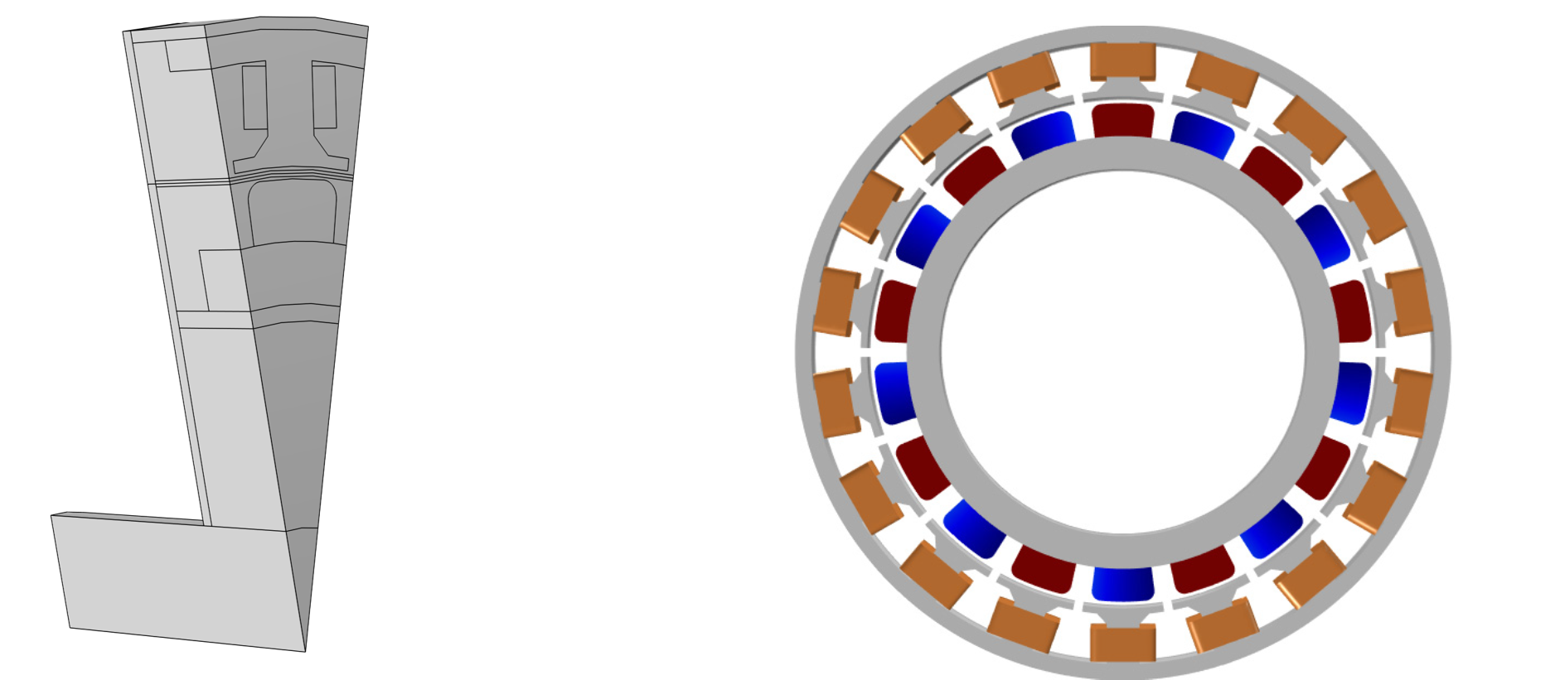
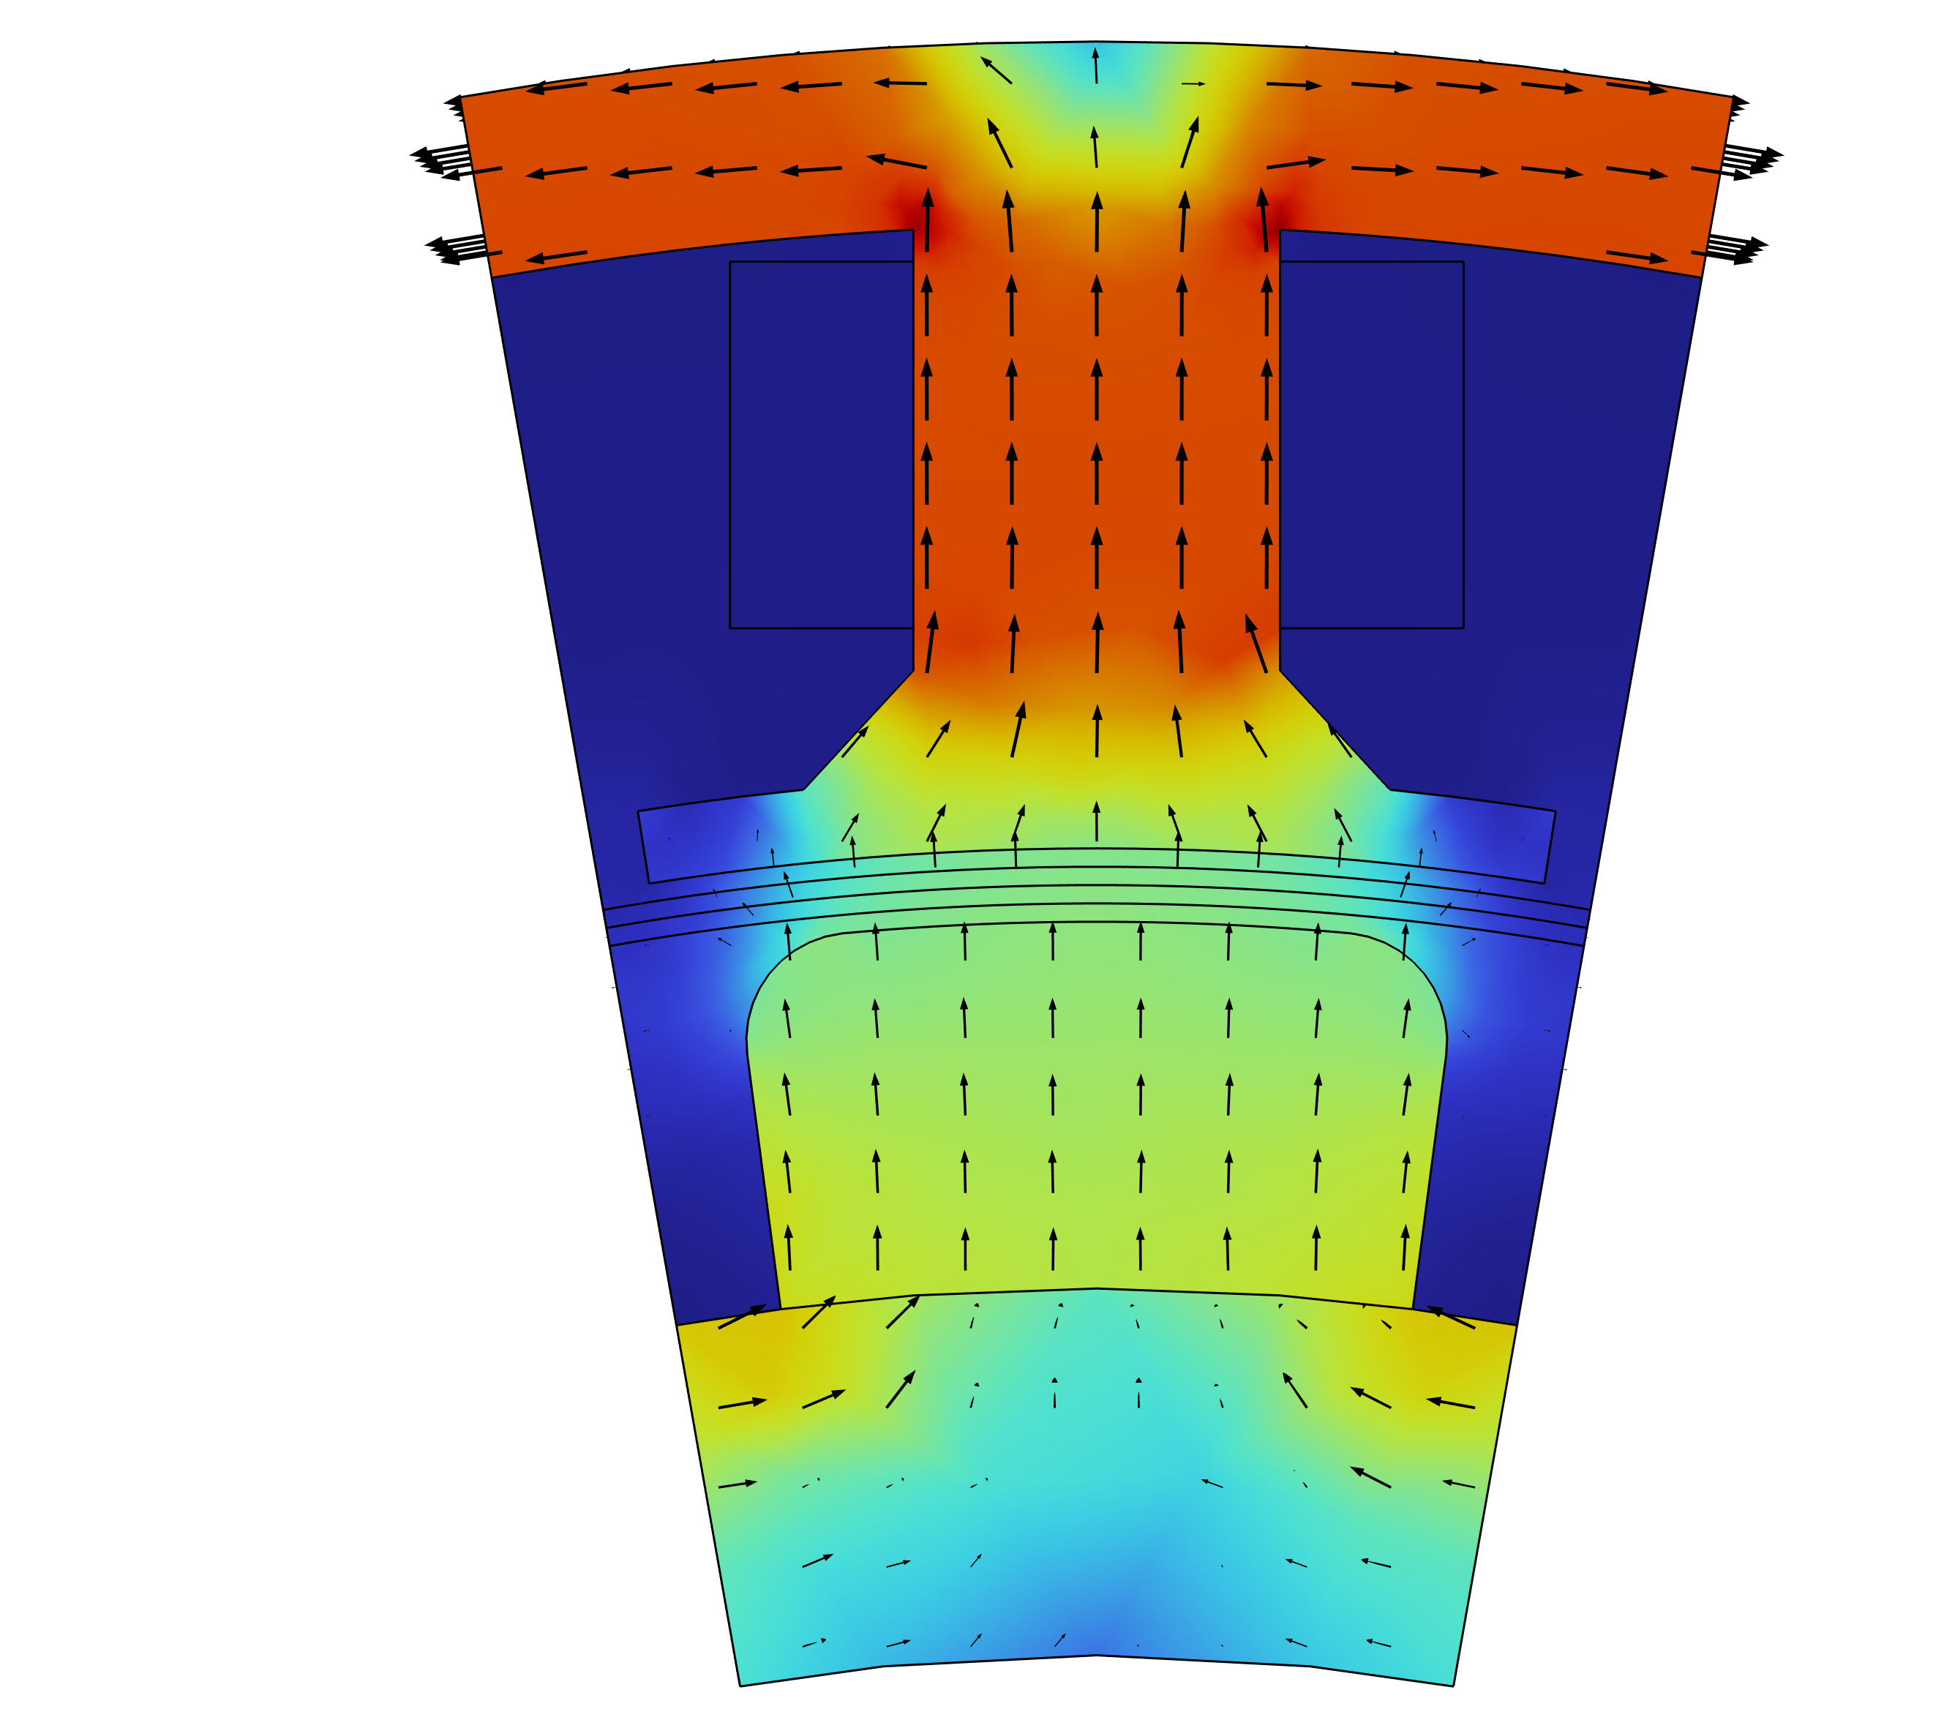
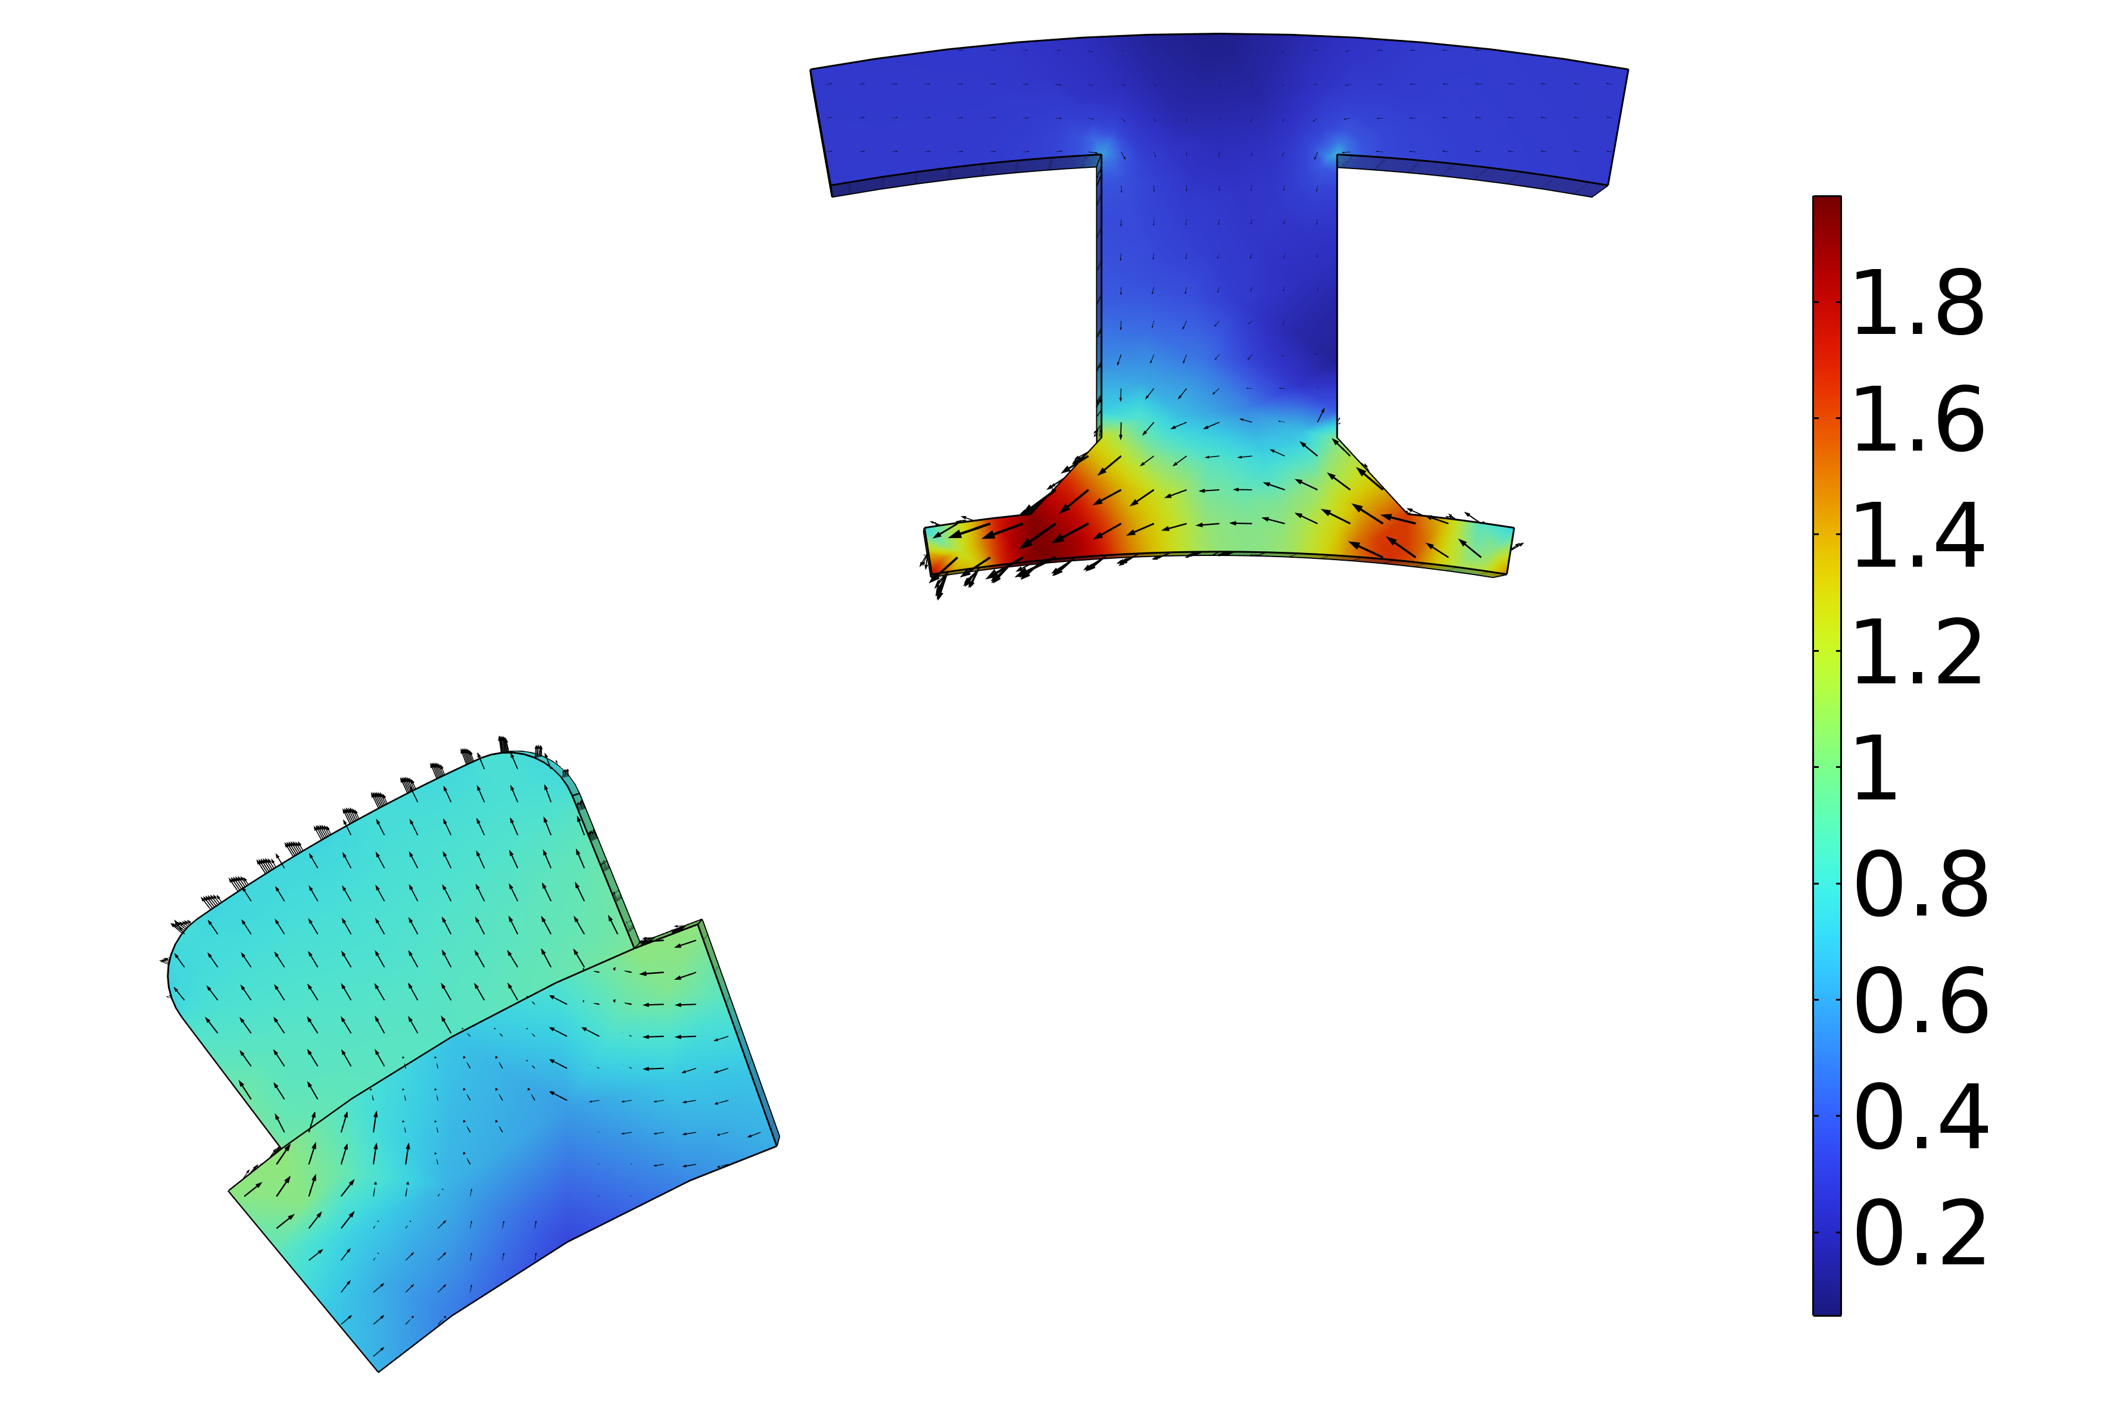
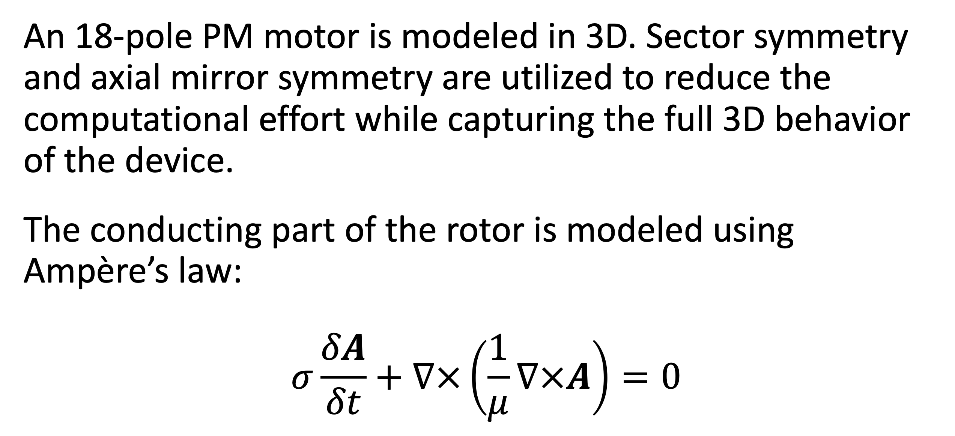
Analysis of a Permanent Magnet Motor in 3D
Optimize permanent magnet (PM) motor performance by understanding their full behavior, including sensitivity to high temperatures.
J. A. Smith¹, M. B. Smith²
1. Department (if applicable), Organization, City, Country.
2. Department (if applicable), Organization, City, Country.
Abstract
While PM motors are valued for the energy savings that they provide, there are some design limitations to address. For example, permanent magnets are sensitive to high temperatures. Such temperatures can occur when currents, particularly eddy currents, generate heat losses.
The findings offer greater insight into the behavior of PM motors, particularly by capturing the eddy current losses that occur within the magnets. This information serves as a useful resource for improving the design of PM motors, and therefore the technology they help power.
Methodology
An 18-pole PM motor is modeled in 3D. Sector symmetry and axial mirror symmetry are utilized to reduce the computational effort while capturing the full 3D behavior of the device.
The conducting part of the rotor is modeled using Ampère’s law:
$$σ\frac{δA}{δt}+∇×\left(\frac{1}{μ}∇×A\right)=0$$
FIGURE 1. Left: Permanent motor sector. Right: Drawing of the PM motor.
Results
The results can be seen in Figure 2, which shows the magnetic flux density for the motor in its stationary state, that is, the initial conditions for the time-dependent simulation. In this state, the coil current is zero. It also shows the magnetic flux density for the motor after revolving one sector angle. In this plot, the air and coil domains are excluded to get a better view.
FIGURE 2. Left: Magnetic flux density from the permanent magnets with only the rotor at rest. Right: Magnetic flux density after revolving one sector angle.
1. Author first initial and last name, “Article Title”, Journal, Volume (vol.), Page numbers (pp.), Year.
2. Author first initial and last name, “Article Title”, Journal, Volume (vol.), Page numbers (pp.), Year.
3. Author first initial and last name, “Article Title”, Journal, Volume (vol.), Page numbers (pp.), Year.

Slide 4
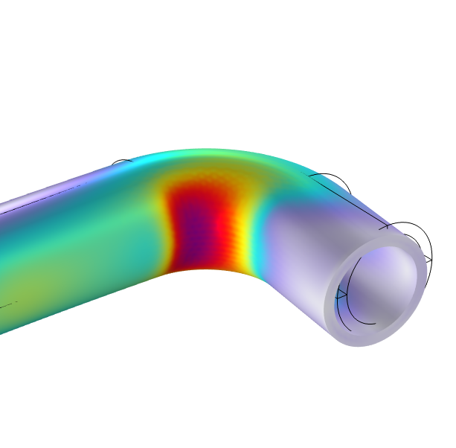
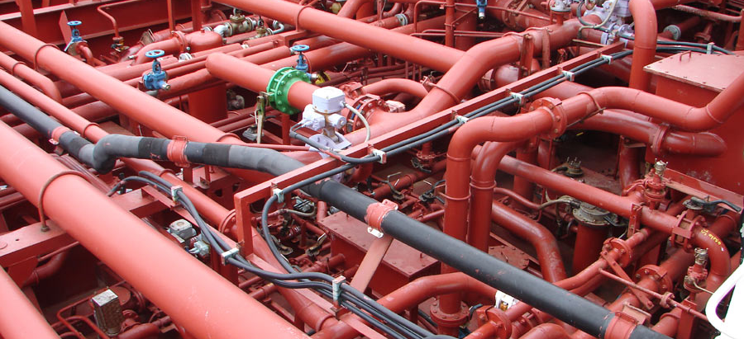
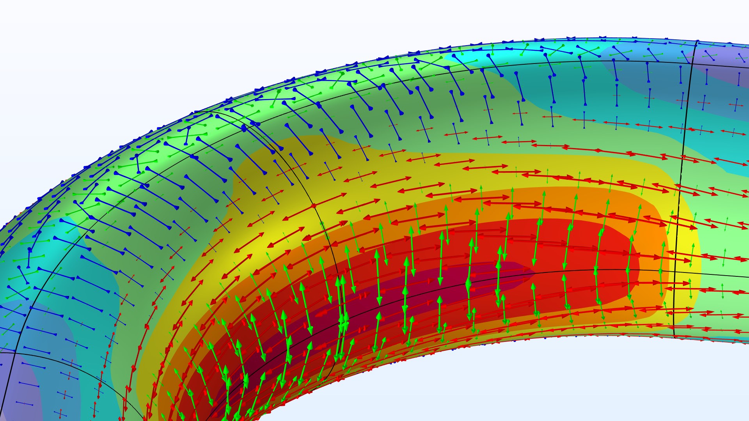
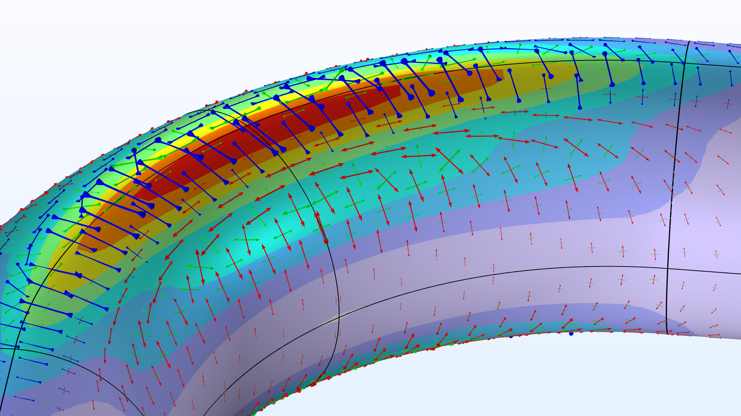
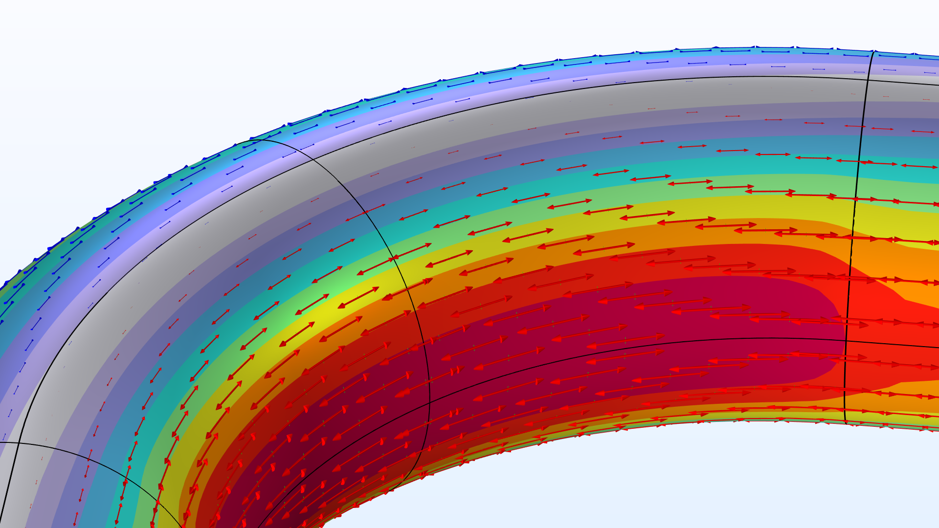
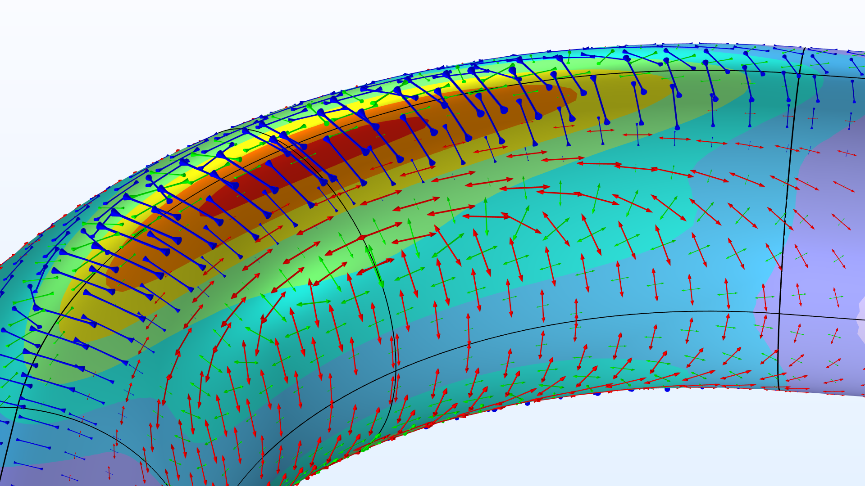
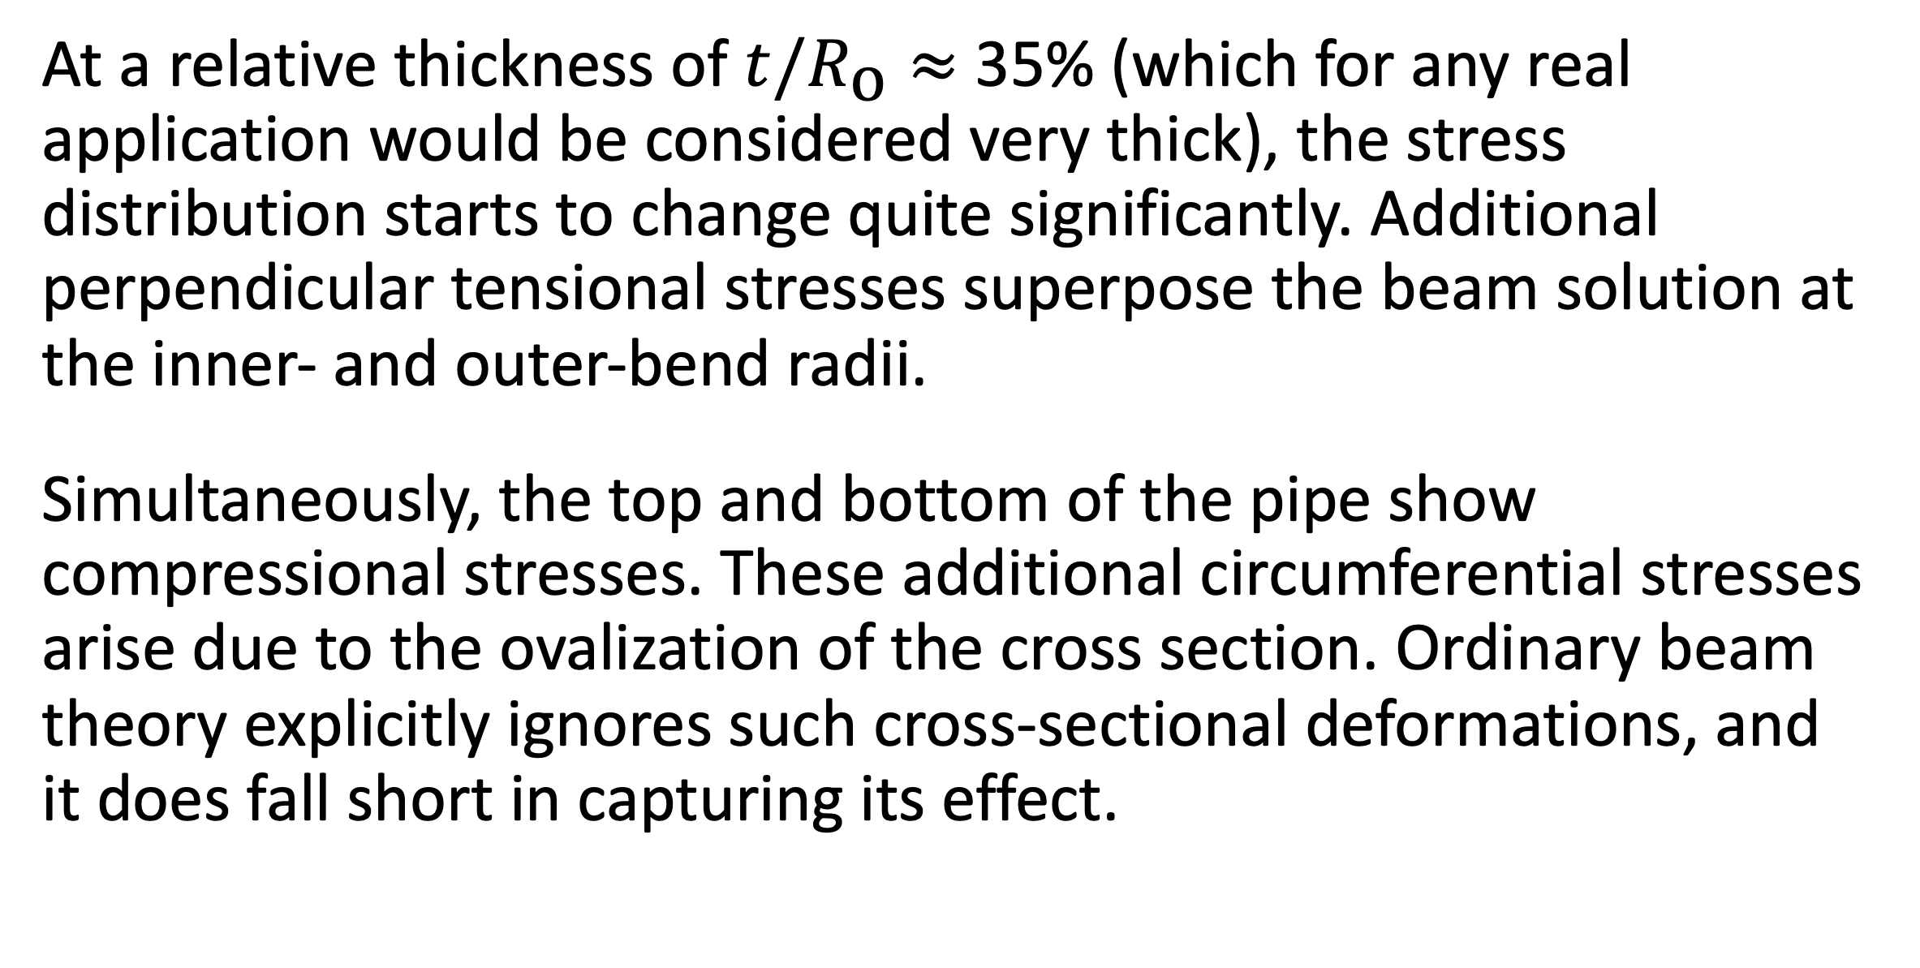
The Intriguing Stresses in Pipe Bends
For many structural engineers, beam theory is a popular analysis tool. Using the equations can be beneficial when considering structural behavior, as they are easy to apply and provide useful results. This work investigates one such case.
J. A. Smith¹, M. B. Smith²
1. Department (if applicable), Organization, City, Country.
2. Department (if applicable), Organization, City, Country.
Introduction & Goals
Pipe bends are common in piping systems, which typically transport liquids or gas, often under high pressure. One place where you may find a lot of pipes are oil tankers. The labyrinthine piping systems can look pretty fascinating.
Many piping standards (or codes) used for industrial applications are based on beam theory when it comes to the structural analysis. But, as we have already discovered, pipe bends generally do not behave like beams. When digging into piping standards, you will find a lot of information dedicated to pipe bends. In particular, piping standards recommend to apply correction factors to the stiffness and stresses for curved pipe sections. (Ref. 1)
Methodology
The pipe is slender with a constant cross section, so it would seem like a natural choice to treat such a structure as a beam in a simplified analysis. The bending moment is the only load acting on the structure, and its thus constant for any given section along the entire beam axis.
The maximum stress even occurs on the inside of the pipe. The cross section of the bend also deforms significantly, and, more specifically, it ovalizes with the major axis either being oriented in the bend plane or perpendicular to it depending on the direction of the bending moment.
FIGURE 1. Piping systems on an oil/chemical tanker. Image licensed under CC BY-SA 3.0 via Wikimedia Commons.
Results
At a relative thickness of $t/R_{\text{o}}≈$ 35% (which for any real application would be considered very thick), the stress distribution starts to change quite significantly. Additional perpendicular tensional stresses superpose the beam solution at the inner- and outer-bend radii.
Simultaneously, the top and bottom of the pipe show compressional stresses. These additional circumferential stresses arise due to the ovalization of the cross section. Ordinary beam theory explicitly ignores such cross-sectional deformations, and it does fall short in capturing its effect.
FIGURE 2. View of the pipe bend showing the von Mises stress (normalized) and principal stresses for different wall thicknesses.
E.A. Wais and E.C. Rodabaugh, “Background of SIFs and Stress Indices for Moment Loadings of Piping Components”, United States, 2005; https://www.osti.gov/biblio/841246
“Stress Intensification Factors (i-Factors), Flexibility Factors (k-Factors), and Their Determination for Metallic Piping Components”, ASME, 2017; https://www.asme.org/codes-standards/find-codes-standards/b31j-stress-intensification-factors-flexibility-factors-determination-metallic-piping-components/2017/drm-enabled-pdf

