Slide 1
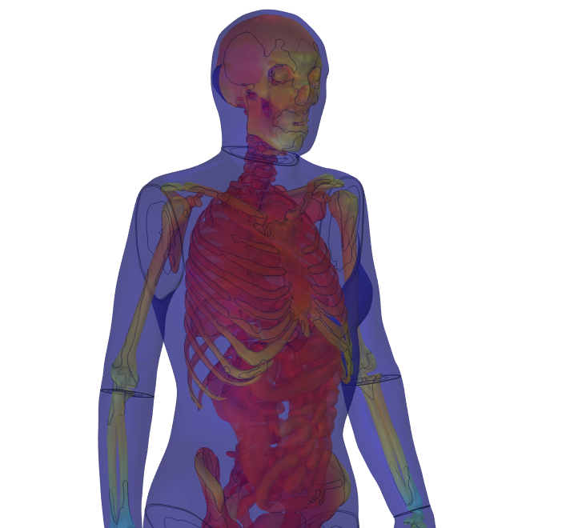
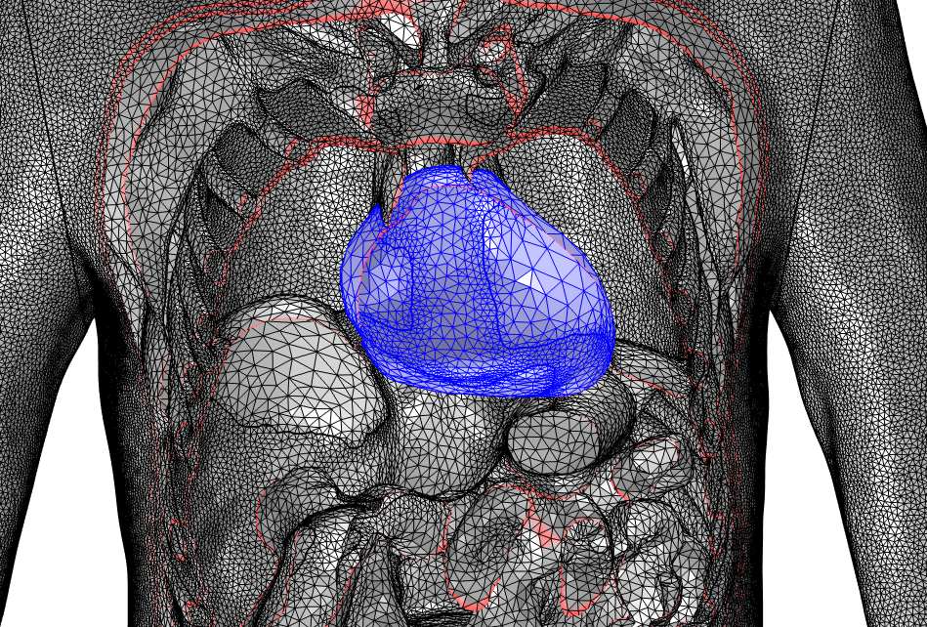
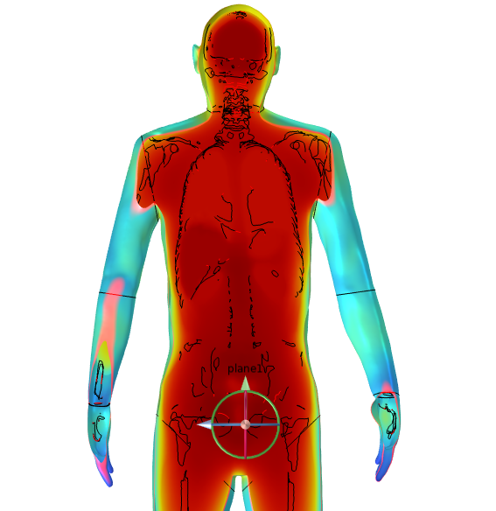
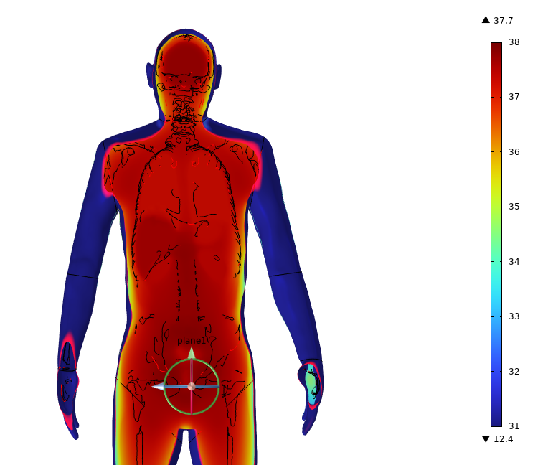
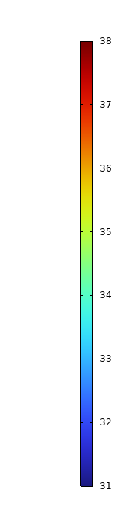


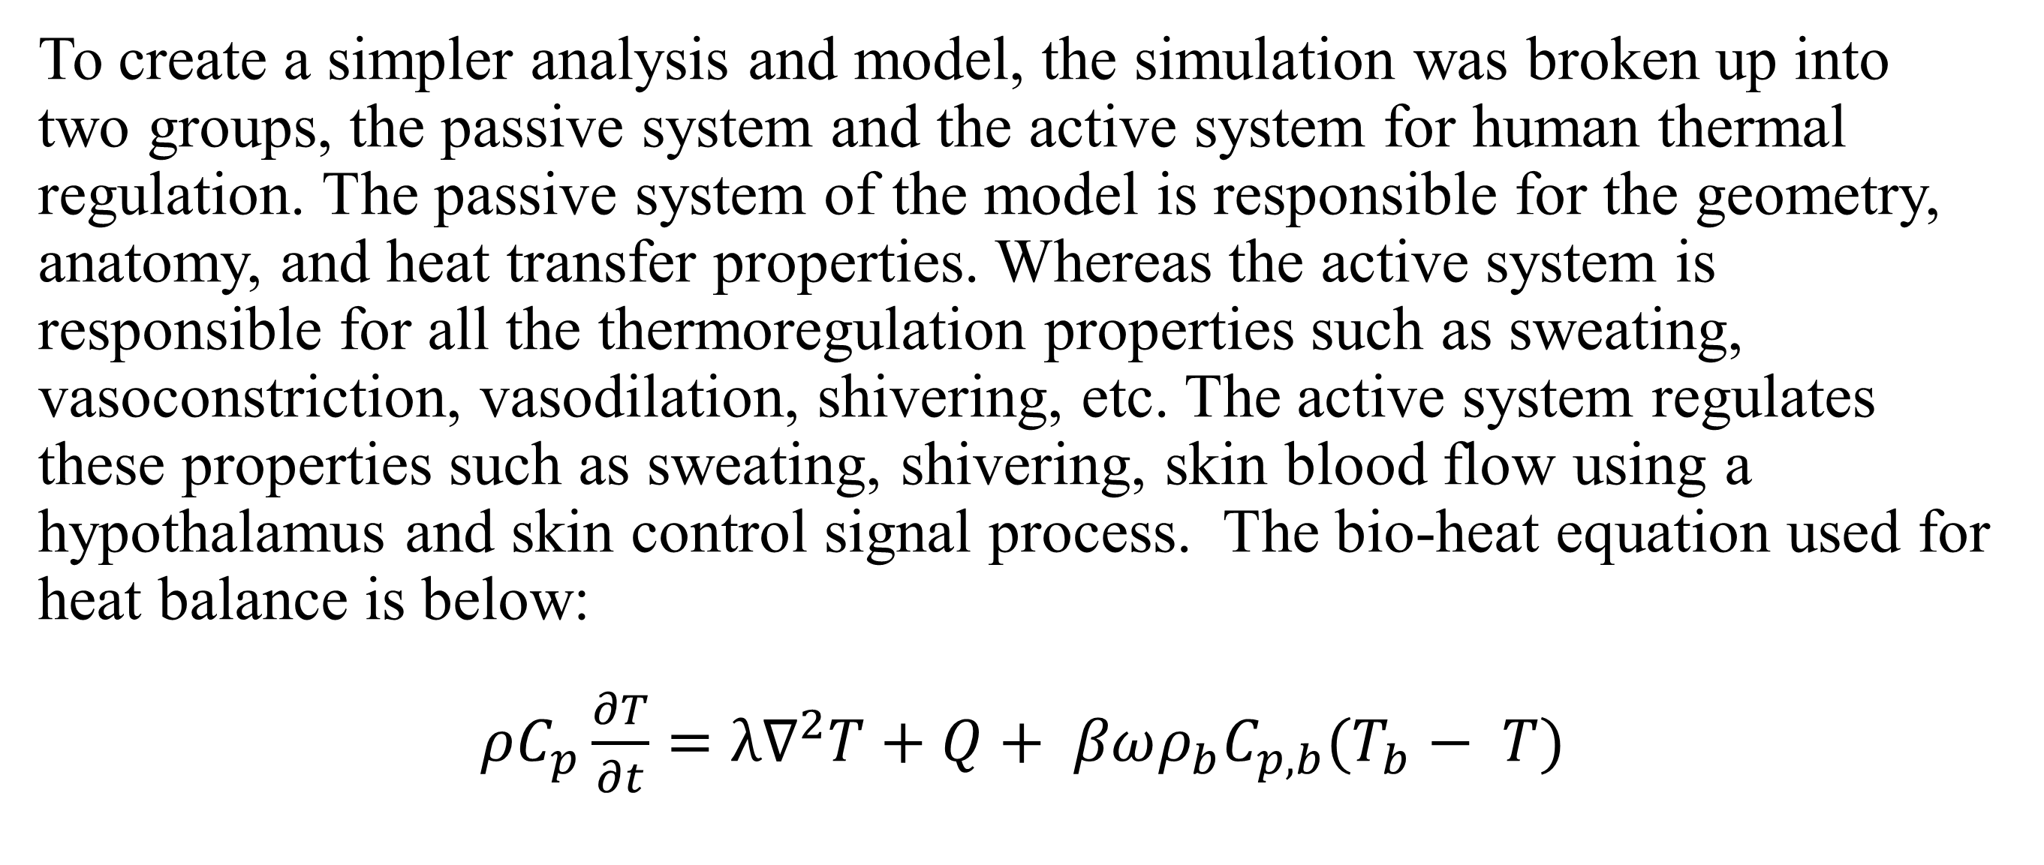
Development of Female and Male Thermoregulatory Models (FETM)
Both female and male bodies have the capability to regulate body temperature and disperse it to achieve homeostasis. This research uses medical images to development a male and female finite element model.
Stefan Gutierrez^{1,2}, Juliette Jacques^{1,2}, Timothy Rioux¹, John Castellani¹, Xiaojiang Xu¹
¹US Army Research Institute of Environmental Medicine, Natick, MA, US
²Oak Ridge Institute for Science and Education (ORISE), Oak Ridge, TN, USA
Abstract
Most current thermoregulation models represent the body in significantly simplified forms, e.g., cylinders or spheres. These simple geometries do not fully represent the complexity of bones, organs, etc. contained in the human body. Modern medical technologies allow for more advanced and accurate scans of human cadavers. These medical techniques enable anatomically correct mesh applications to be used for heat transfer simulations that include organs, tissues, and complicated geometry. This information serves as a way to improve human modeling and thermoregulation analyses with geometry based on medical images.
Methodology
To create a simpler analysis and model, the simulation was broken up into two groups, the passive system and the active system for human thermal regulation. The passive system of the model is responsible for the geometry, anatomy, and heat transfer properties. Whereas the active system is responsible for all the thermoregulation properties such as sweating, vasoconstriction, vasodilation, shivering, etc. The active system regulates these properties such as sweating, shivering, skin blood flow using a hypothalamus and skin control signal process. The bio-heat equation used for heat balance is below:
$ρC_{p}\frac{∂T}{∂t}=λ∇^{2}T+Q+ βωρ_{b}C_{p,b}(T_{b}− T)$
FIGURE 1. Male Heart Mesh Model
Results
Despite having different physical geometries, both male and female simulations show similar responses. Figure 5 also shows the temperature distribution in different body regions when the ambient temperature is 10 ℃. As expected, the model predicts that as time goes on, body temperatures decrease. At time 0 min, 5 min, and 20 min, the model’s core resulted in the highest temperature reached 37.6 ℃, 37.6 ℃, and 37.7 ℃, respectively. The lowest temperatures at the given times came from the toe region and were 30.9 ℃, 27 ℃, and 20.3 ℃, respectively . The model decreased in temperature significantly throughout the 90 mins with the low end of the toe region decreasing by 10.6 degrees Celsius showing that prolonged cold environment can dramatically decreases the body’s peripheral region temperature such as toes.
FIGURE 2. Left: Temperature distribution at 10 ℃ at 0 min . Right: Temperature distribution at 10 ℃ at 20 min
Castellani MP, Rioux TP, Castellani JW, Potter AW, Notley SR, Xu X. Finite element model of female thermoregulation with geometry based on medical images. J Therm Biol. Apr 2023; 113:103477.
Castellani MP, Rioux TP, Castellani JW, Potter AW, Xu X. A geometrically accurate 3-dimensional model of human thermoregulation for transient cold and hot environments. Comput Biol Med. Nov 2021; 138:104892.
Werner J and Reents T. A contribution to the Topography of Temperature Regulation in Man, European Journal of Applied Physiology, pp. 87-94, 1980
Author views not official US-Army/DOD policy. Any citations of commercial organizations and trade names in this report do not constitute an official Department of the Army endorsement of approval of the products or services of these organizations.

