Slide 1
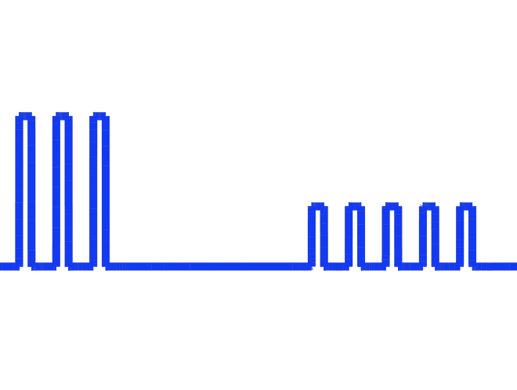
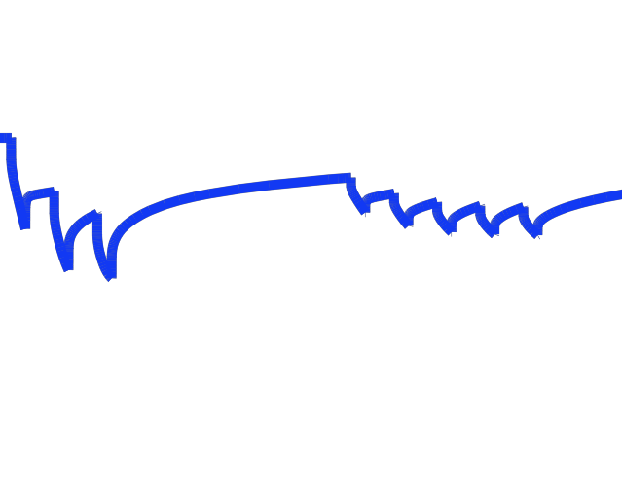
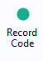
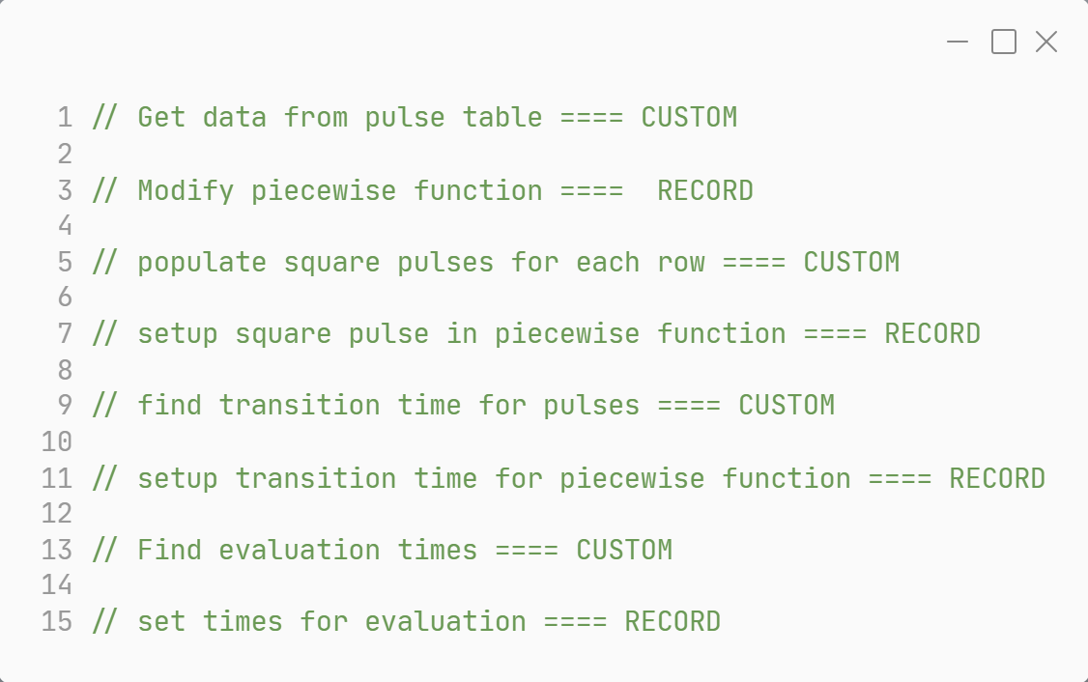
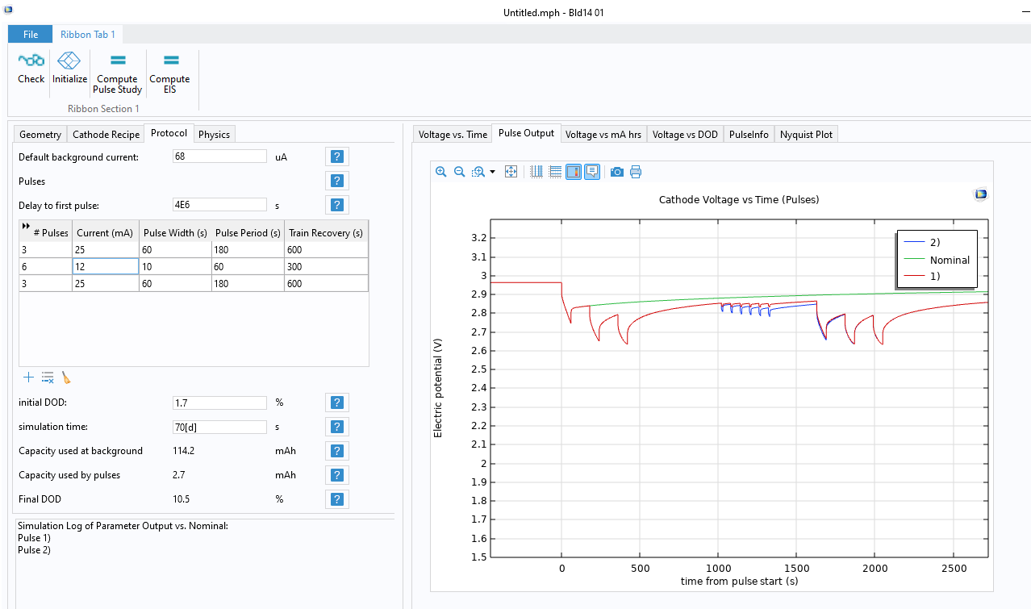


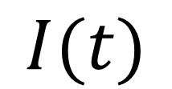

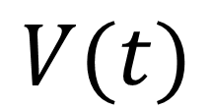
Coordination of Time Dependent Simulation Parameters Using the Application Builder in COMSOL Multiphysics®
$$I(t)$$
$$t$$
Design an App to cut the Time it takes to specify a Time-dependent simulation.
$$V(t)$$
$$t$$
Dr. Anna Harrington, Dr. Paul Belk
Boston Scientific, Arden Hills, MN, USA
Introduction
Time-dependent simulations are most interesting when external factors also change.
BUT….
  Need to re-evaluate before/after each external change
  Need to coordinate external changes with re-evaluation (inconvenient!)
  Can use the Application Builder to solve this:
    Build a User Interface (UI)
    Develop code to automatically change conditions and line up times
Model Builder
Application Builder
Methodology
Piecewise function
Table Object
Step 0: Create UI in App Builder to specify time-dependent factors
Step 1: Link data structures to UI via Declarations
Step 2: Specify Time Dependent Solver Settings
Step 3: Comment Method code
Step 4: Record code to set up conditions
Step 5: Record code to set up evaluation times
Step 6: Modify Method code
Step 7: Execute UI Application
Declarations
Method Code Structure
Methods
Java Code
FIGURE 1: Flowchart illustrating how data structures are linked in various COMSOL Multiphysics® environments.
Results
We demonstrate how to customize and model irregularly changing boundary conditions across a wide range of time scales.
Through custom code in Application Builder, users can develop an app to input parameters in a table object which will subsequently update a piecewise function in the model.
To ensure an optimal simulation, evaluation times are recorded and specified to resolve pulse events across large time scales.
This automated approach saves time, reduces errors, and can be applied to many different physics.
FIGURE 2: Battery application capable of simulating multiple current pulse events using a custom input table.
…To learn more about our App, attend our Talk at 10:30am on Thursday!
Boston Scientific Public- Public Release Authorized

