Slide 1
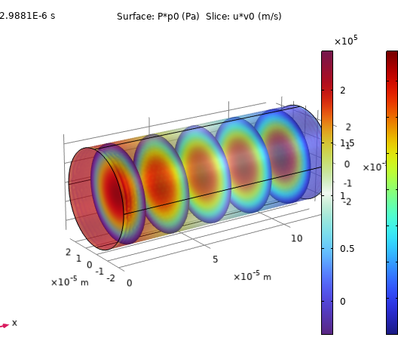
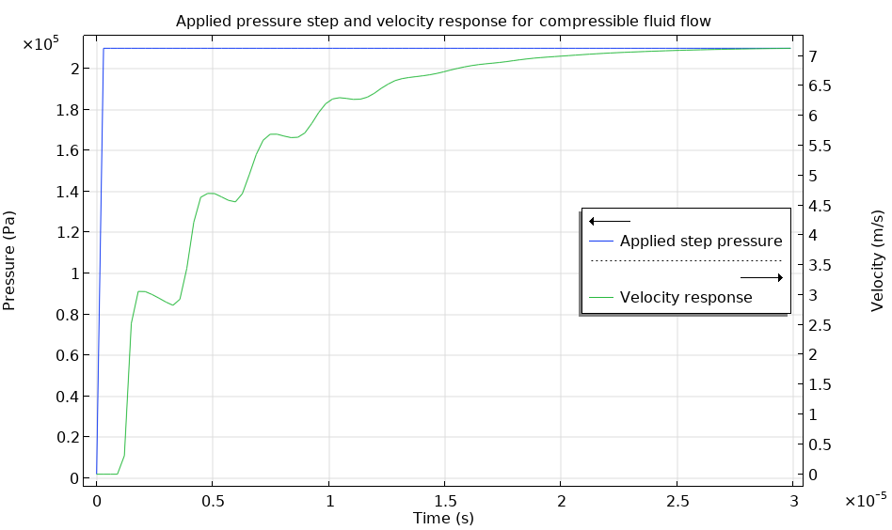
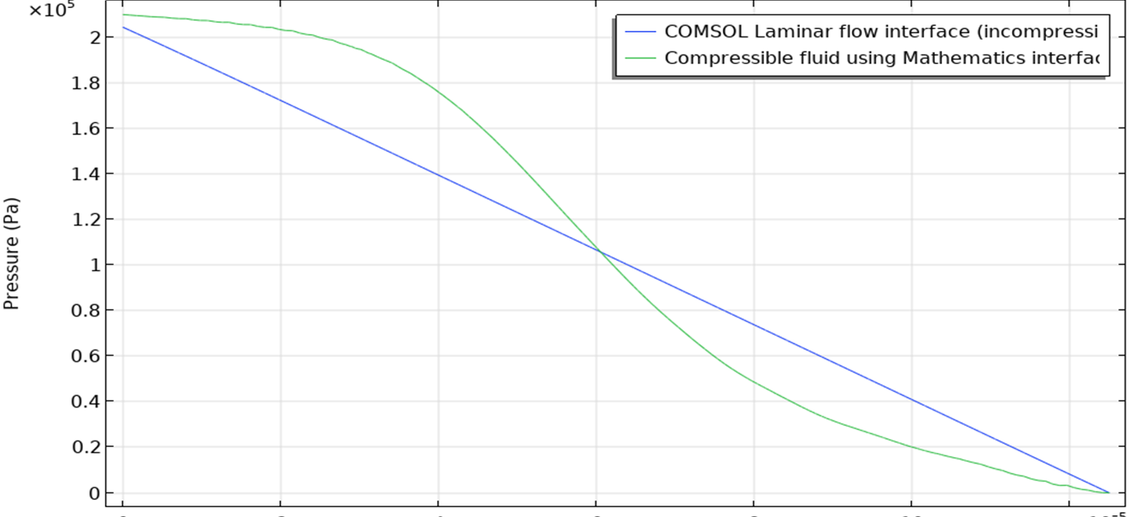

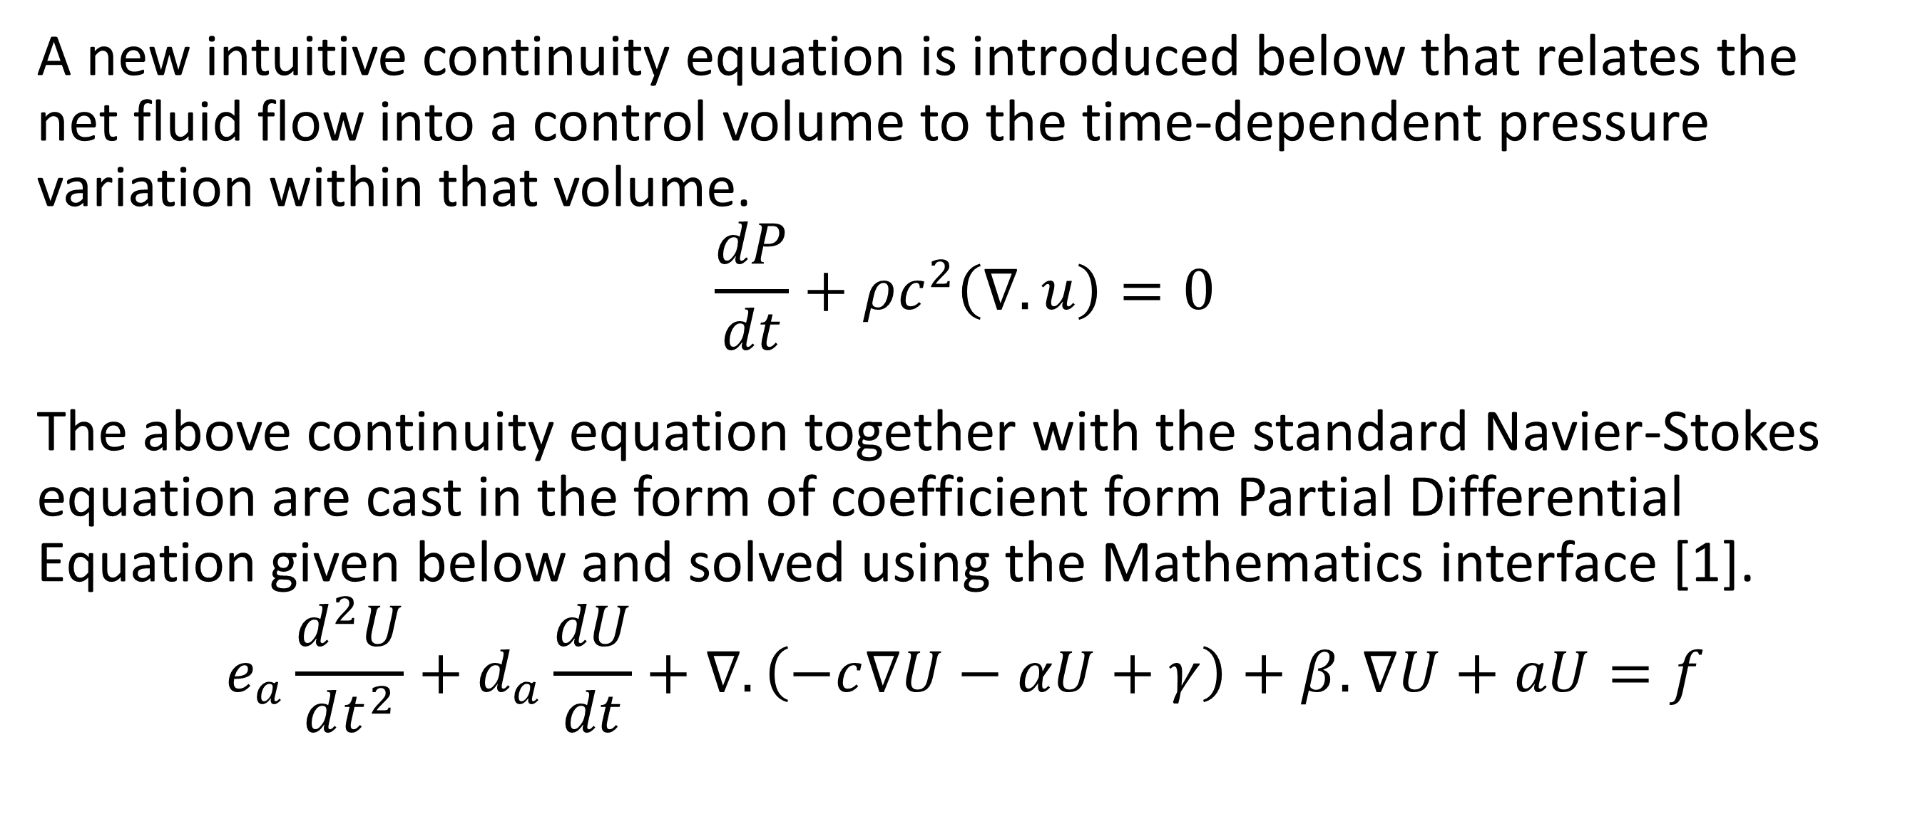
Compressible Fluid Flow Modelling in COMSOL
Implement a new compressible flow Physics using the coefficient form PDE in the Mathematics Interface that accounts for the time-dependent pressure variation due to the intrinsic compressibility of the fluid.
Mani Sivaramakrishnan
ARNDIT LLC, Portland, OR
Abstract
COMSOL offers three different fluid flow models in its single-phase Laminar Flow Physics interface: (1) Incompressible flow (2) Weakly compressible flow and (3) Compressible flow with low Mach numbers (<0.3). In the case of compressible flow, Navier-Stokes equation is solved together with the time-dependent continuity equation for density. The continuity equation accounts for the density variation caused by external factors only (e.g. temperature). However, in some applications, it is often required to compute the pressure variation caused by the intrinsic fluid compressibility. For this purpose, a new Physics is developed using the coefficient form Partial Differential Equation (PDE) in the Mathematics interface. Results from the new compressible fluid Physics interface are compared with the standard incompressible Laminar Flow Physics interface in COMSOL.
Methodology
A new intuitive continuity equation is introduced below that relates the net fluid flow into a control volume to the time-dependent pressure variation within that volume.
$$\frac{dP}{dt}+ρc^{2}\left(∇. u\right)=0$$
The above continuity equation together with the standard Navier-Stokes equation are cast in the form of coefficient form Partial Differential Equation given below and solved using the Mathematics interface [1].
$$e_{a}\frac{d^{2}U}{dt^{2}}+d_{a}\frac{dU}{dt}+∇.\left(−c∇U−αU+γ\right)+β.∇U+aU=f$$
FIGURE 1. Applied pressure step and the fluid response (exit velocity) for the new compressible flow model. Notice the oscillations caused by the fluid compressibility.
Results
A simple cylindrical geometry is used to test the new Physics interface. Two different time-dependent studies are made on the same model. (1) Laminar Flow Physics (incompressible fluid) from the standard COMSOL pre-built interface and (2) New Compressible Flow Physics using the coefficient form PDE. The average fluid velocity at the outlet of the cylinder in response to a pressure step applied at the inlet is shown in Fig. 1. The pressure oscillations due to the fluid compressibility are clearly seen superimposed over the gradual rise of the fluid velocity to its steady state value. The solution from the compressible flow Physics also exhibits a non-linear pressure distribution at intermediate times before the steady state is reached, as shown in Fig. 2.
FIGURE 2. Pressure distribution along the flow direction for the incompressible flow and the new compressible fluid flow models.
1. COMSOL Multiphysics Reference Manual: Equation Based Modeling : Modeling with PDEs: The Coefficient Form PDE.

