Slide 1
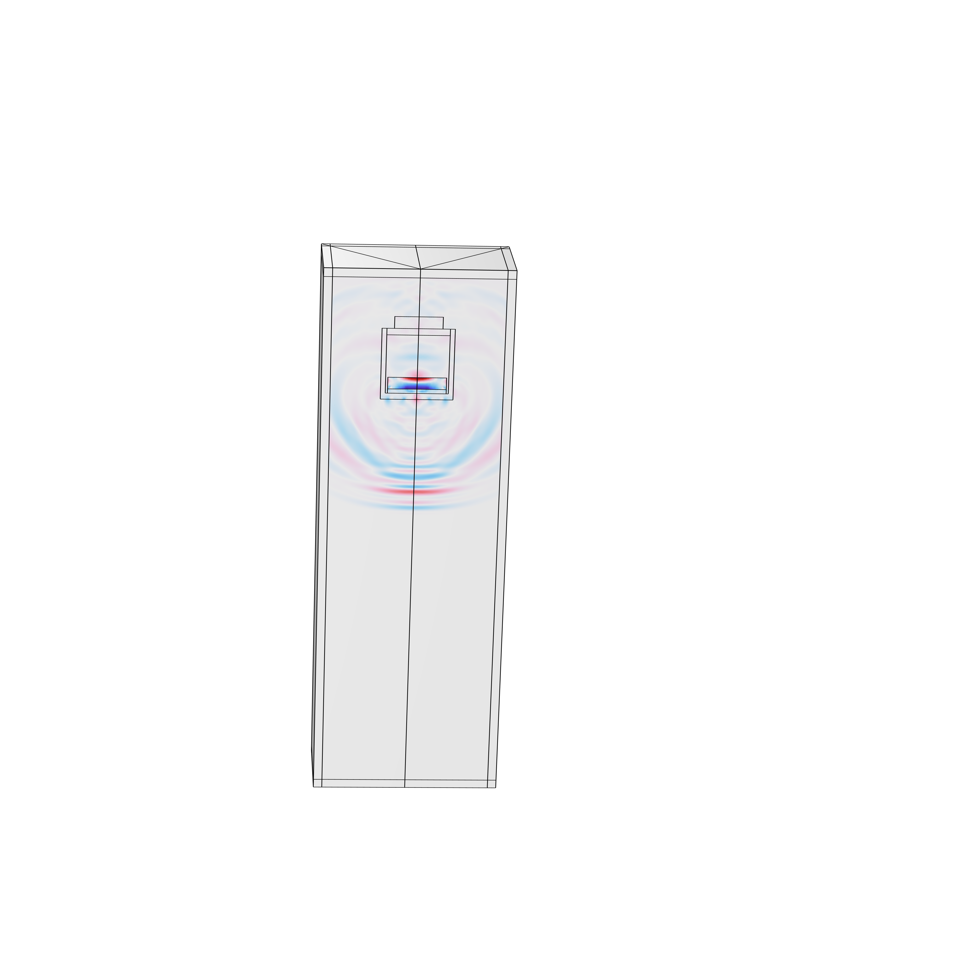
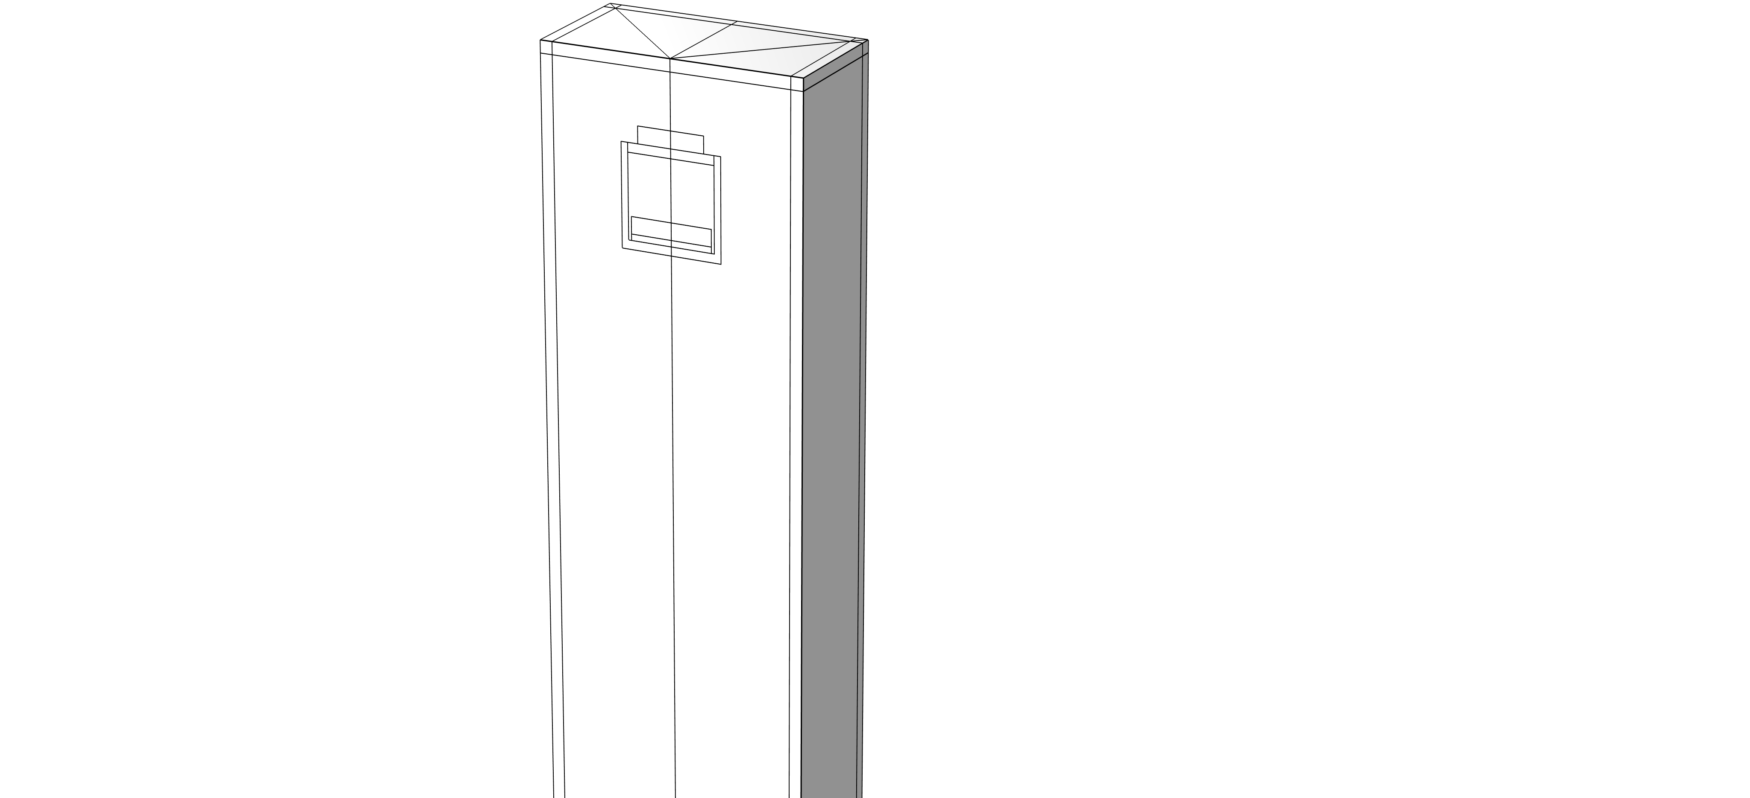
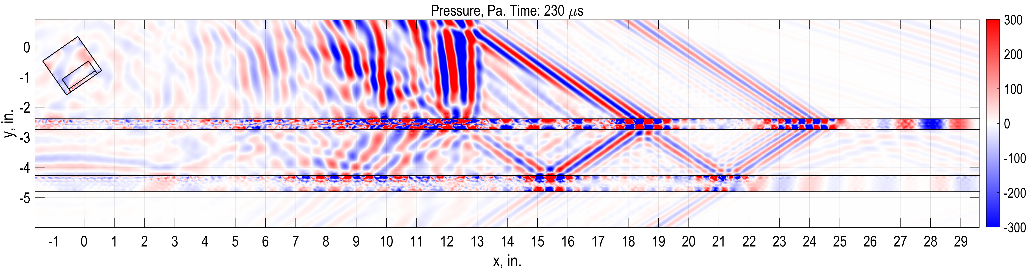
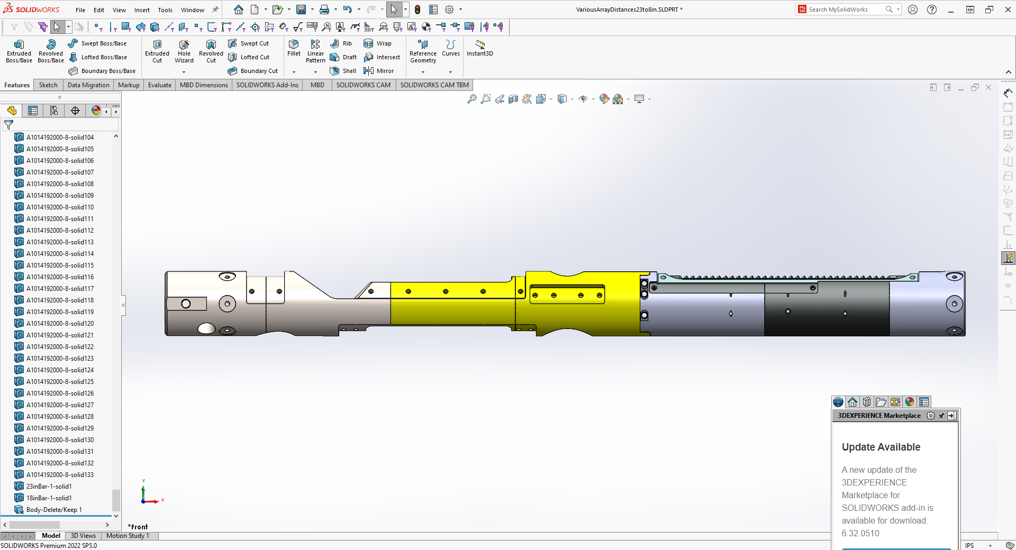
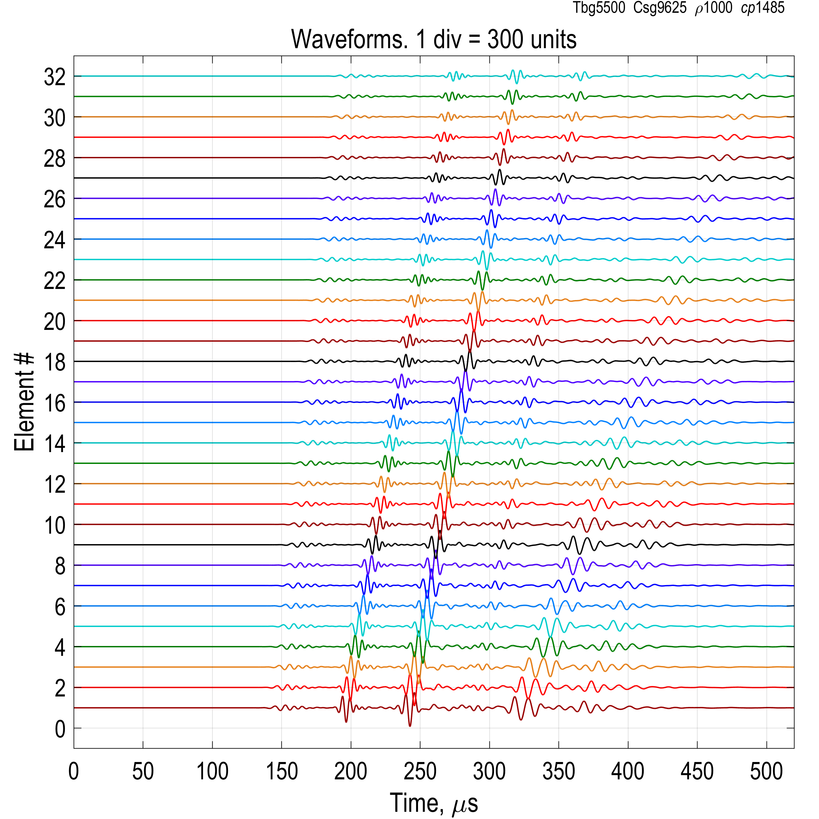
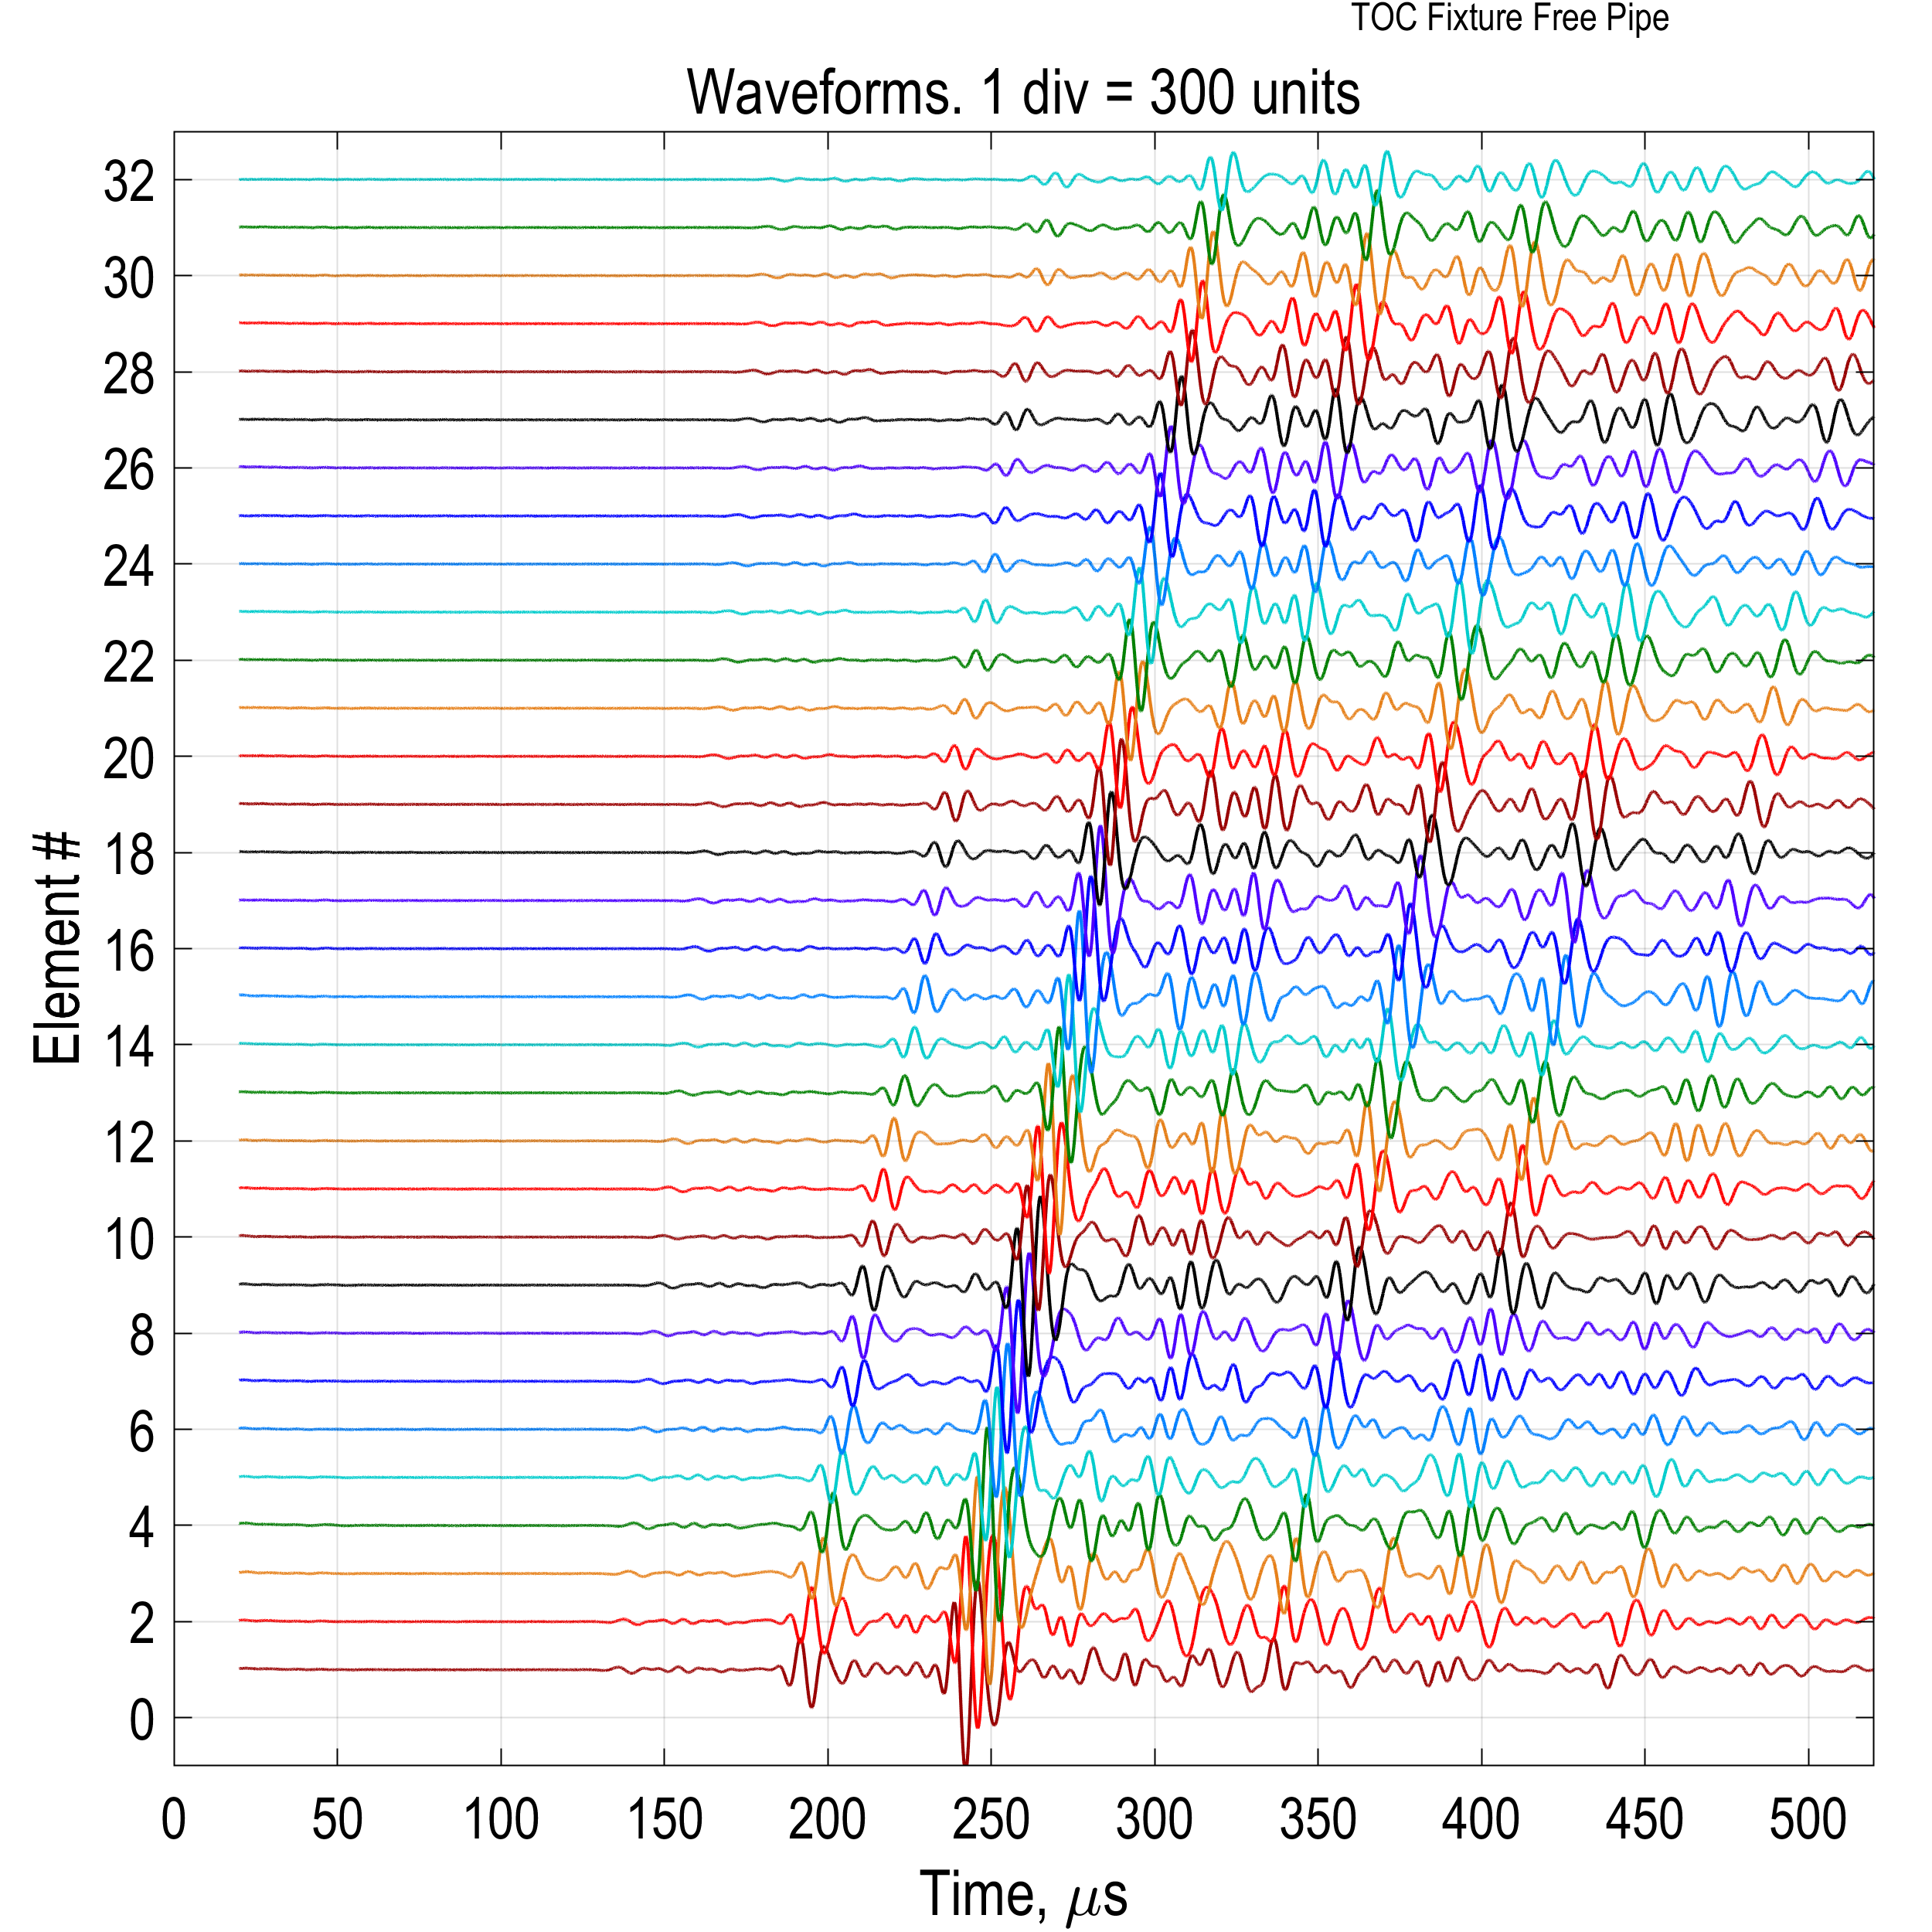

3D Ultrasonic Simulations for Pulse Echo and Pitch Catch Testing
This study employs advanced computational modeling to simulate ultrasonic wave propagation in pulse echo and pitch catch testing, providing a cost-effective alternative to physical prototyping.
Haiqi Wen¹, Marc Ramirez²
Baker Hughes, Houston, Texas, USi
Abstract
Ultrasonic nondestructive testing (NDT) is extensively used in fields like medicine, oil and gas, and aerospace to inspect materials without causing damage. However, developing experimental setups and prototypes can be costly and time-consuming. This study employs advanced computational modeling to simulate ultrasonic wave propagation, providing a cost-effective alternative to physical prototyping. A COMSOL 3D multiphysics model is utilized to simulate ultrasonic acoustic transducers in a water tank. The model couples a piezoelectric transducer with an elastic wave model via a piezoelectric effect coupling module. The interaction between the acoustic wave in the elastic medium and the fluid is modeled using an acoustic-structure boundary coupling. Simulation results are compared with experimental to validate the model. This comparison helps understand the impact of frequency, material properties, and piezoelectric transducer design on acoustic wave propagation, reducing the need for extensive physical prototyping and thereby cutting costs and improving efficiency.
Methodology
Electrostatics module (es) is coupled to the Elastic Waves, Time Explicit (elte) module to transform voltage signal to elastic wave.
Elastic Waves, Time Explicit (elte) module is coupled to Pressure Acoustics, Time Explicit (pate) module to model fluid-structural interaction at the transducer’s boundary.
An external electrical circuit is coupled to the terminal of the piezoelectric element.
Symmetric boundary condition is applied to reduce simulation time
Figure 1. Piezoelectric transducer coupled to fluid
Results
In this study, ultrasonic piezoelectric transducers are coupled to the fluid to study acoustic wave propagation in pulse-echo and pitch catch simulation.
The model can be used to characterize the wave propagation of different modes.
Overall, COMSOL model simulations are capable to capture the experimental response. With good tuning, the model can be used to develop transducers and test setups to reduce prototyping cost.
Fluid mode
Secondary A0 arrival
SecondaryA0
Primary A0 arrival
Primary A0
Primary S0 arrival
Casing A0
Secondary S0
Sim.
Free Pipe
Expt.
Secondary A0
Quat. A0
Secondary A0
Quat. A0
Fluid Mode
Primary A0
Tertiary A0
Primary A0
Tertiary A0
Fluid Mode
Pitch catch wave propagation and waveform
1
1. Wang, H., Tao, G., & Shang, X. (2016). Understanding acoustic methods for cement bond logging. The Journal of the Acoustical Society of America, 139(5), 2407-2416.

Slide 2

Guidelines
General Notes for Using the Template
Do not adjust the template; work within it. See the examples provided.
Left align text within textboxes, and do not justify your text.
Titles are the largest font on the slide (90–120 pt.), then subtitles (70–80 pt.). Captions, references, and affiliation are the smallest text (18–40 pt.).
Titles and subtitles are bold; any other use of bold should be for emphasis.
Text is either black or grey and should only be adjusted for diagrams.
Images can be adjusted and fitted into the boxes using the Crop feature. (In PowerPoint: Format tab → Size section on the right → Crop.)
Please keep in mind:
The solid red lines are the 3 mm that will be cut off during printing.
The dotted lines represent a small margin that may or may not be cut off during printing.
Exporting an Image for the Header
The settings shown on the right export the highest quality image with a transparent background.
The most important settings to use are the two outlined in pink. This will export an image that can be placed in the blue space of the header.

Slide 3
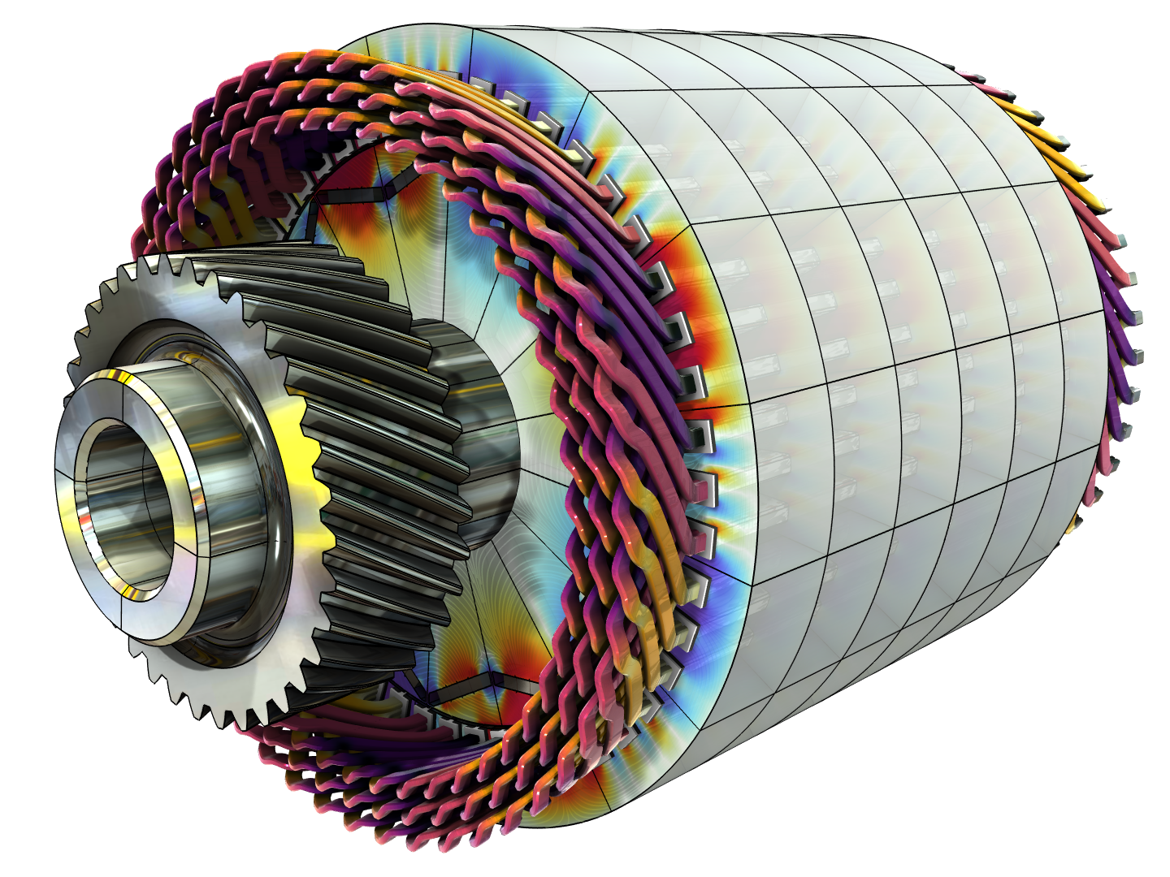
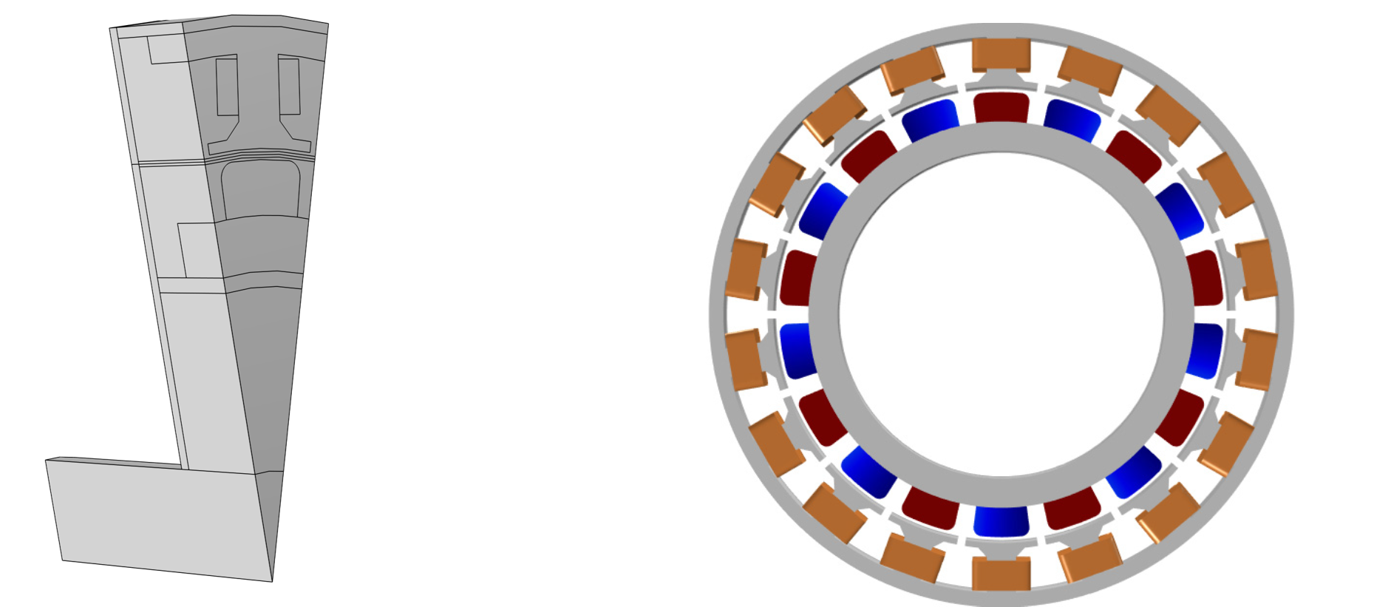
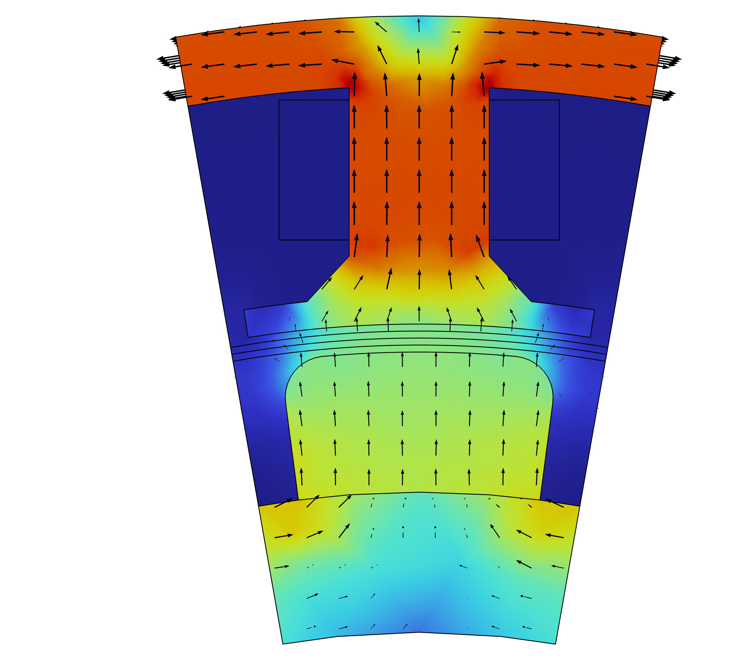
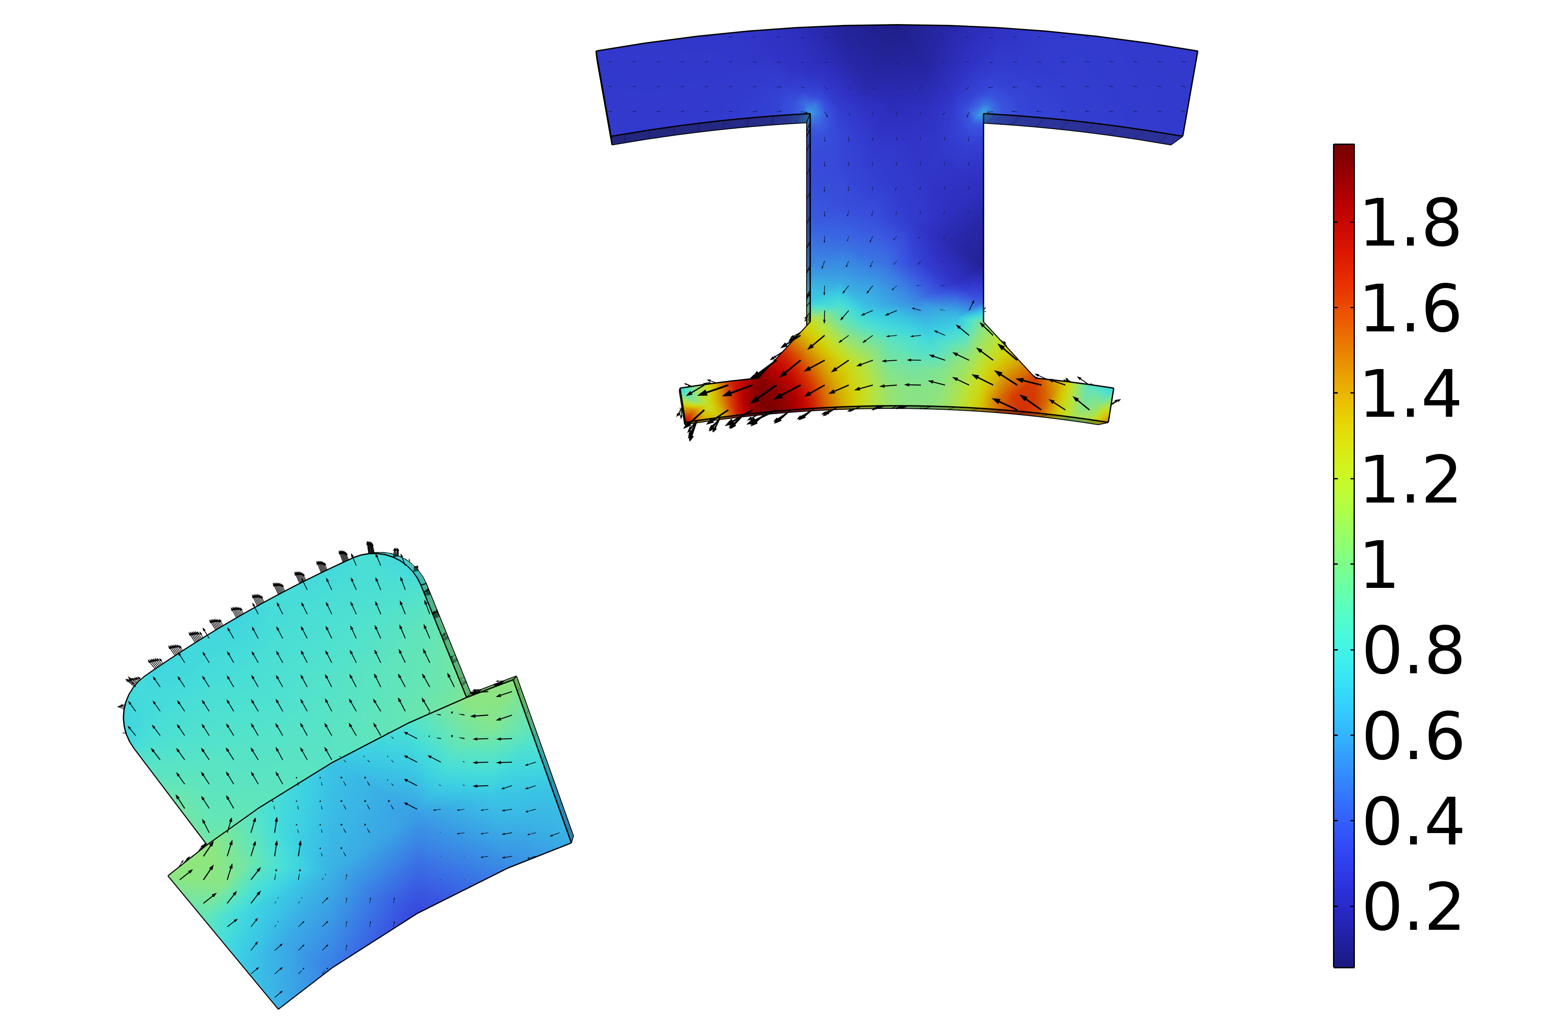
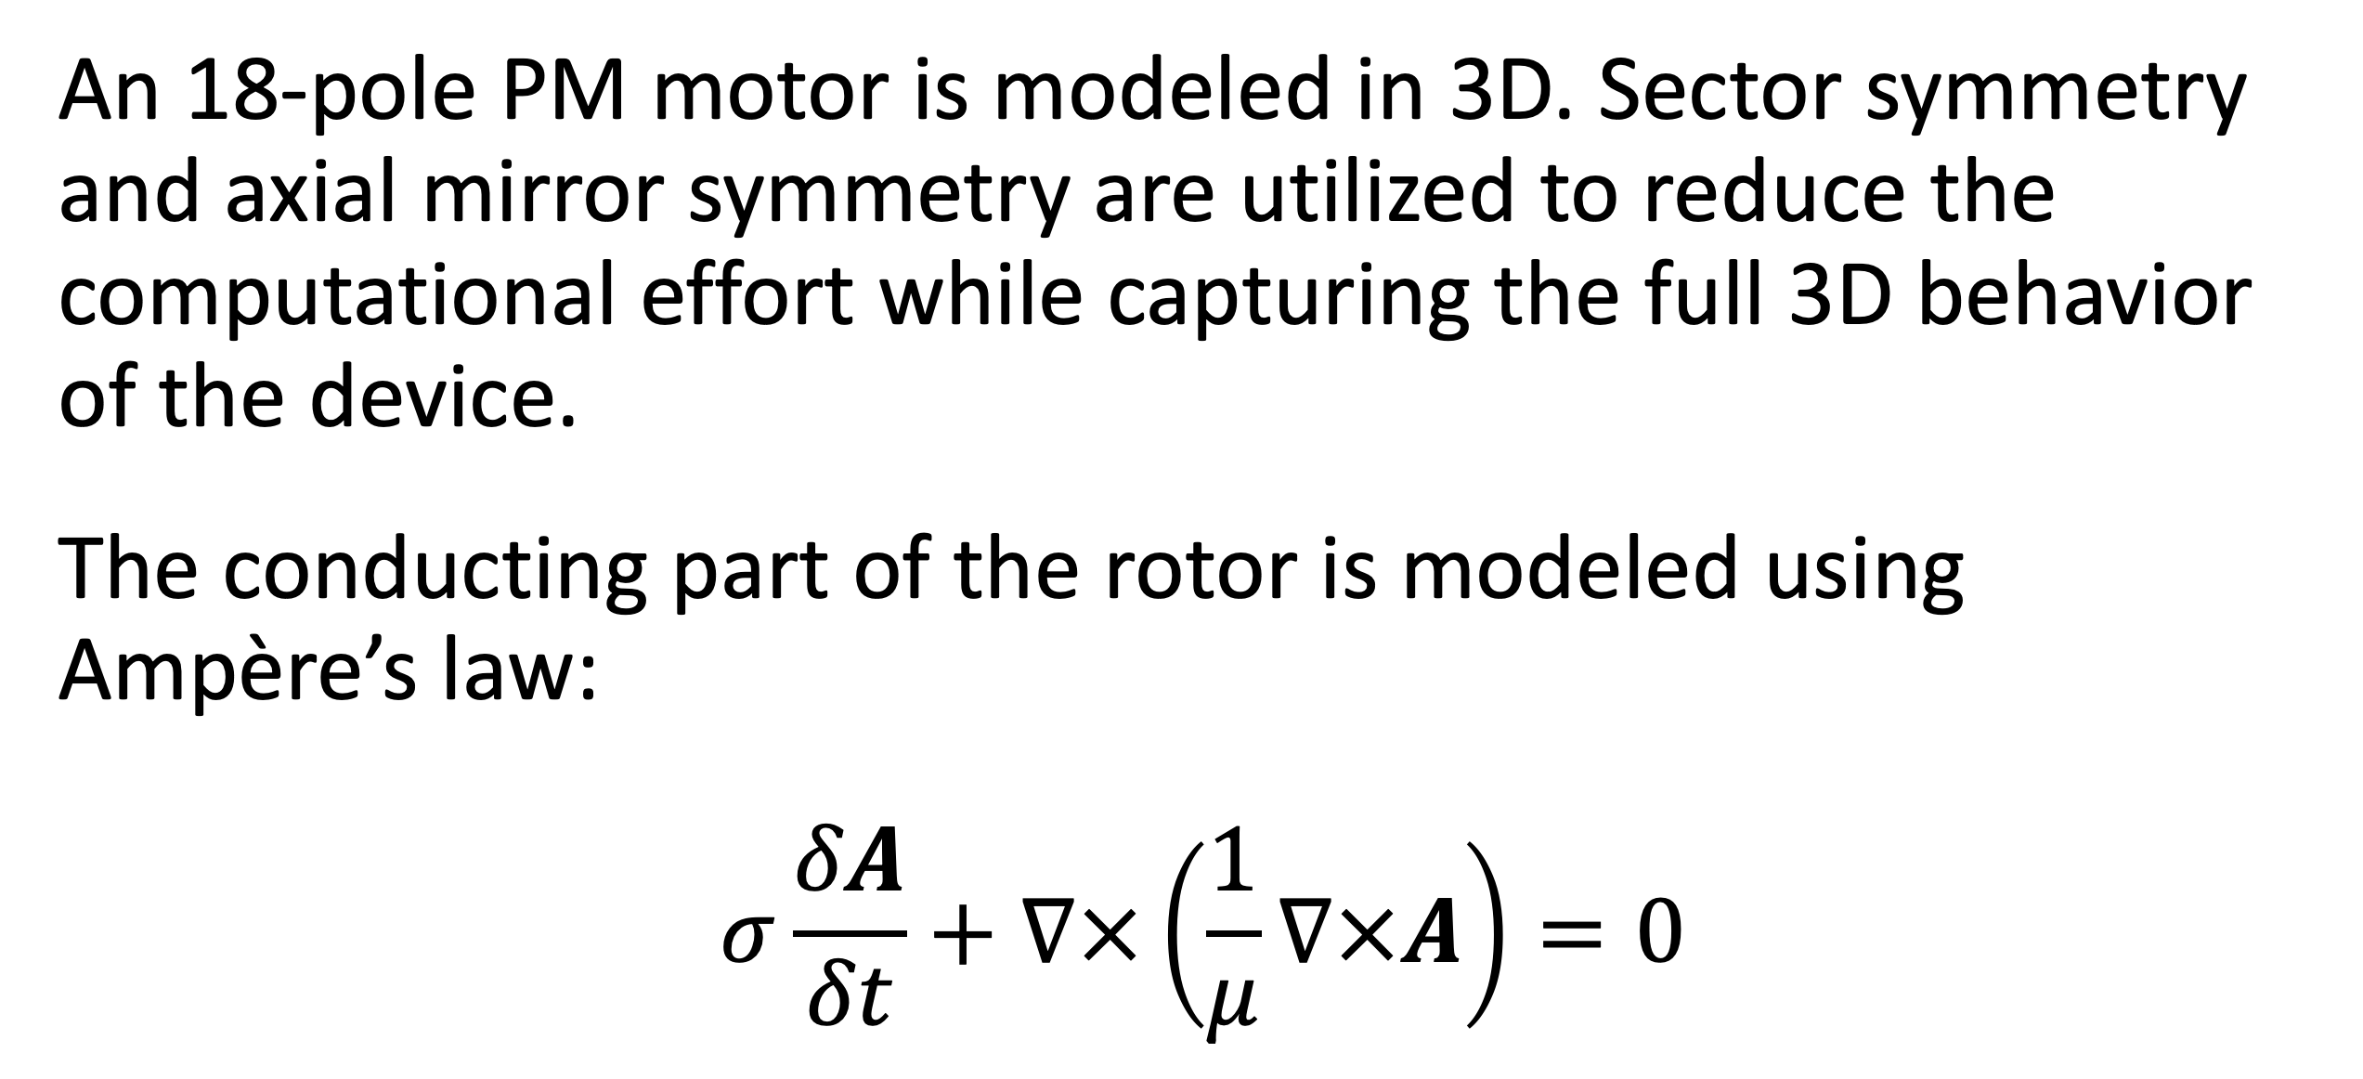
Analysis of a Permanent Magnet Motor in 3D
Optimize permanent magnet (PM) motor performance by understanding their full behavior, including sensitivity to high temperatures.
J. A. Smith¹, M. B. Smith²
1. Department (if applicable), Organization, City, Country.
2. Department (if applicable), Organization, City, Country.
Abstract
While PM motors are valued for the energy savings that they provide, there are some design limitations to address. For example, permanent magnets are sensitive to high temperatures. Such temperatures can occur when currents, particularly eddy currents, generate heat losses.
The findings offer greater insight into the behavior of PM motors, particularly by capturing the eddy current losses that occur within the magnets. This information serves as a useful resource for improving the design of PM motors, and therefore the technology they help power.
Methodology
An 18-pole PM motor is modeled in 3D. Sector symmetry and axial mirror symmetry are utilized to reduce the computational effort while capturing the full 3D behavior of the device.
The conducting part of the rotor is modeled using Ampère’s law:
$$σ\frac{δA}{δt}+∇×\left(\frac{1}{μ}∇×A\right)=0$$
FIGURE 1. Left: Permanent motor sector. Right: Drawing of the PM motor.
Results
The results can be seen in Figure 2, which shows the magnetic flux density for the motor in it’s stationary state, that is, the initial conditions for the time-dependent simulation. In this state, the coil current is zero. It also shows the magnetic flux density for the motor after revolving one sector angle. In this plot, the air and coil domains are excluded in order to get a better view.
FIGURE 2. Left: Magnetic flux density from the permanent magnets with only the rotor at rest. Right: Magnetic flux density after revolving one sector angle.
1. Author first initial and last name, “Article Title”, Journal, Volume (vol.), Page numbers (pp.), Year.
2. Author first initial and last name, “Article Title”, Journal, Volume (vol.), Page numbers (pp.), Year.
3. Author first initial and last name, “Article Title”, Journal, Volume (vol.), Page numbers (pp.), Year.

Slide 4
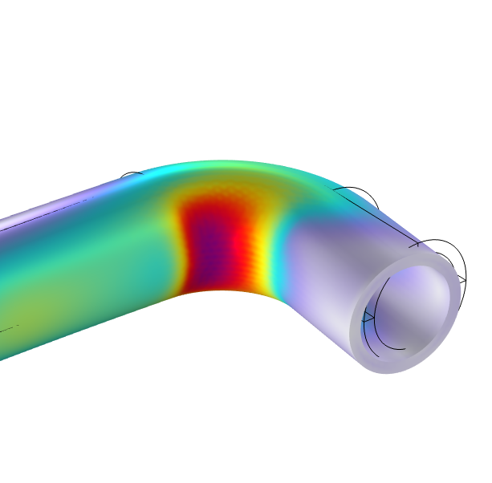
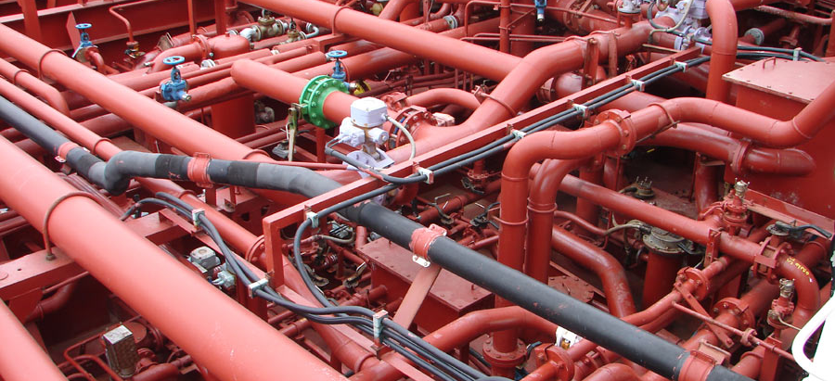
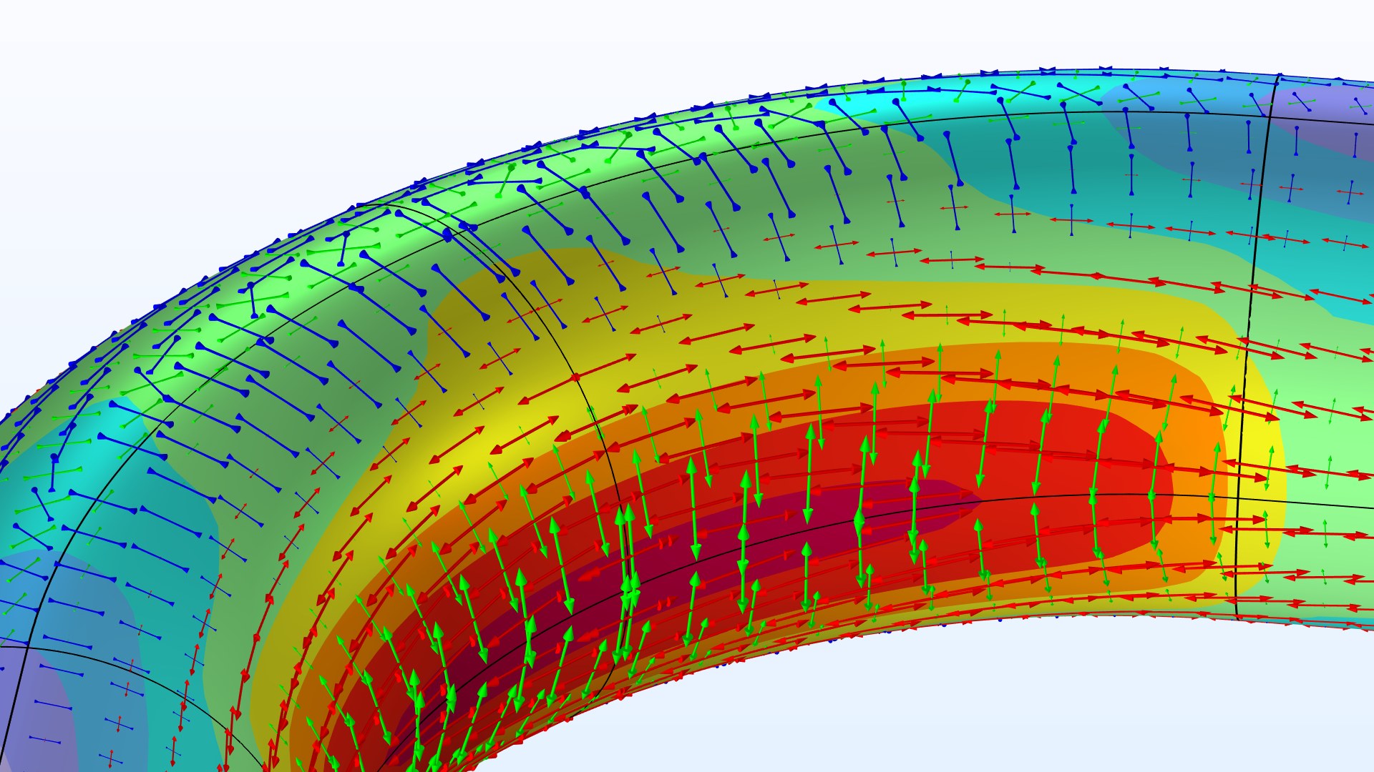
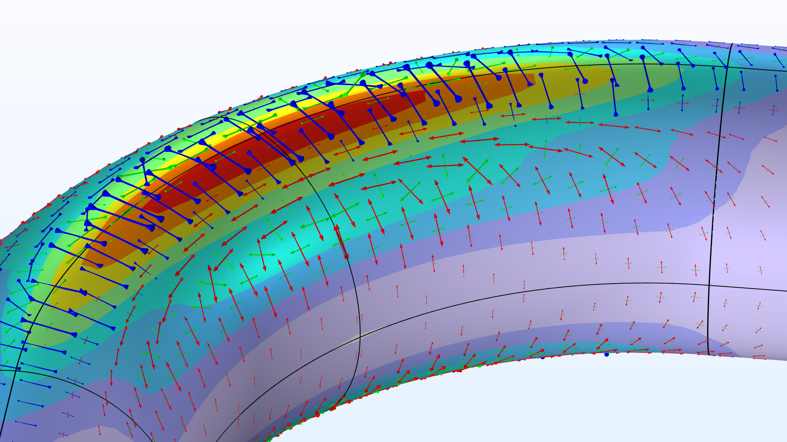
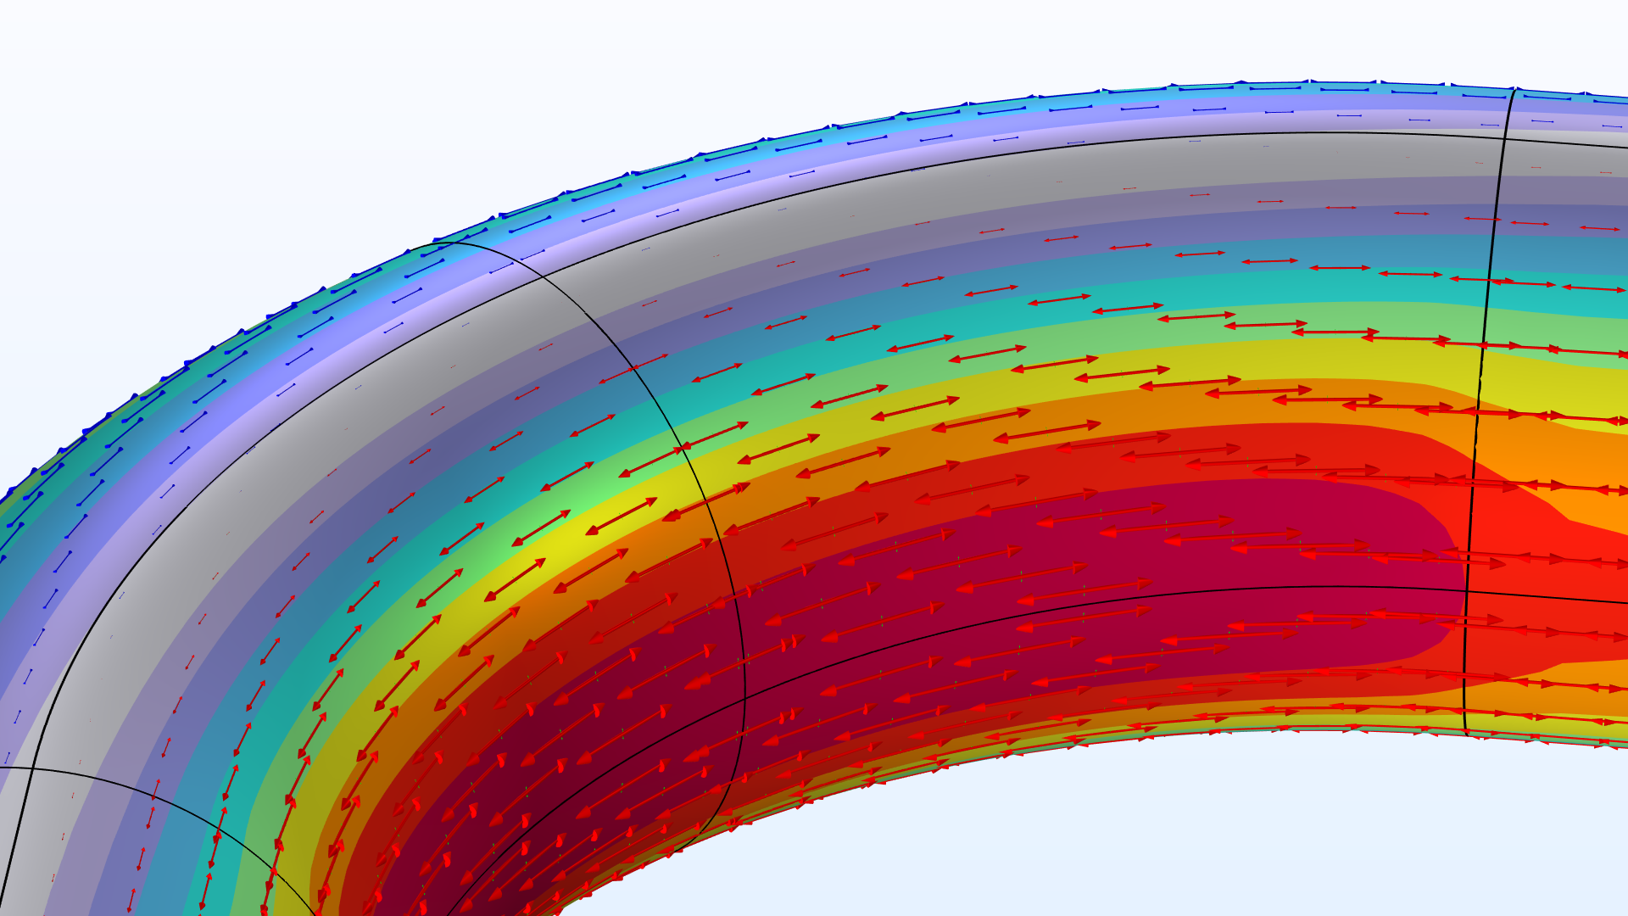
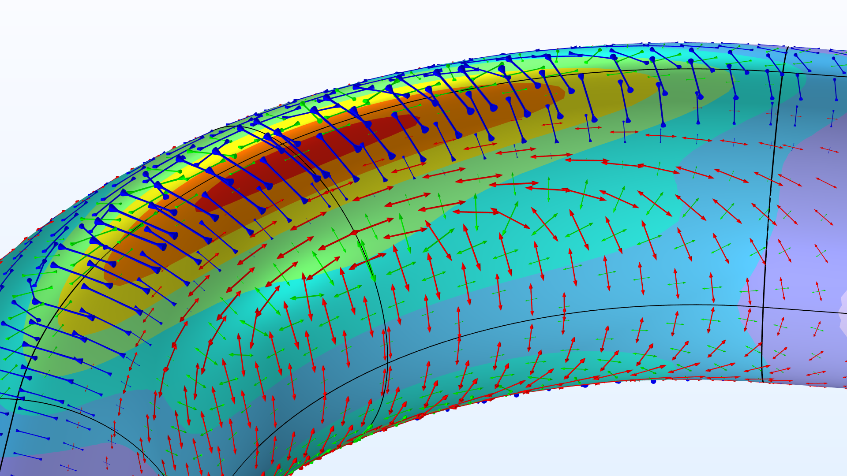
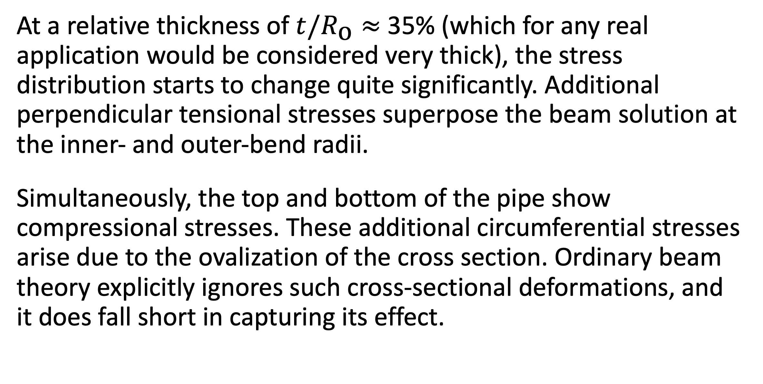
The Intriguing Stresses in Pipe Bends
For many structural engineers, beam theory is a popular analysis tool. Using the equations can be beneficial when considering structural behavior, as they are easy to apply and provide useful results. This work investigates one such case.
J. A. Smith¹, M. B. Smith²
1. Department (if applicable), Organization, City, Country.
2. Department (if applicable), Organization, City, Country.
Introduction & Goals
Pipe bends are common in piping systems, which typically transport liquids or gas, often under high pressure. One place where you may find a lot of pipes are oil tankers. The labyrinthine piping systems can look pretty fascinating.
Many piping standards (or codes) used for industrial applications are based on beam theory when it comes to the structural analysis. But, as we have already discovered, pipe bends generally do not behave like beams. When digging into piping standards, you will find a lot of information dedicated to pipe bends. In particular, piping standards recommend to apply correction factors to the stiffness and stresses for curved pipe sections. (Ref. 1)
Methodology
The pipe is slender with a constant cross section, so it would seem like a natural choice to treat such a structure as a beam in a simplified analysis. The bending moment is the only load acting on the structure, and it’s thus constant for any given section along the entire beam axis.
The maximum stress even occurs on the inside of the pipe. The cross section of the bend also deforms significantly, and, more specifically, it ovalizes with the major axis either being oriented in the bend plane or perpendicular to it depending on the direction of the bending moment.
FIGURE 1. Piping systems on an oil/chemical tanker. Image licensed under CC BY-SA 3.0 via Wikimedia Commons.
Results
At a relative thickness of $t/R_{\text{o}}≈$ 35% (which for any real application would be considered very thick), the stress distribution starts to change quite significantly. Additional perpendicular tensional stresses superpose the beam solution at the inner- and outer-bend radii.
Simultaneously, the top and bottom of the pipe show compressional stresses. These additional circumferential stresses arise due to the ovalization of the cross section. Ordinary beam theory explicitly ignores such cross-sectional deformations, and it does fall short in capturing its effect.
FIGURE 2. View of the pipe bend showing the von Mises stress (normalized) and principal stresses for different wall thicknesses.
E.A. Wais and E.C. Rodabaugh, “Background of SIFs and Stress Indices for Moment Loadings of Piping Components”, United States, 2005; https://www.osti.gov/biblio/841246
“Stress Intensification Factors (i-Factors), Flexibility Factors (k-Factors), and Their Determination for Metallic Piping Components”, ASME, 2017; https://www.asme.org/codes-standards/find-codes-standards/b31j-stress-intensification-factors-flexibility-factors-determination-metallic-piping-components/2017/drm-enabled-pdf

