Slide 1
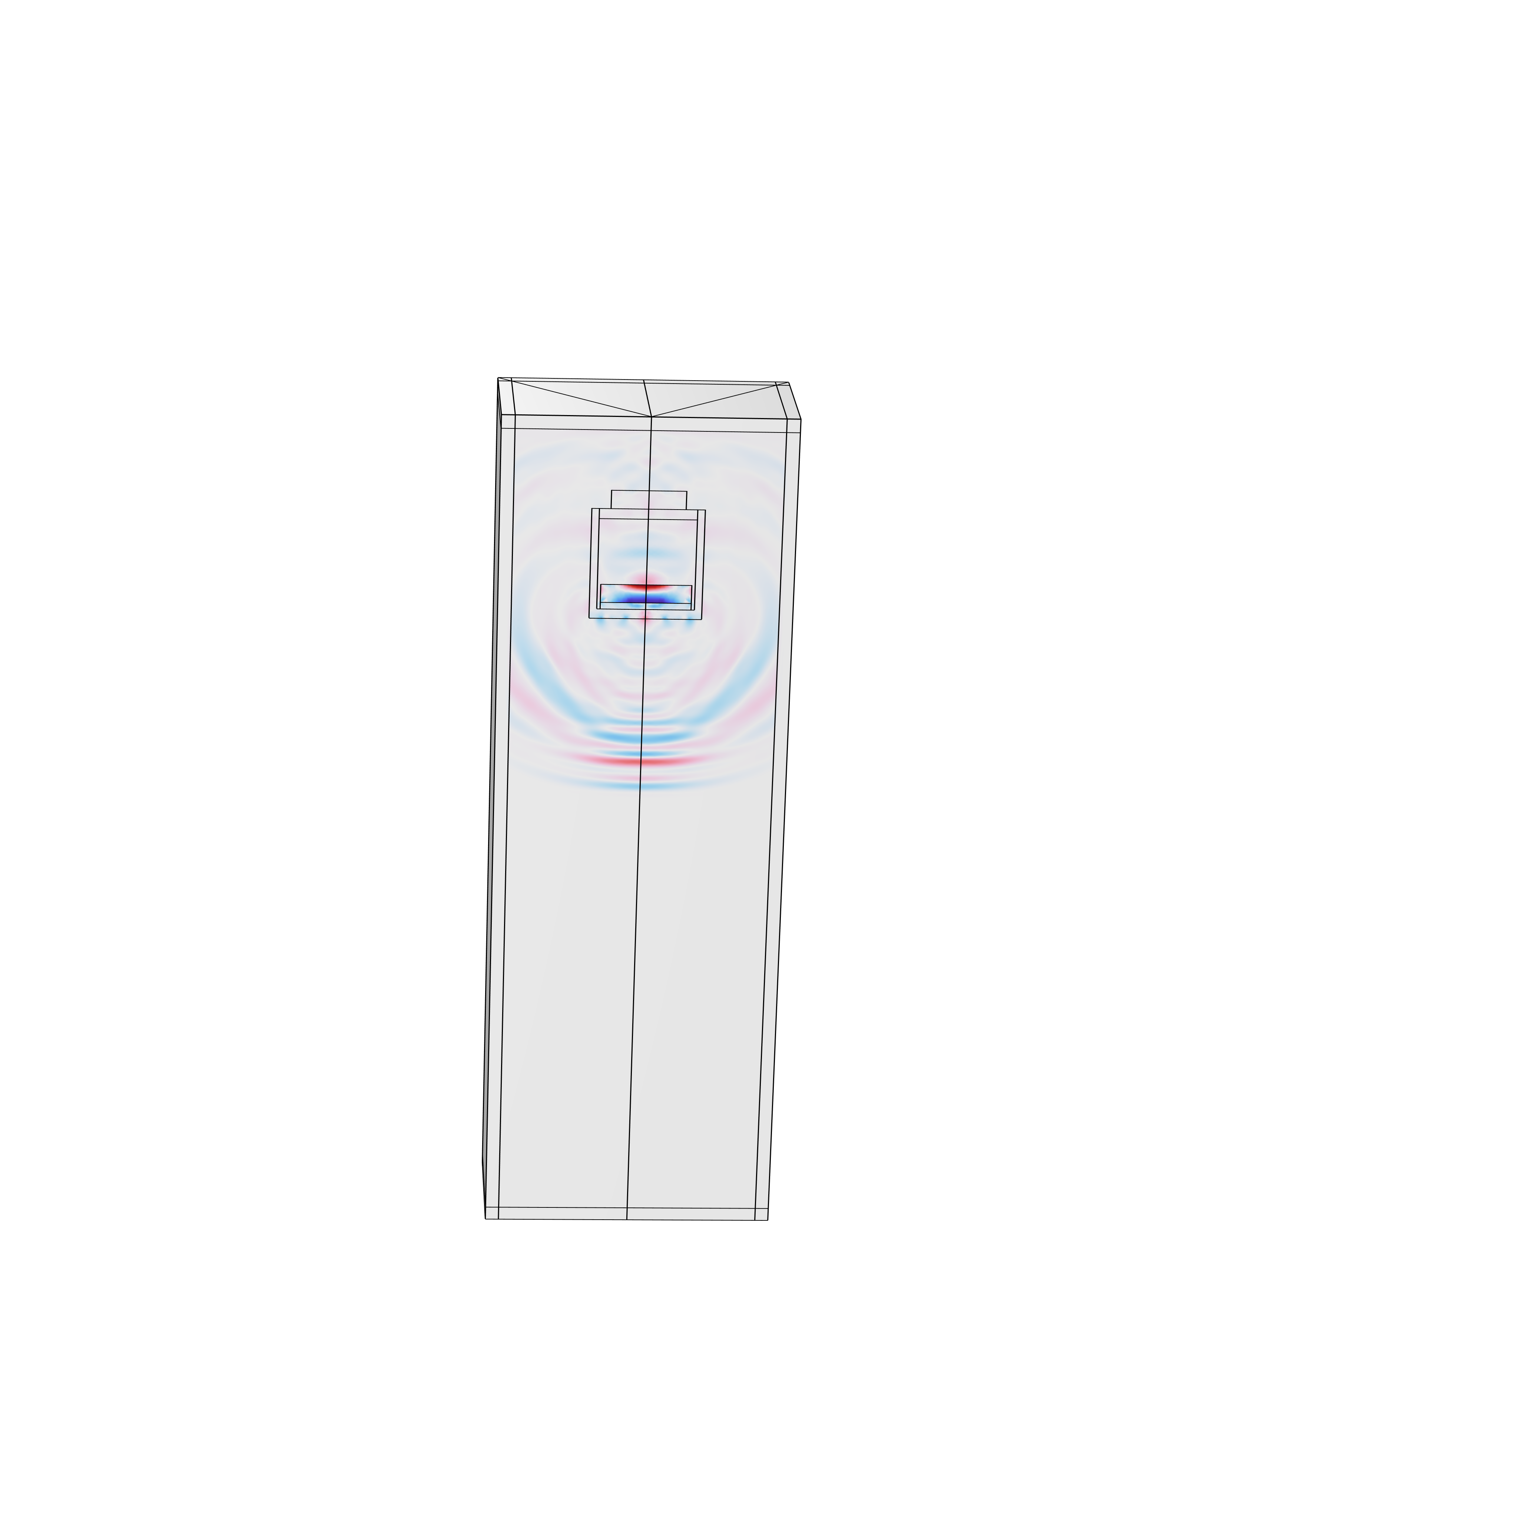
3D Ultrasonic Simulations for Pulse Echo and Pitch Catch Testing
Haiqi Wen
Lead Scientist @ Baker Hughes

Slide 2








Oil and Gas Production Process
Exploration: Locating potential sites for oil and gas drilling and extraction
Upstream
Drilling: Boring a hole using a drill bit to create a well for oil and natural gas production
Extraction: Oil and natural gas flows up from the well bore and fracturing fluid is then recovered .
Processing: Oil and natural gas are separated, then transferred to the gas processing plants.
Midstream
Storing: Natural gases are usually stored in underground spaces such as depleted reservoirs, while finished oil products, crude oil and refined oil commonly use above ground tanks as storage.
Transportation: Unrefined oil is transported via tankers and pipelines, while final petroleum products travel to the market through trucks, railroad cars, etc…
Refining: Converting oil and natural gas into petroleum products that can be used for various purpose.
Downstream
Distribution: The finished petroleum products are distributed to business and consumers.

Slide 3
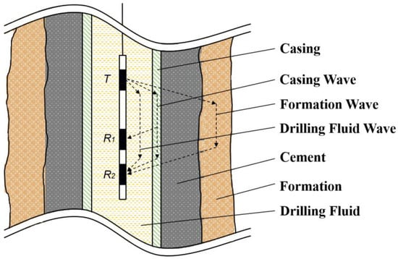
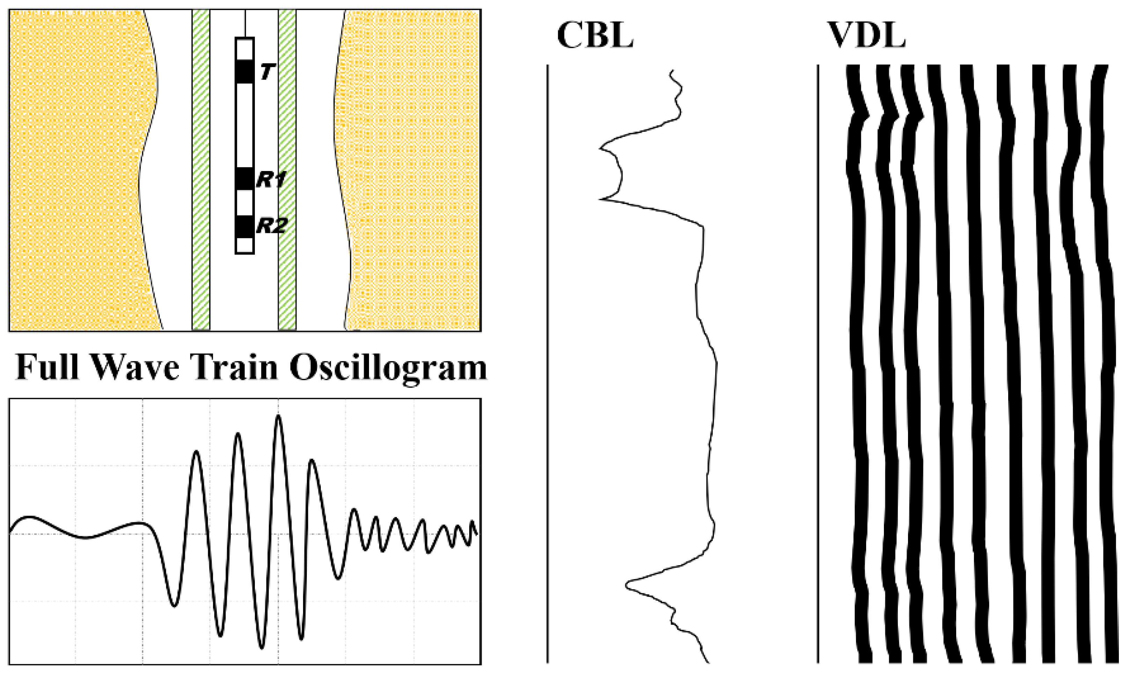
Cement Bonding Evaluation
Well cementing is a key procedure during well construction, The cement sheath provides a hydraulic seal that prevents fluid communication between producing zones in the borehole and blocking the escape of fluids to the surface.
Cement-bonding logs (CBL) and variable-density log (VDL) leverage ultrasonic tools run on wireline to provide highly reliable estimates of well integrity and zone isolation.
Fang et al. 2022

Slide 4
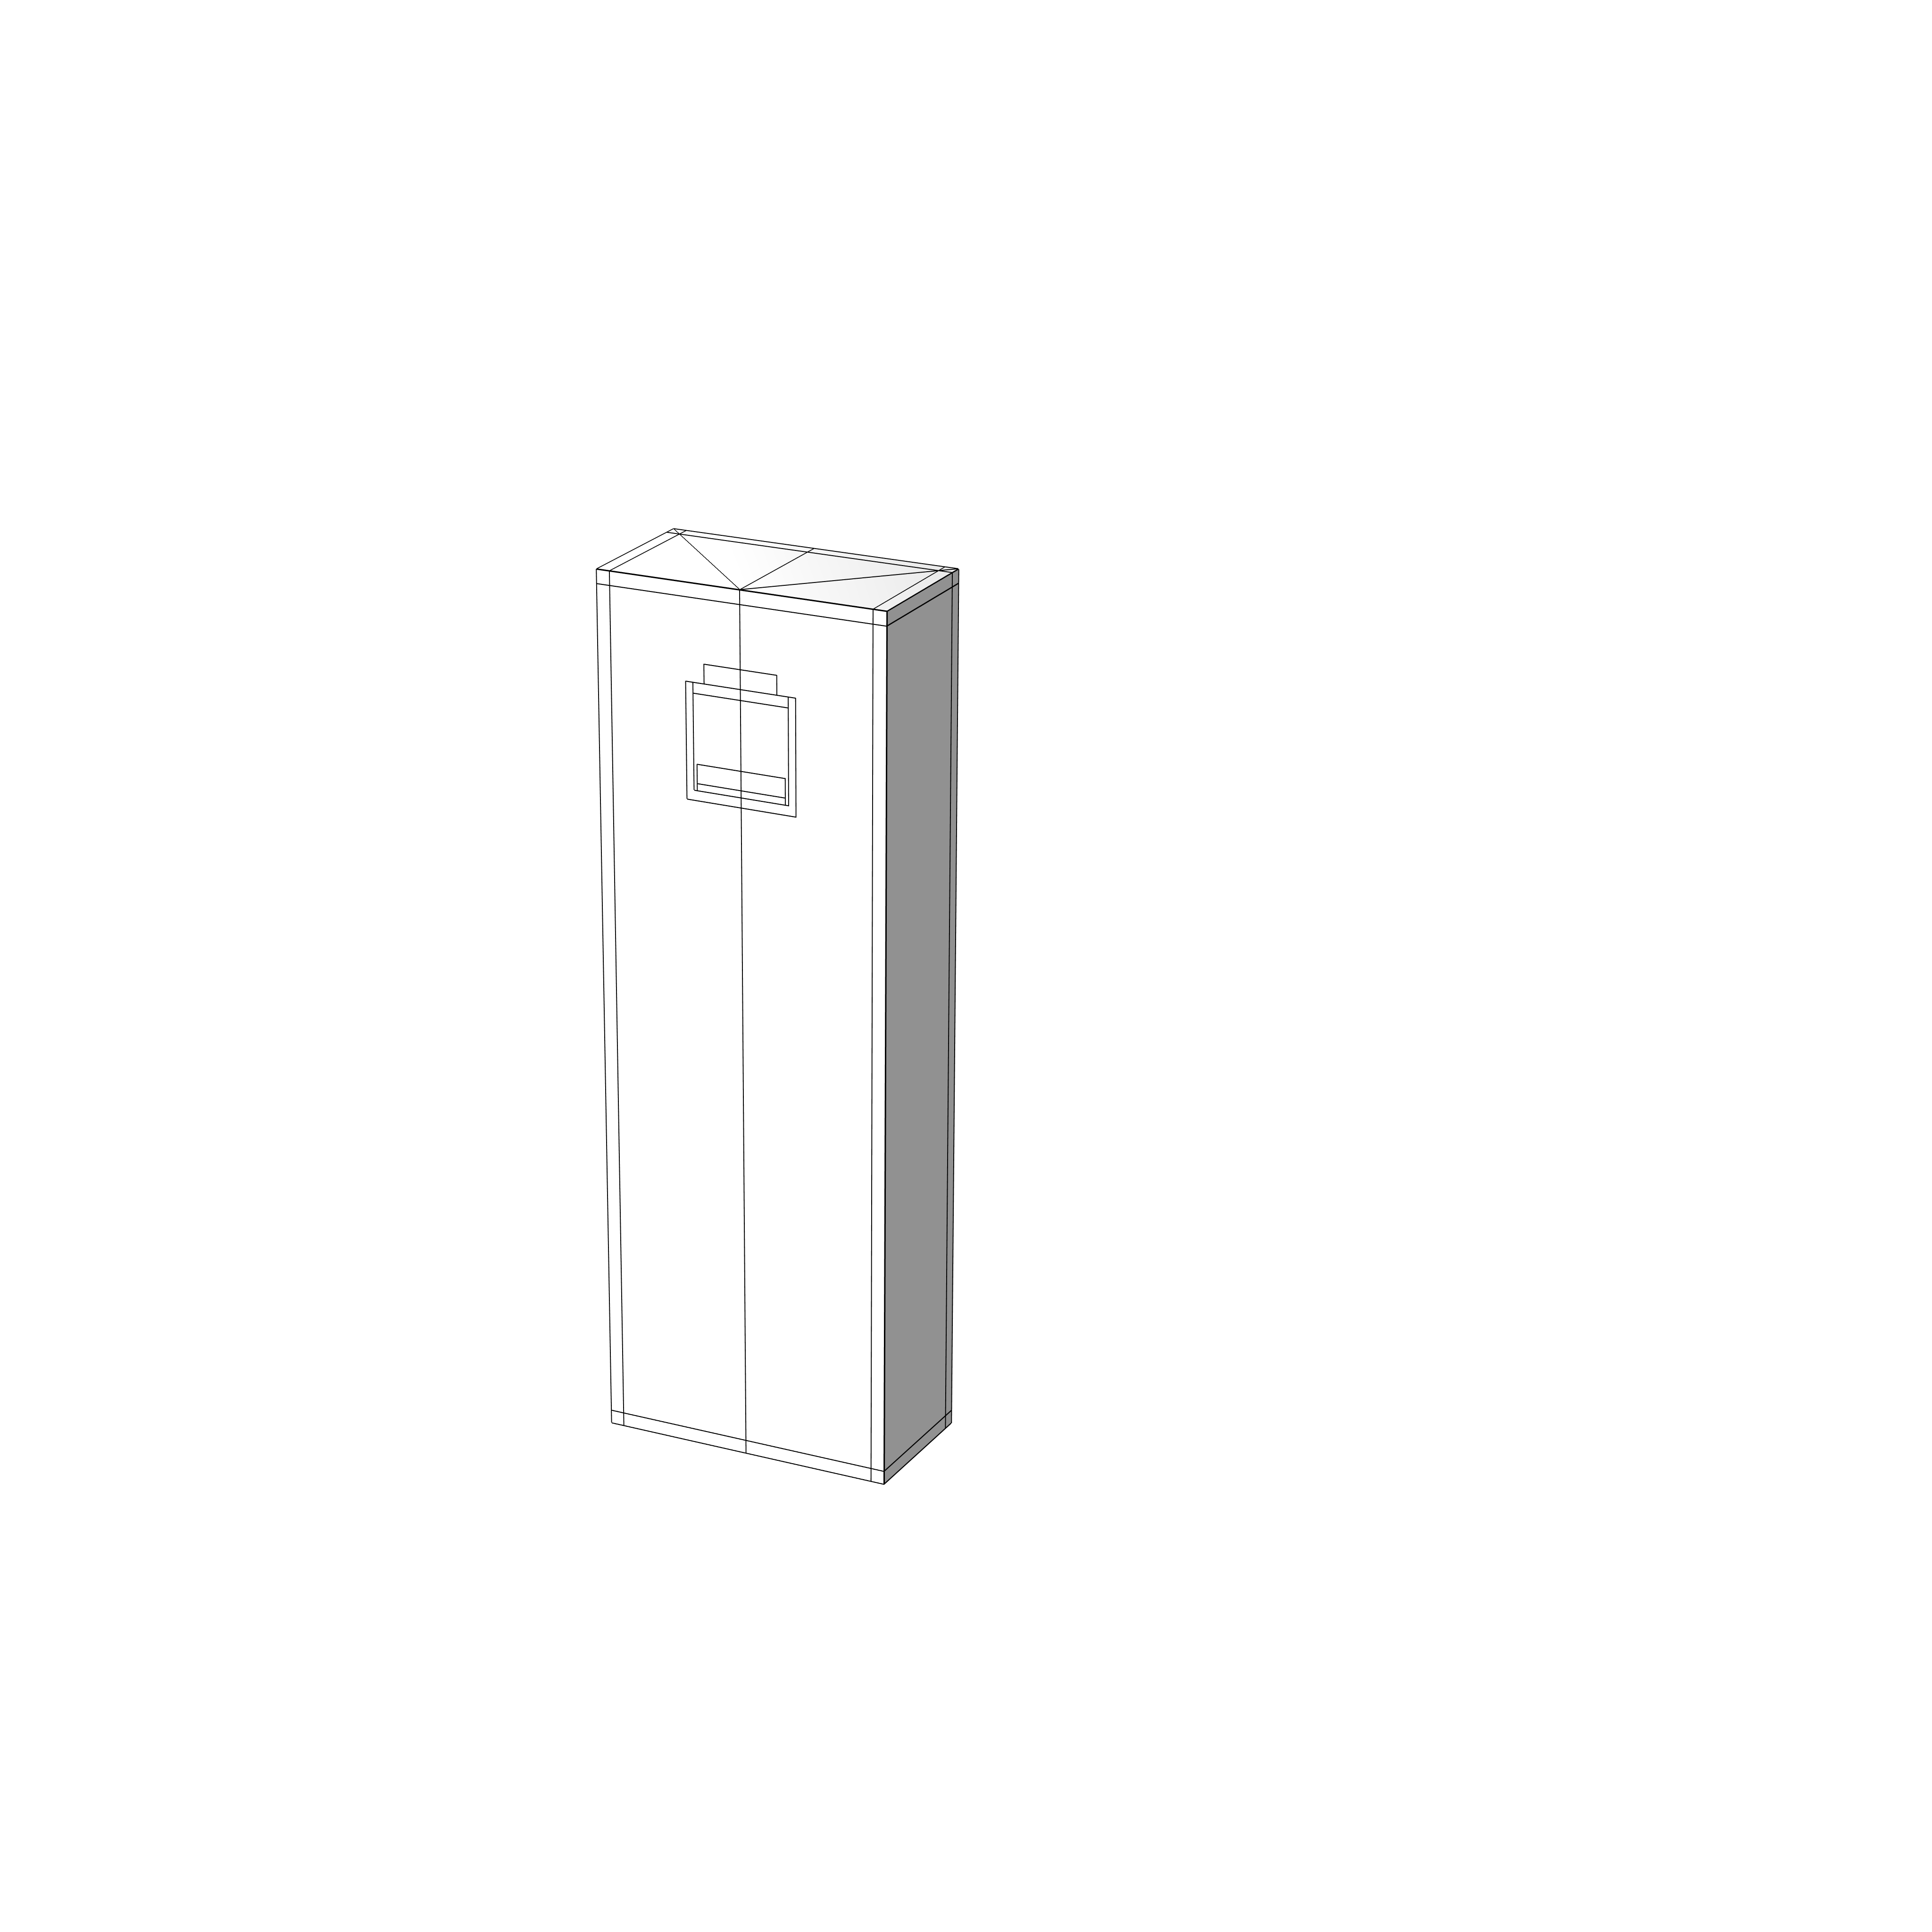
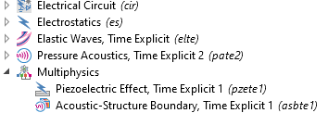
Piezoelectric Transducer Modeling
Damping Material
Piezoelectric Material
Matching Layer
Absorbing Layer
Transducer Housing
Fluid
In this study, four physics modules are introduced to the Multiphysics model:
Electrostatics module (es) is coupled to the Elastic Waves, Time Explicit (elte) module to transform voltage signal to elastic wave.
Elastic Waves, Time Explicit (elte) module is coupled to Pressure Acoustics, Time Explicit (pate) module to model fluid-structural interaction at the transducer’s boundary.
An external electrical circuit is coupled to the terminal of the piezoelectric element.

Slide 5
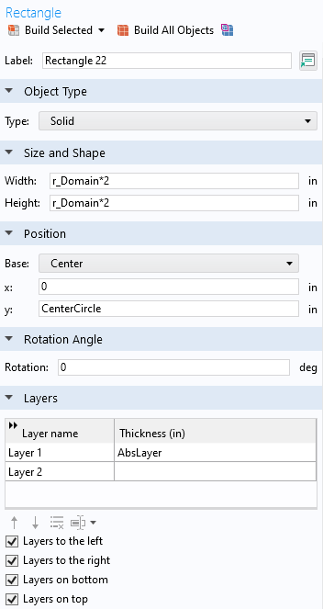
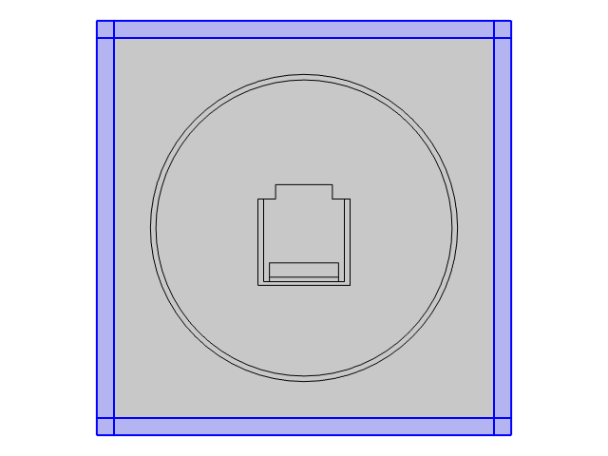

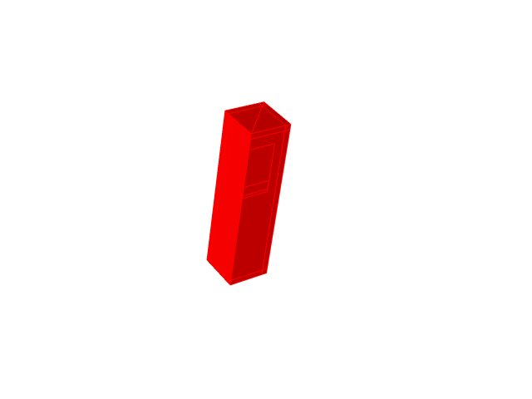

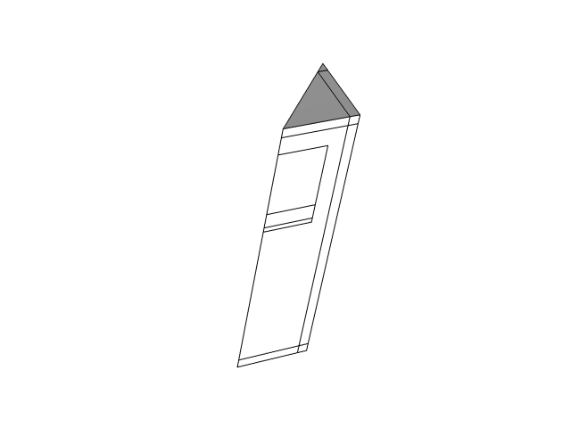
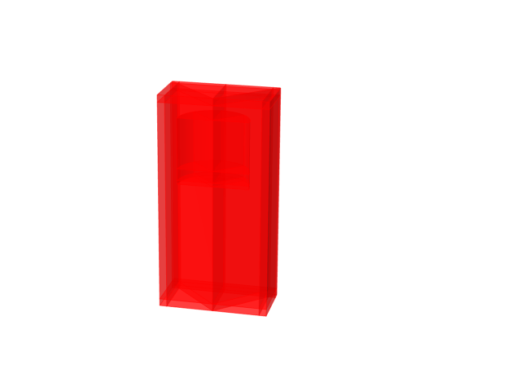
Boundary Conditions
1/8
1/4
1/2
Full Model
Only 1/8 of the model is simulated to improve computation efficiency. Full model response can be obtained by creating mirror data sets.
Absorbing layer is introduced to absorb acoustic waves and prevent reflection

Slide 6
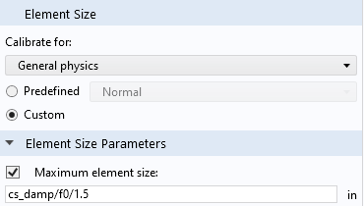
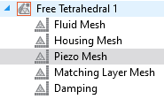

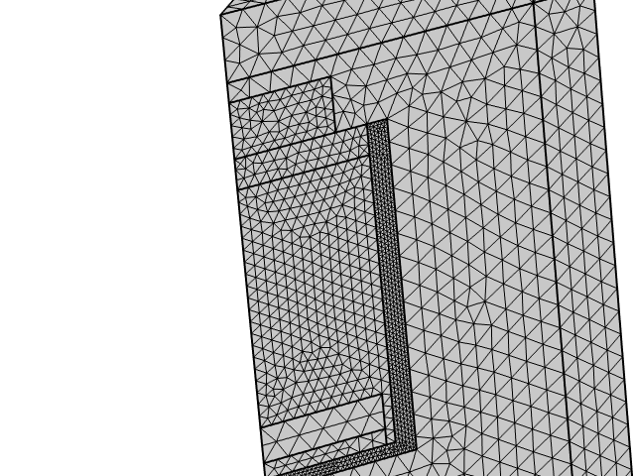
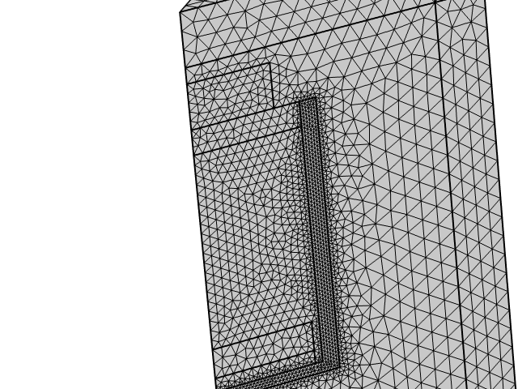
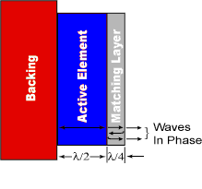
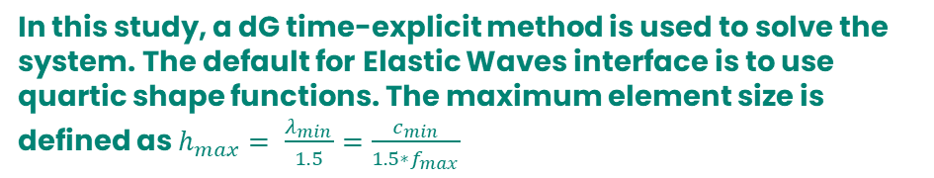
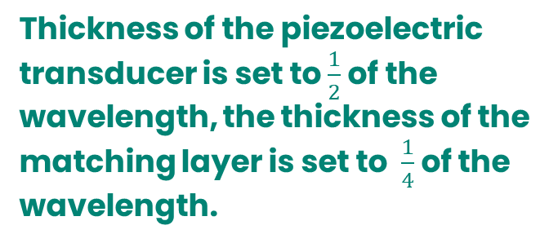
Transducer Dimension and Mesh Setting
Thickness of the piezoelectric transducer is set to $\frac{1}{2}$ of the wavelength, the thickness of the matching layer is set to $\frac{1}{4}$ of the wavelength.
In this study, a dG time-explicit method is used to solve the system. The default for Elastic Waves interface is to use quartic shape functions. The maximum element size is defined as $h_{max}= \frac{λ_{min}}{1.5}=\frac{c_{min}}{1.5∗f_{max}}$
Mesh size is continuous at interface
Mesh size does not to be continuous at interface

Slide 7
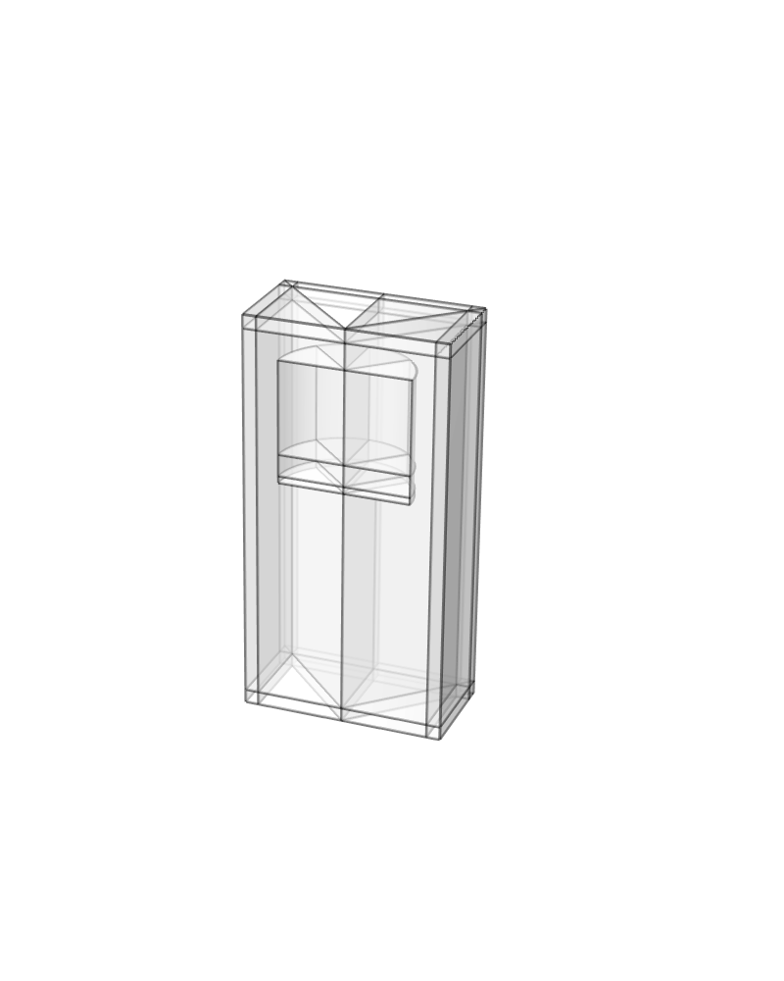
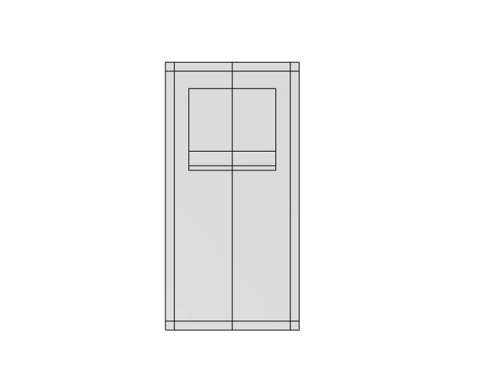
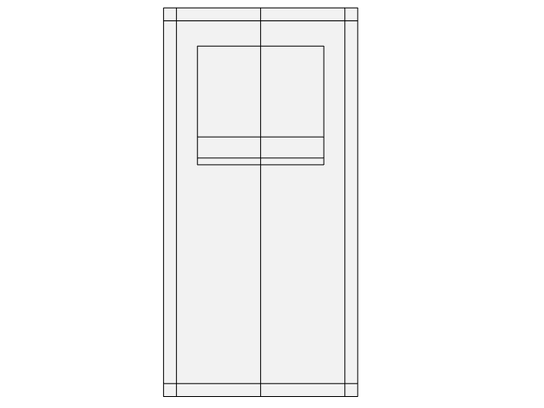
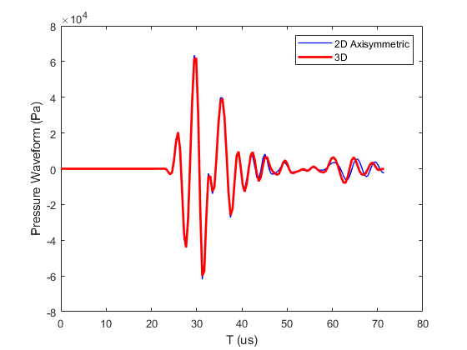
2D Axisymmetric Model vs 3D Model
F0 = 280 kHz
3D model results were obtained by evaluating the pressure response at the yz-cut plane (x = 0)
2D Axisymmetric Model
3D Model

Slide 8
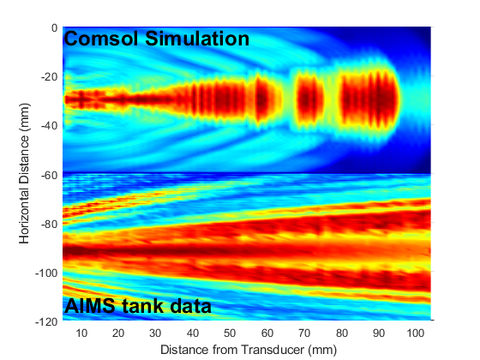
Model Validation
Transducer’s center frequency is at 280 kHz
Amplitude is normalized.
Peak Pressure
Simulation and measurement data agrees well at near field. The maximum pressure is found on axis.
Side lobes were observed in measurement data, whereas the model results does not exhibit side lobe.
Local cancellation are found in simulation, while the experiment data shows a continuous decay.

Slide 9
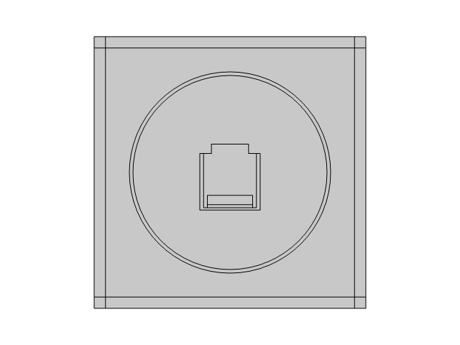
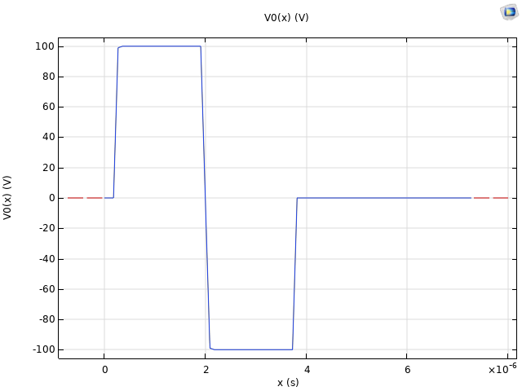

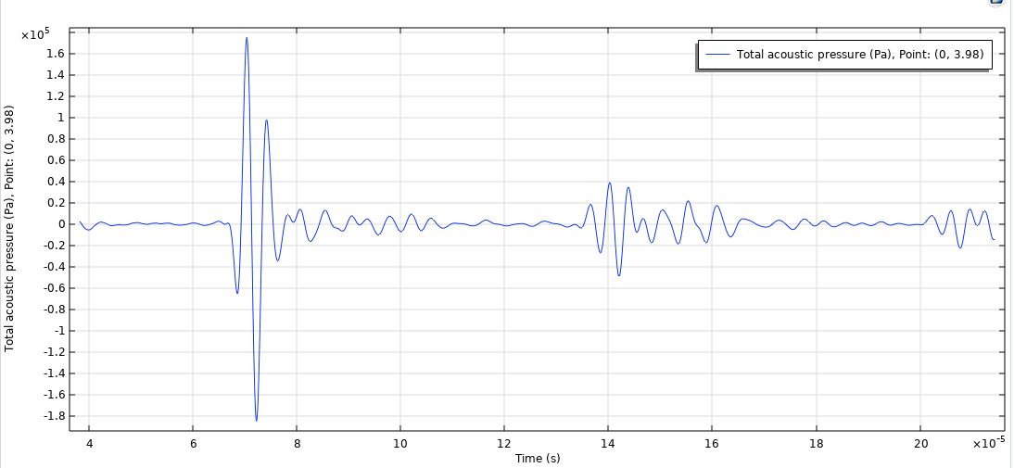
Pulse Echo Simulation
Pulse-echo is an ultrasonic non-destructive testing (NDT) technique using ultrasonic pulsed waves to find defects in materials.
7 in casing (0.5 in thickness)
Modified Square Pulse Signal
Wave Propagation
Pressure Waveform
Pressure Probe
Fluid
Transducer

Slide 10
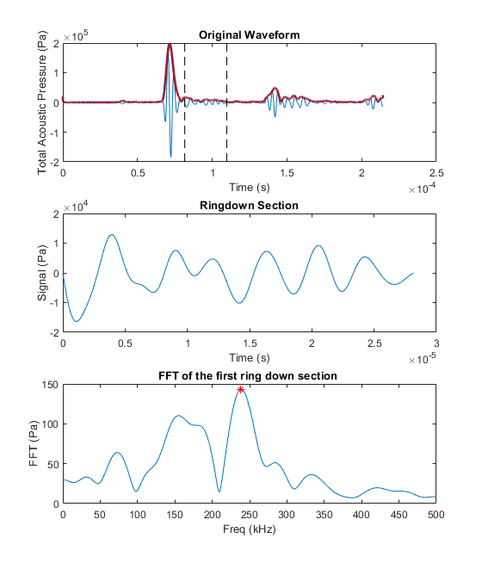
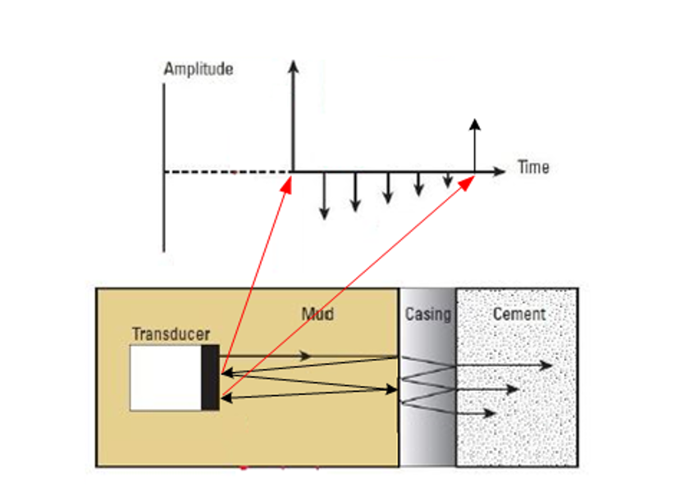
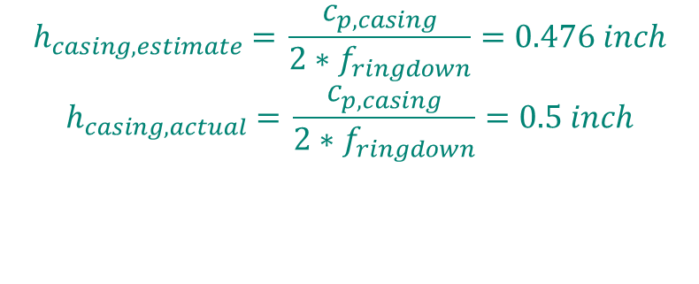
Estimate Casing Thickness
Extract Waveform Envelope using Hilbert Transform
$$h_{casing, estimate}\text{ = }\frac{c_{p,casing}}{2∗f_{ringdown}}=0.476 inch$$
$$h_{casing, actual}\text{ = }\frac{c_{p,casing}}{2∗f_{ringdown}}=0.5 inch$$

Slide 11
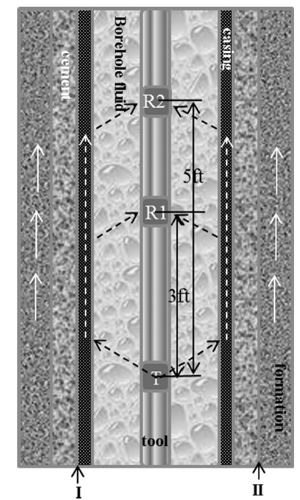
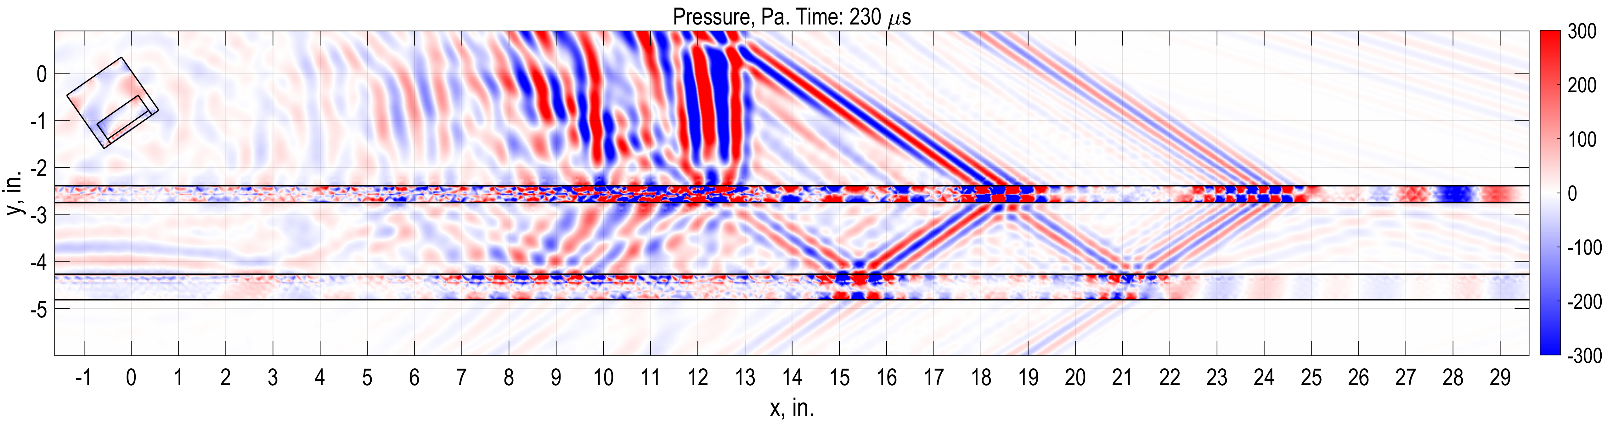
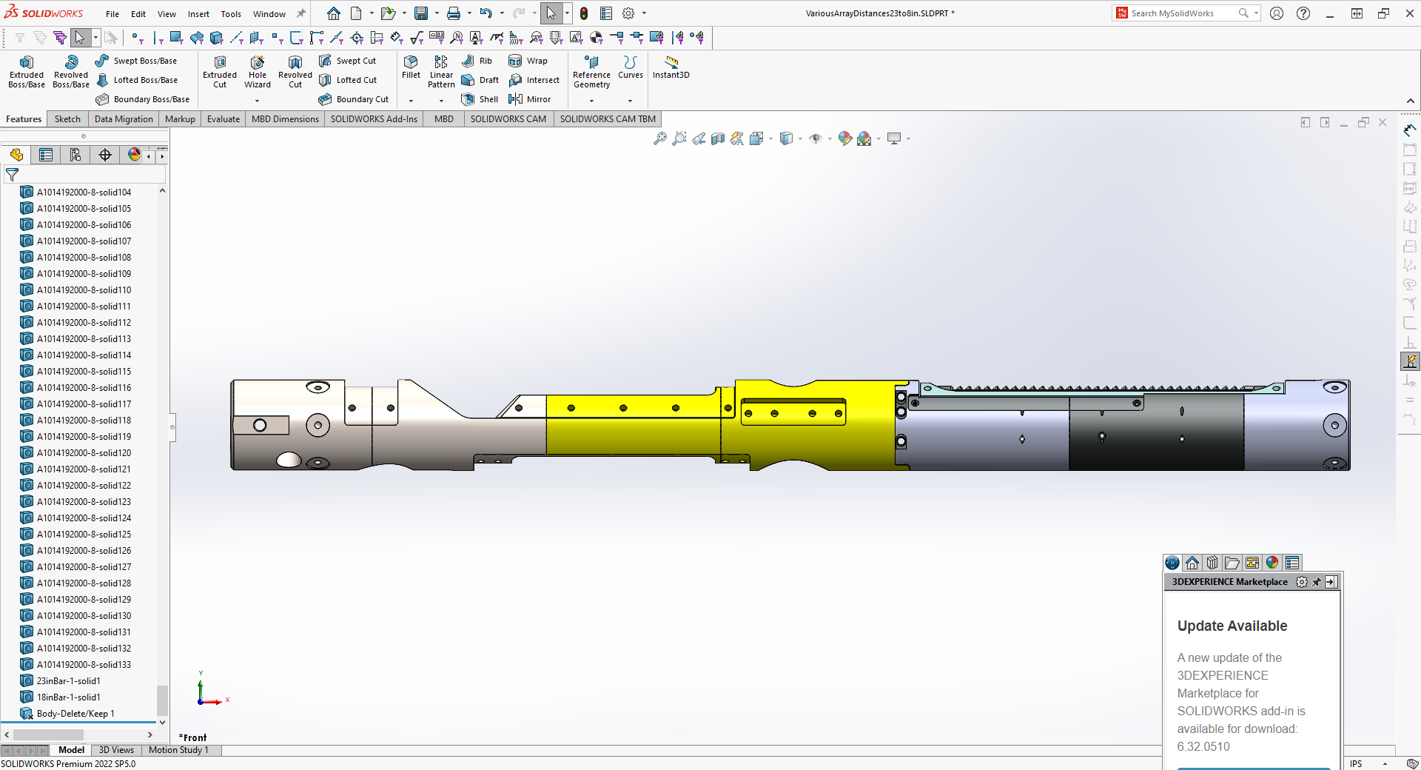
Pitch Catch Simulation
Unlike the pulse-echo testing, where the same transducer is used to send and receive the signal. In pitch-catch testing, a transmitter and one or multiple receiver are used to send and receive the signal
Secondary A0 arrival
Primary A0 arrival
Primary S0 arrival
Fluid mode
SecondaryA0
Primary A0
Secondary S0
Casing A0 leaking into water
Casing A0

Slide 12
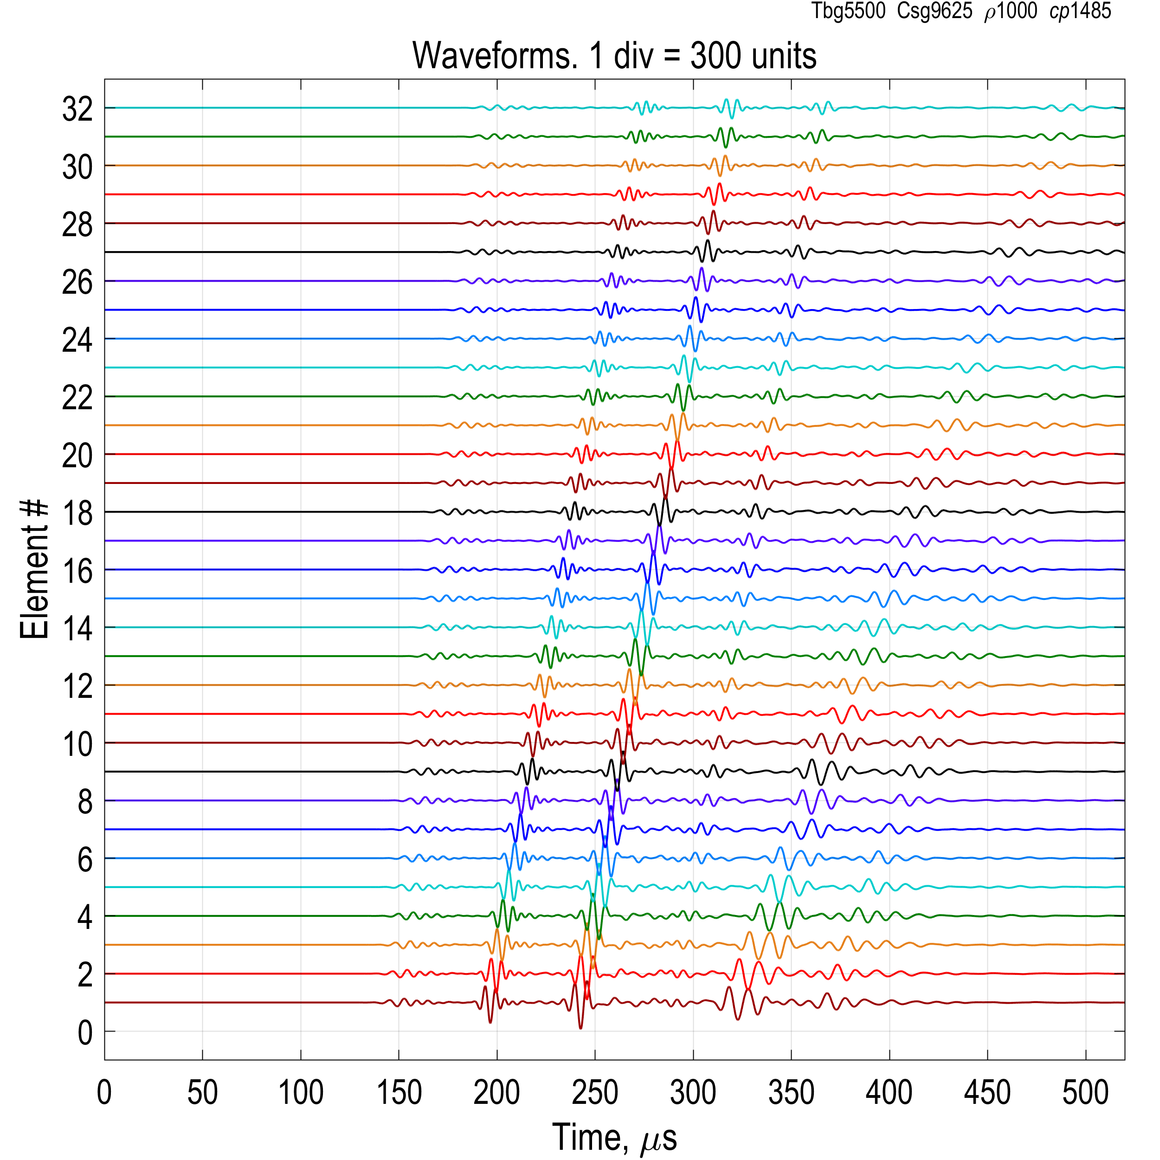
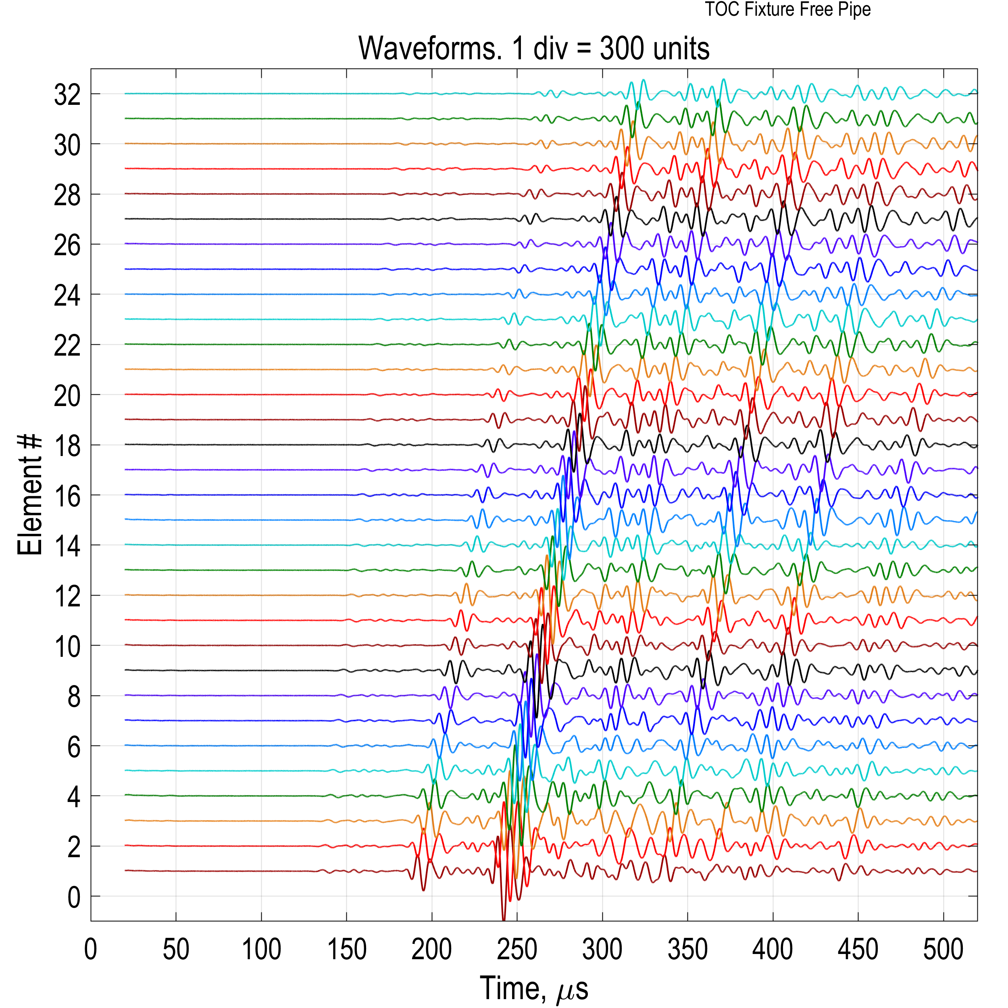
Simulations vs. TOC Fixture Measurements. Waveforms
Sim.
Expt.
Free Pipe
Secondary A0
Quat. A0
Fluid Mode
Secondary A0
Quat. A0
Primary A0
Tertiary A0
Primary A0
Tertiary A0
Fluid Mode
12

Slide 13
Summary
In this study, ultrasonic piezoelectric transducers are coupled to the fluid to study acoustic wave propagation in pulse-echo and pitch catch simulation.
The model can be used to characterize transducer’s free field response, estimate casing thickness and provide cement bonding evaluation.
Overall, COMSOL model simulations are capable to capture the experimental response. With good tuning, the model can be used to develop transducers and test setups to reduce prototyping cost.

