Slide 1
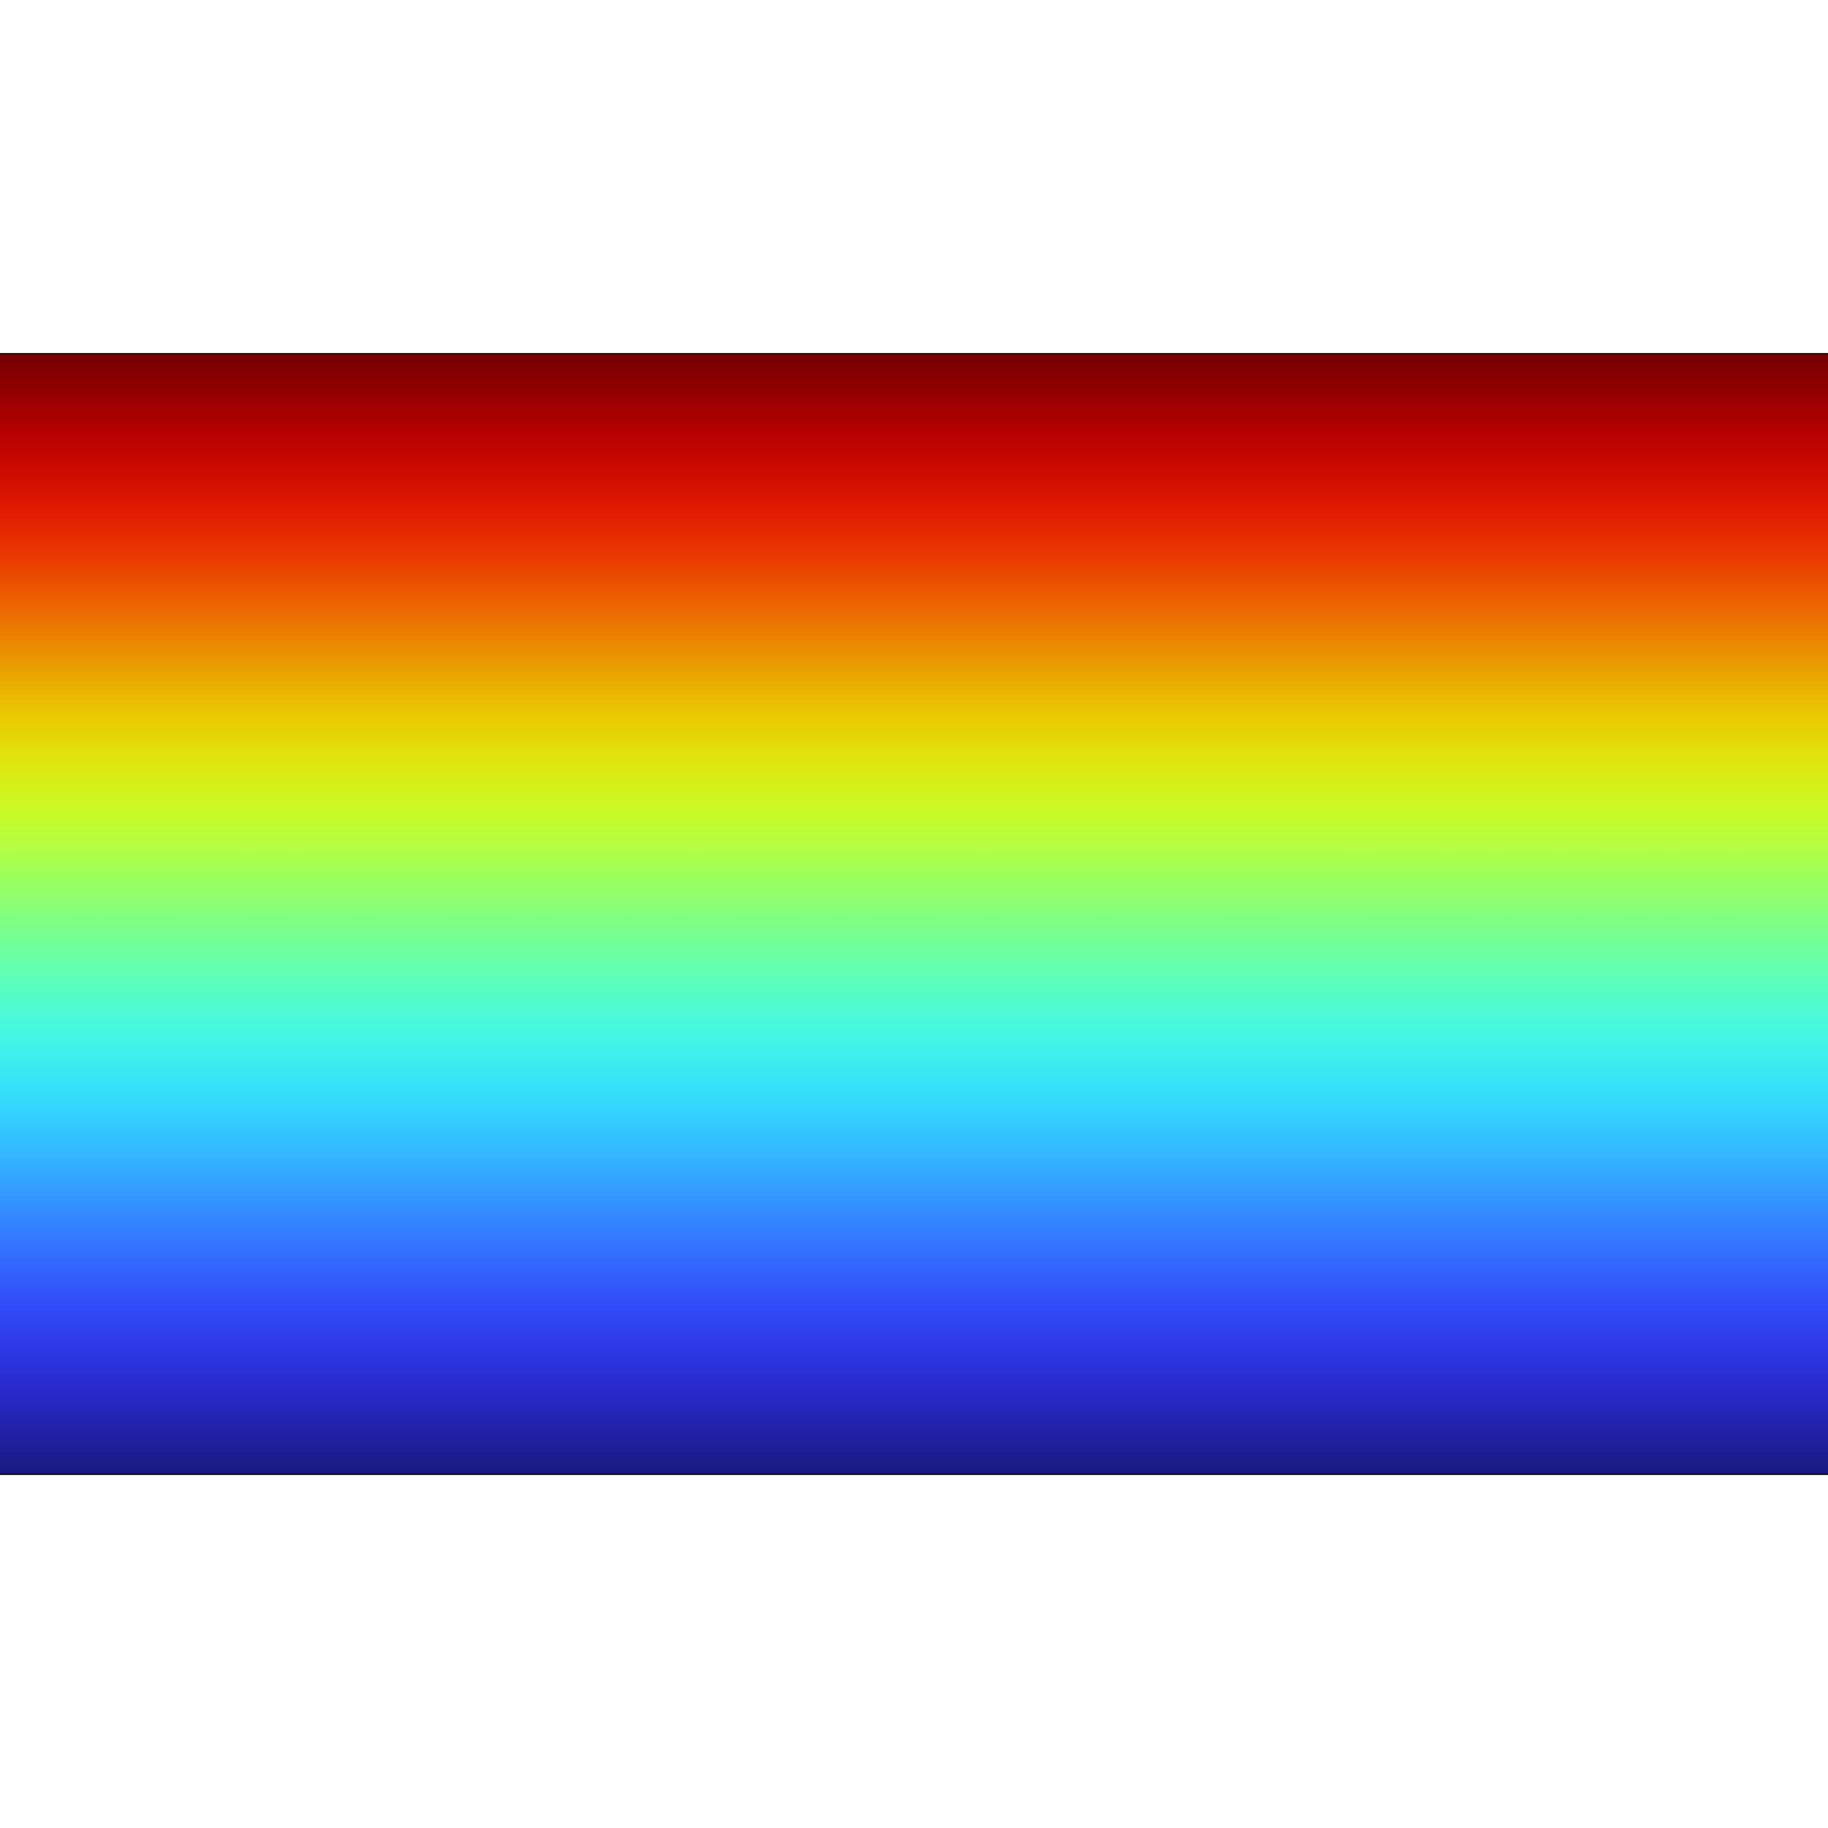
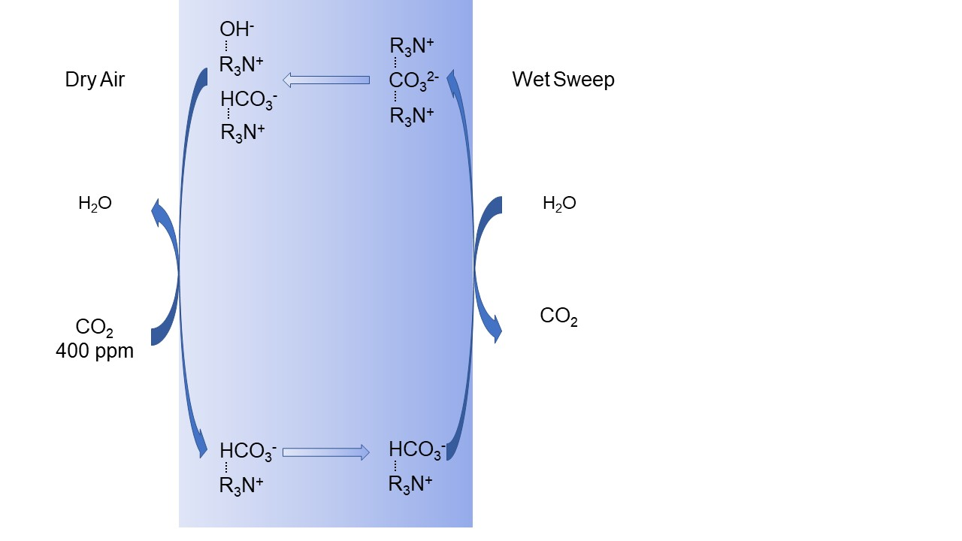
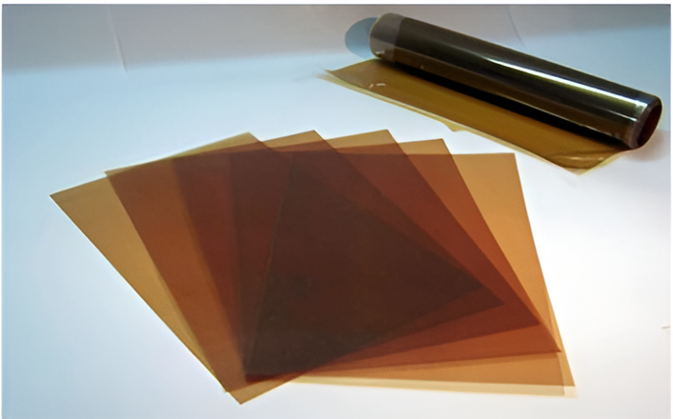
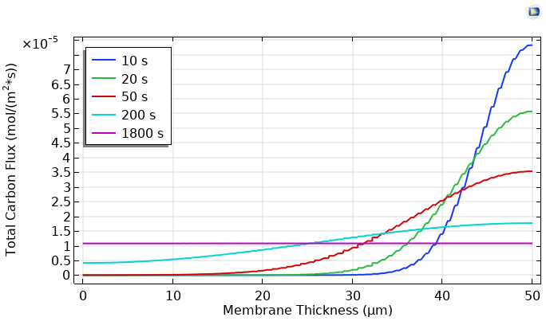
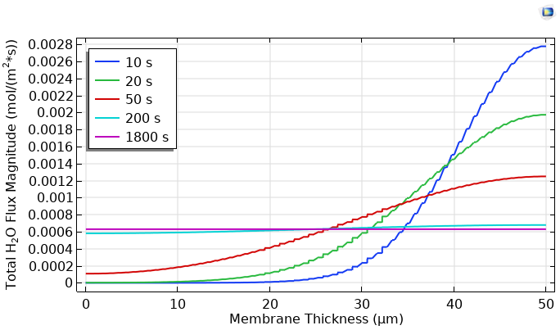

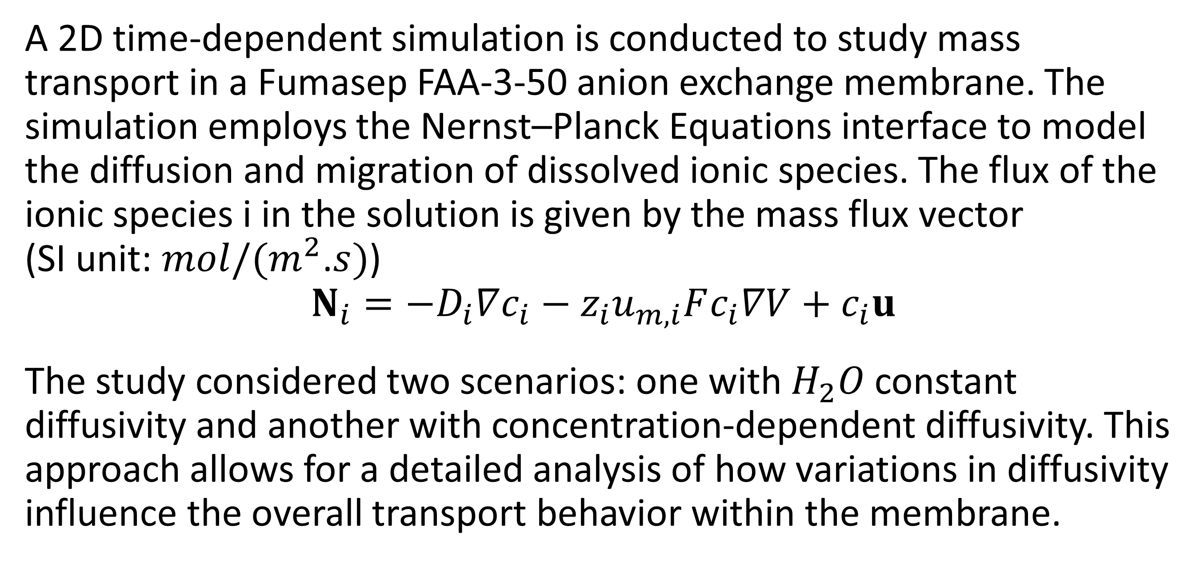
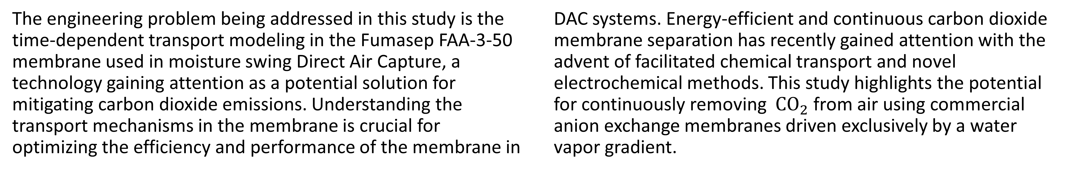
Transport Modeling in Fumasep FAA-3-50 Membrane for Optimizing Direct Air Capture Systems
This study optimizes Direct Air Capture systems using advanced membrane modeling. This improves efficiency in removing CO₂ from the atmosphere, making carbon capture more sustainable and cost-efficiently; essential for combating climate change.
S. Bayati¹, J. Wade¹
1. Department of Mechanical Engineering, Northern Arizona University, Flagstaff, Arizona, United States.
Introduction & Goals
The engineering problem being addressed in this study is the time-dependent transport modeling in the Fumasep FAA-3-50 membrane used in moisture swing Direct Air Capture, a technology gaining attention as a potential solution for mitigating carbon dioxide emissions. Understanding the transport mechanisms in the membrane is crucial for optimizing the efficiency and performance of the membrane in DAC systems. Energy-efficient and continuous carbon dioxide membrane separation has recently gained attention with the advent of facilitated chemical transport and novel electrochemical methods. This study highlights the potential for continuously removing ${CO}_{2}$ from air using commercial anion exchange membranes driven exclusively by a water vapor gradient.
Methodology
A 2D time-dependent simulation is conducted to study mass transport in a Fumasep FAA-3-50 anion exchange membrane. The simulation employs the Nernst–Planck Equations interface to model the diffusion and migration of dissolved ionic species. The flux of the ionic species i in the solution is given by the mass flux vector (SI unit: $mol/(m^{2}$.$s)$)
$$N_{i}=−D_{i}∇c_{i}−z_{i}u_{m,i}Fc_{i}∇V+c_{i}u$$
The study considered two scenarios: one with $H_{2}O$constant diffusivity and another with concentration-dependent diffusivity. This approach allows for a detailed analysis of how variations in diffusivity influence the overall transport behavior within the membrane.
FIGURE 1. Fumasep FAA-3-50 membrane (Ref. 4)
FIGURE 2. CO₂ Pumping in the presence of a water gradient in moisture-swing membranes (Ref. 1)
Results
The simulation results for steady-state carbon flux, including the flux of HCO₃⁻, CO₃²⁻, and CO₂, yielded 10.8 μmol/(m²·s), closely matching the published value of 11 μmol/(m²·s). For steady-state H₂O flux, the values were 0.58 mmol/(m²·s) with a constant diffusion coefficient and 0.55 mmol/(m²·s) with concentration-dependent diffusivity, aligning well with the reported value of 0.58 mmol/(m²·s). Also, An ion concentration gradient generated an electric field of approximately 1.9 mV in the membrane. These results demonstrate the importance of maximizing carbon flux while minimizing water usage and energy costs effects to enhance DAC performance. Future work will extend these findings by incorporating electric field, making the system more efficient and sustainable for large-scale deployment.
FIGURE 3. Total carbon flux distribution in the membrane over time
FIGURE 4. Total $H_{2}O$ flux distribution in the membrane over time
1. J. L. Wade, H. L. Marques, W. Wang, J. Flory, B.Freeman, “Moisture-driven CO2 pump for direct air capture”, Journal of Membrane Science,
Vol. 685, 2023.
2. Kuldeep, P. Kauranen, H. Pajari, R. Pajarre, L. Murtomäki, “Electrodiffusion of ions in ion exchange membranes: Finite element simulations and experiments”, Chemical Engineering Journal Advances, Vol. 8, 2021.
3. M. Erans, E. S. Sanz-Pérez, D. P. Hanak, Z. Clulow, D. M. Reiner, and G. A. Mutch., “Direct air capture: process technology, technoeconomic and socio-political challenges”, Energy & Environmental Science, 15, pp. 1360–1405, 2022.
4. https://www.fuelcellstore.com/fumasep-faa-3-50

