Slide 1
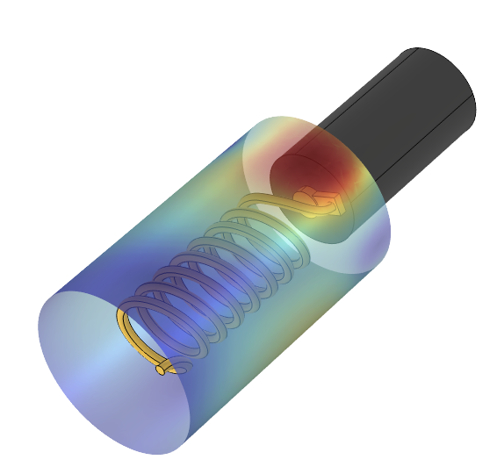
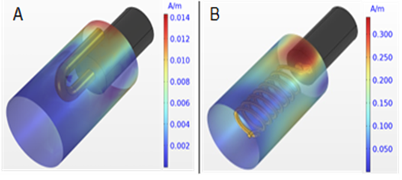
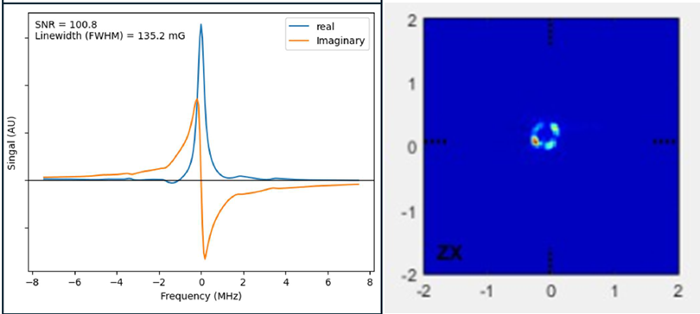

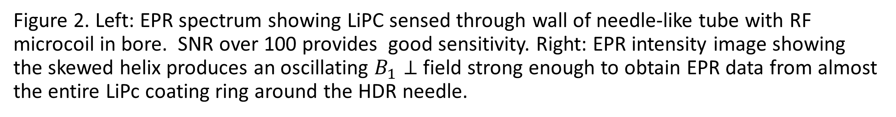

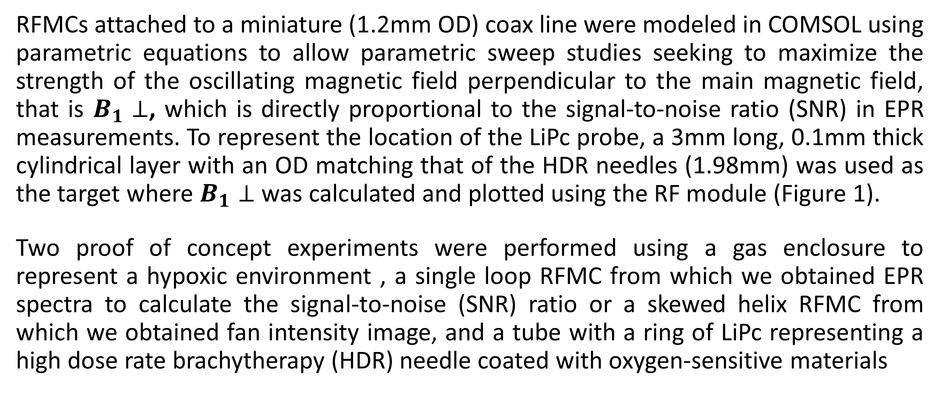
Development of Radiofrequency Microcoils Towards Oxygen Guided Radiation Treatment
Hypoxia has widely been recognized to be a primary cause of poor clinical outcomes. However, the lack of a device to measure tumor oxygen in clinical conditions poses a barrier to incorporation of tumor oxygen information into treatment planning.
${\text{D}\text{. }\text{Olivera} \text{Velarde}}^{1}$, ${\text{S}\text{. }\text{Sundramoorthy}}^{1},{ \text{B}\text{. }\text{Epel}}^{1}, { \text{E}\text{. }\text{Pearson}\text{1}}^{1}, {\text{H}\text{. }\text{Halpern}}^{1}, {\text{B}\text{. }\text{Aydogan}}^{1}$
$$1_{\text{The} \text{University} \text{of} \text{Chicago}}$$
Introduction & Goals
It has been established that nearly all solid tumors develop hypoxic or oxygen-deficient volumes (pO2 < 10mmHg) and that the presence of hypoxic volumes significantly correlate with increased radiation resistance, treatment failure, and metastasis. In fact, hypoxic cancer cells require three times the amount of radiation needed to kill normoxic cancer cells. Pre-clinical experiments where the dose of radiation therapy was adjusted based on the local tissue oxygen levels obtained via electron paramagnetic resonance (EPR) imaging demonstrated the critical role of hypoxia in treatment outcomes (Refs 1, 2). However, there is no clinical method or device capable of measuring tissue oxygen levels in real-time under clinical conditions. We present the development of four EPR radio frequency micro coils (RFMC) designed for clinical use to enable personalization of radiation treatments based on the oxygen levels at different locations inside tumor tissues. The purpose of the RFMCs is to provide an oscillating magnetic field (B1) to the oxygen sensitive spin probe composed of lithium phthalocyanine (LiPc) and medical grade silicone to excite the free electrons in the probe.
Methodology
RFMCs attached to a miniature (1.2mm OD) coax line were modeled in COMSOL using parametric equations to allow parametric sweep studies seeking to maximize the strength of the oscillating magnetic field perpendicular to the main magnetic field, that is $B_{1}⊥$, which is directly proportional to the signal-to-noise ratio (SNR) in EPR measurements. To represent the location of the LiPc probe, a 3mm long, 0.1mm thick cylindrical layer with an OD matching that of the HDR needles (1.98mm) was used as the target where $B_{1}⊥$ was calculated and plotted using the RF module (Figure 1).
Two proof of concept experiments were performed using a gas enclosure to represent a hypoxic environment , a single loop RFMC from which we obtained EPR spectra to calculate the signal-to-noise (SNR) ratio or a skewed helix RFMC from which we obtained fan intensity image, and a tube with a ring of LiPc representing a high dose rate brachytherapy (HDR) needle coated with oxygen-sensitive materials
Figure 1. 𝐵1⊥ field distributions on a surface cylinder representing the paramagnetic oxygen sensitive probe. The single loop RFMC design is shown in A and the skewed helical micro coil in B. Higher flux will provide increased sensitivity.
Results
The simulation results showed that the skewed helix produced the strongest oscillating 𝐵1⊥ field and its active volume had the greatest coverage of the LiPc probe.
The proof-of-concept measurement with the single turn loop RFMC, which produced a significantly smaller oscillating 𝐵1⊥ field in simulations was able to obtain EPR measurements with adequate SNR > 100 with under 5 seconds of data collection per measurement point (Figure 2 left).
The experiment with the skewed helix RFMC, which produced the largest 𝐵1⊥ field in simulations, successfully allowed EPR imaging of our LiPc ring in a hypoxic environment. The variation in the intensity image can be explained due to a combination of the variation in 𝐵1⊥ field intensity as shown in the simulations and variation of the spin density in the LiPc ring which was applied by hand (Figure 2 right).
Figure 2. Left: EPR spectrum showing LiPC sensed through wall of needle-like tube with RF microcoil in bore. SNR over 100 provides good sensitivity. Right: EPR intensity image showing the skewed helix produces an oscillating $B_{1}⊥$ field strong enough to obtain EPR data from almost the entire LiPc coating ring around the HDR needle.
Epel B, Maggio MC, Barth ED, Miller RC, Pelizzari CA, Krzykawska-Serda M, Sundramoorthy S V., Aydogan B, Weichselbaum RR, Tormyshev VM, Halpern HJ. Oxygen-Guided Radiation Therapy. Int J Radiat Oncol Biol. Phys. Elsevier Inc.; 2019 Mar 15;103(4):977–984.
Gertsenshteyn I, Epel B, Giurcanu M, Barth E, Lukens J, Hall K, Martinez JF, Grana M, Maggio M, Miller RC, Sundramoorthy S V., Krzykawska-Serda M, Pearson E, Aydogan B, Weichselbaum RR, Tormyshev VM, Kotecha M, Halpern H. Absolute Oxygen-Guided Radiation Therapy Improves Tumor Control in Three Preclinical Tumor Models. Front Med Sec Nucl Med. 2023;10.

